Slide 1
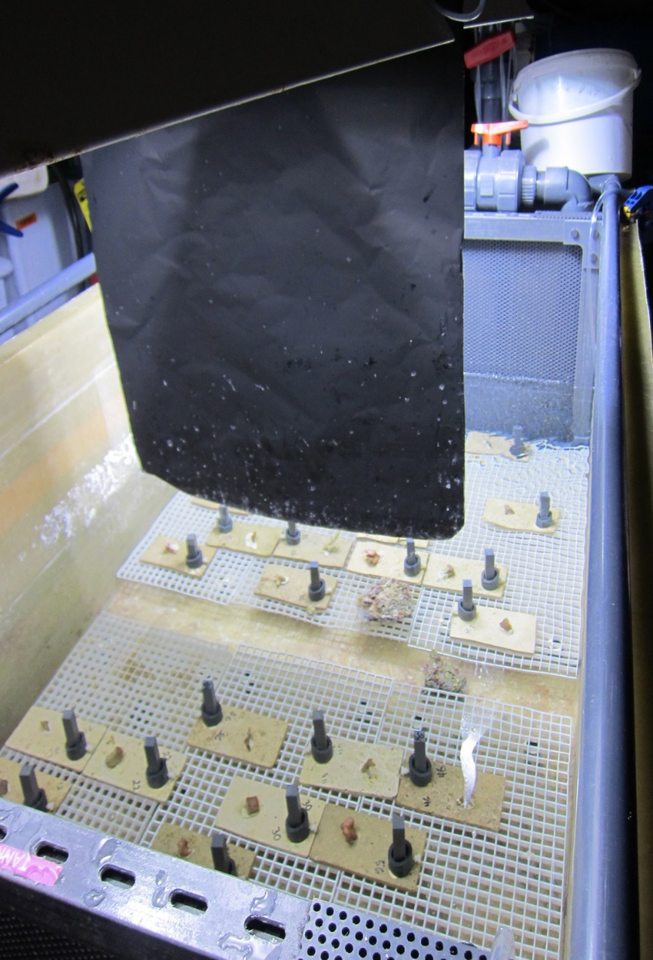
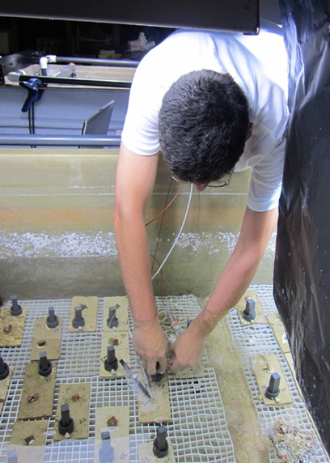
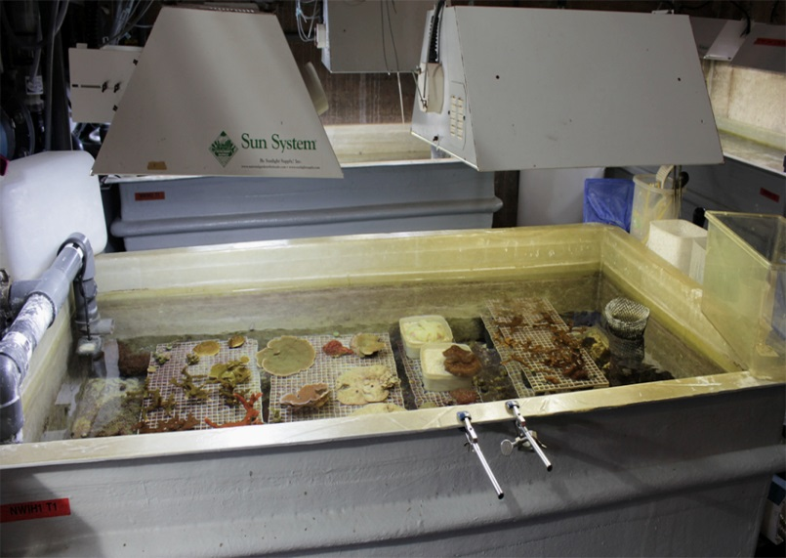
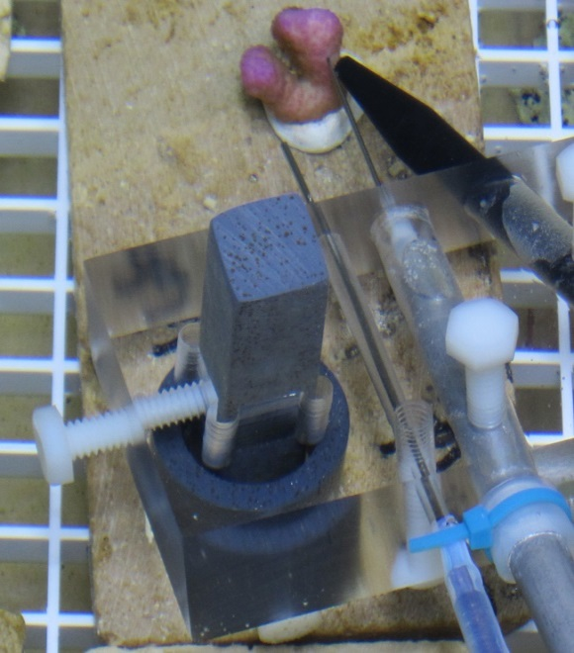
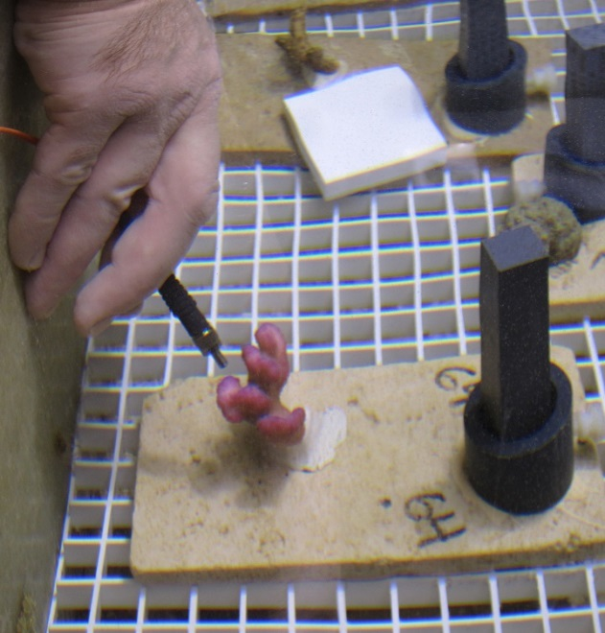
Figure S6
a.
b.
d.
d.
c.
e.
Notes:
FINAL!
Figure S6. Experimental set-up
Replace last image with emailed image, label a-f, and polish. – DONE
Reinsert all photos from the originals (sent to you by email from Luisa) at highest resolution possible – DONE
Replace panel d with the image (1st change light & hue; not green, but white) in slide 2 – DONE
Crop & resize panel e (in photoshop) to the same as c – DONE

