Slide 1
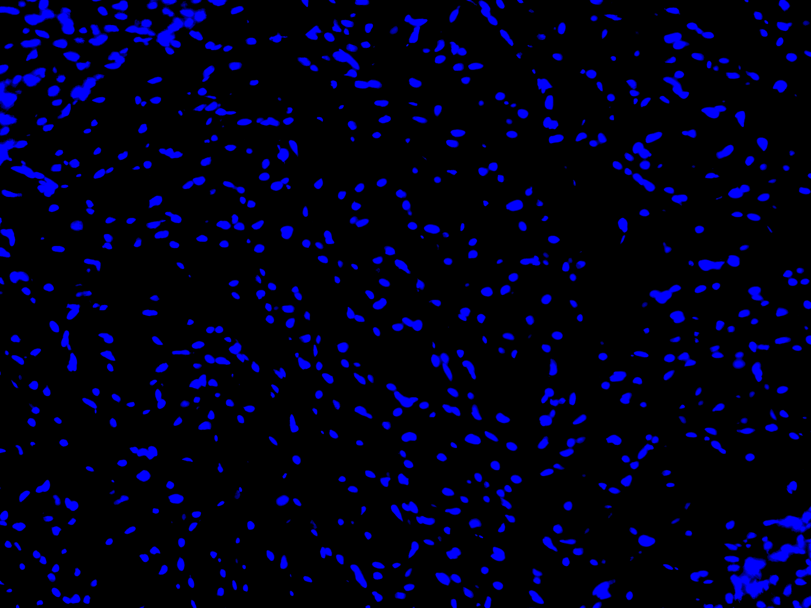
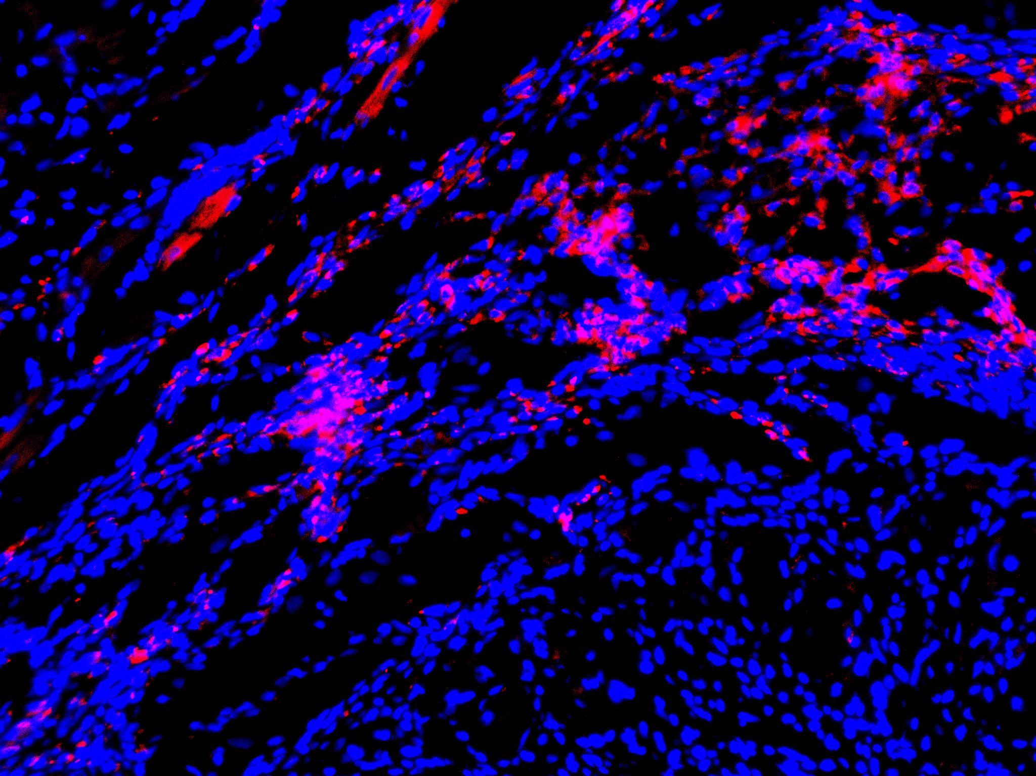
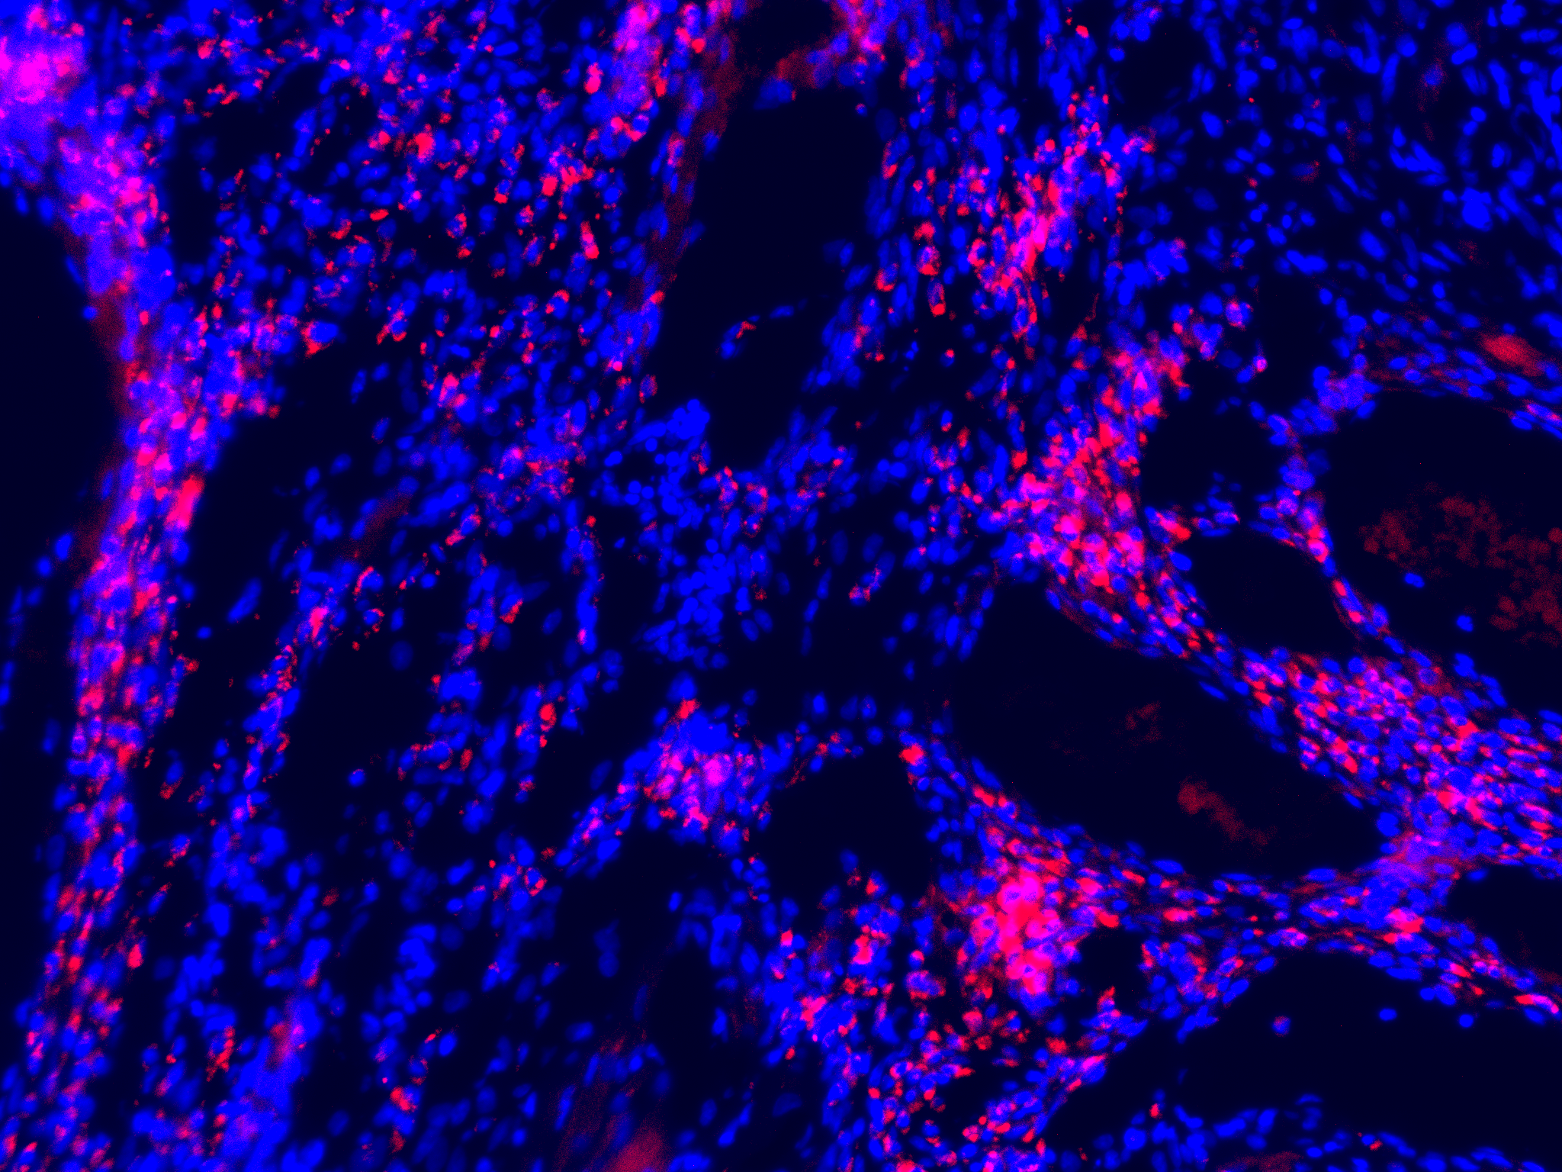
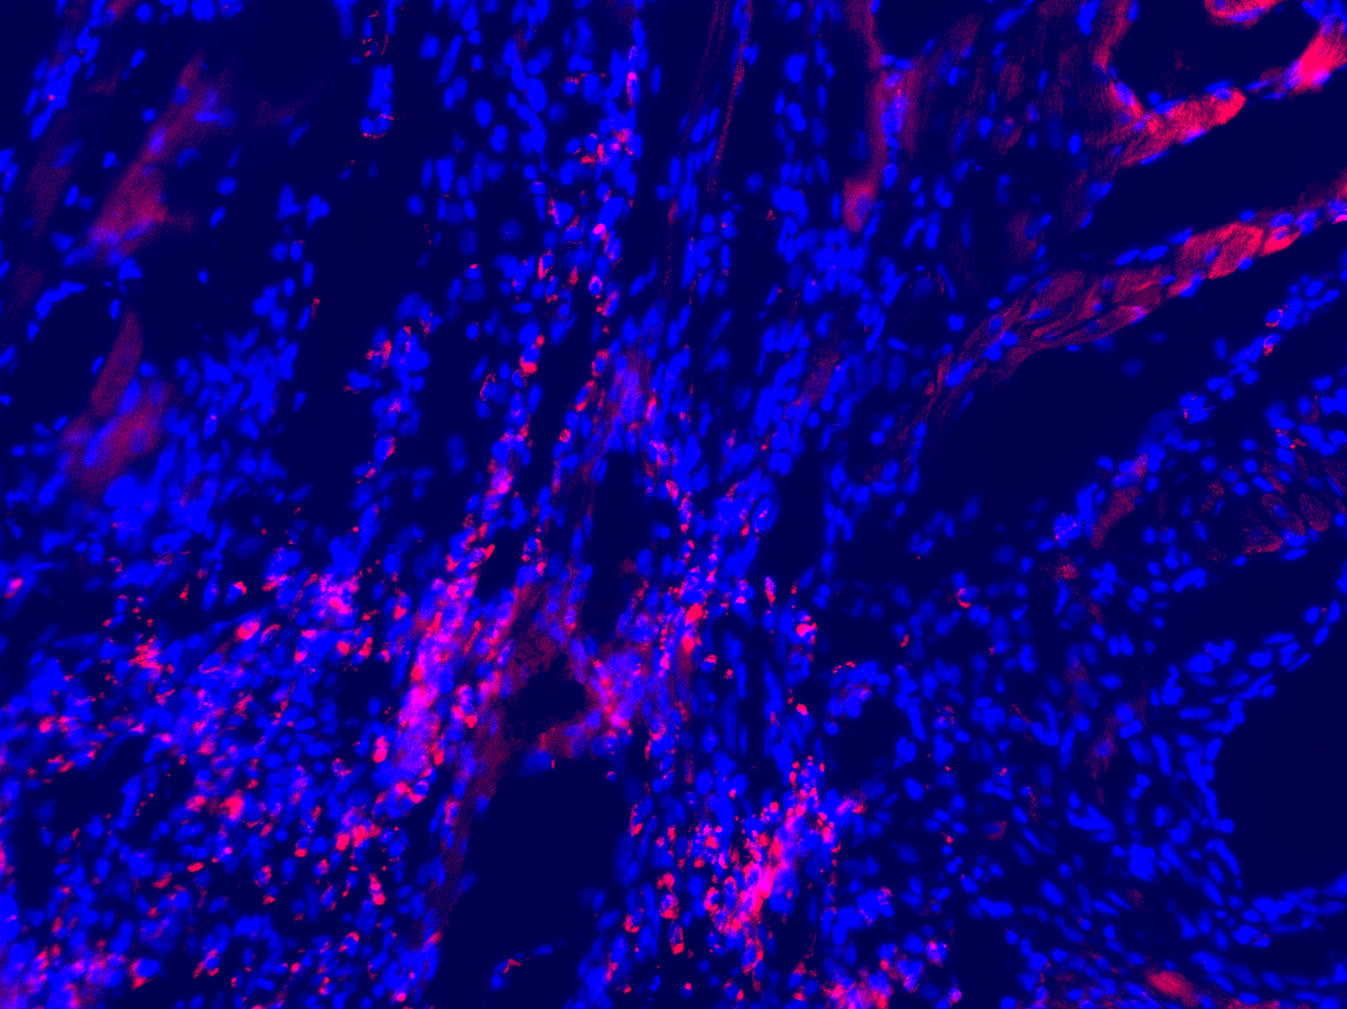
Fig. S1.
CNT
99.6
34.6
CD4
CD4, 19.4
CD48
CD48
RCPs
FSC-A
CD4
GDF15
86.4
RCP-GDF15KD
33.5
CD48
CD48
GDF15
GDF15
Fig. S2.
Sham.
Sham
Plac.
rCPCs
Allo
rCPCs-Allo
GDF15KD
GDF15/ DAPI

