Slide 1
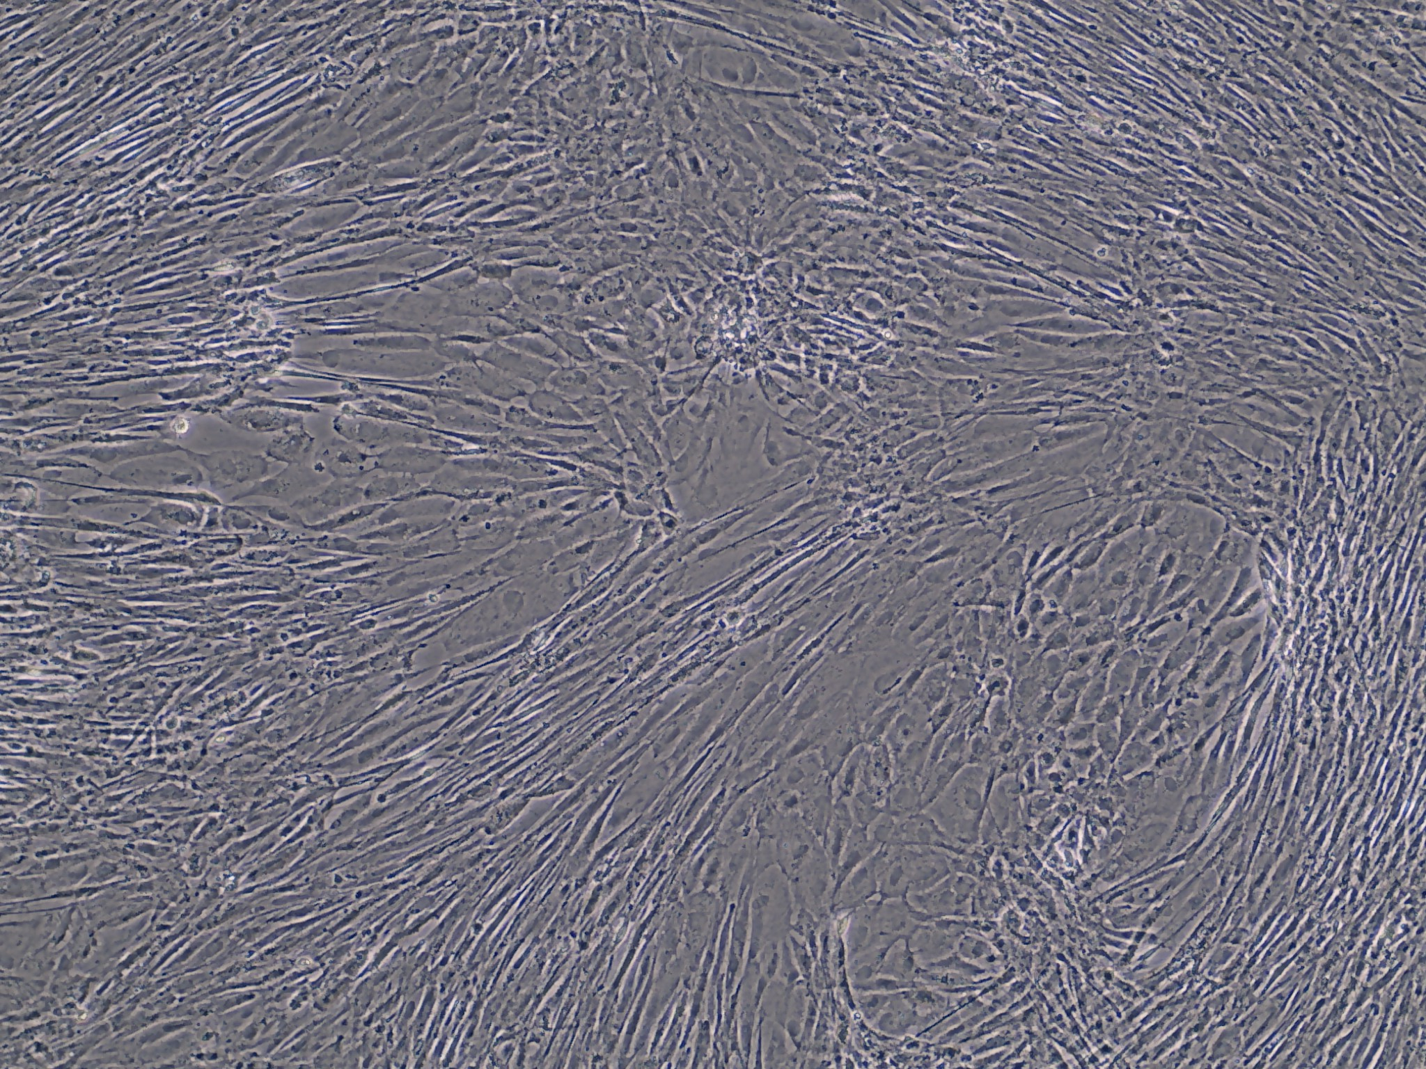
A
SHK-1 + P. sal + DFO
4 DPI

Slide 2
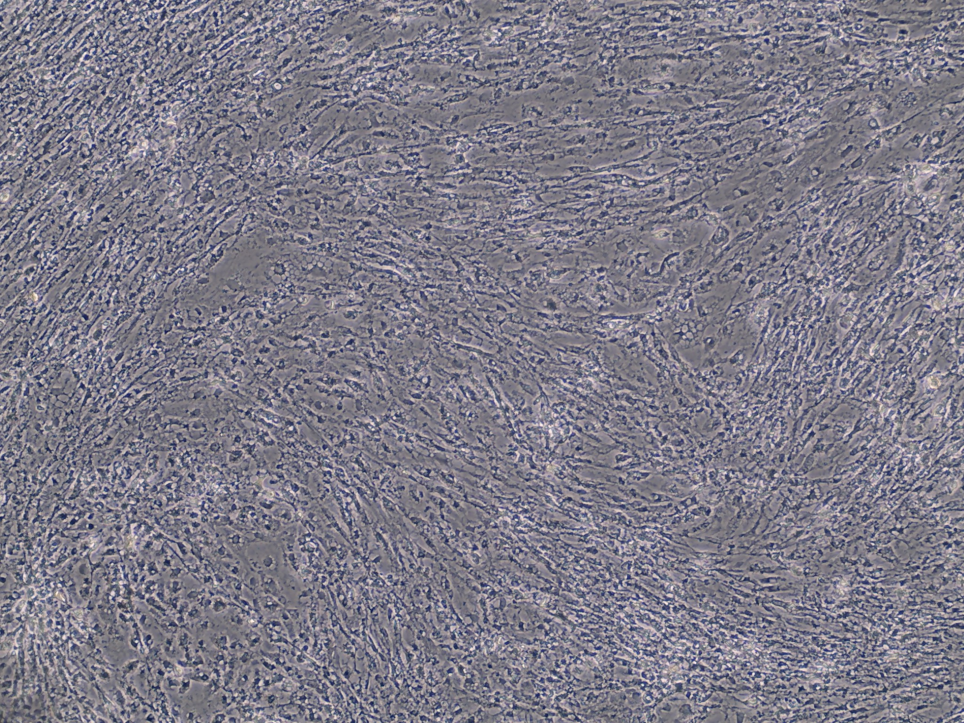
B
SHK-1 + P. sal + DFO
7 DPI

Slide 3
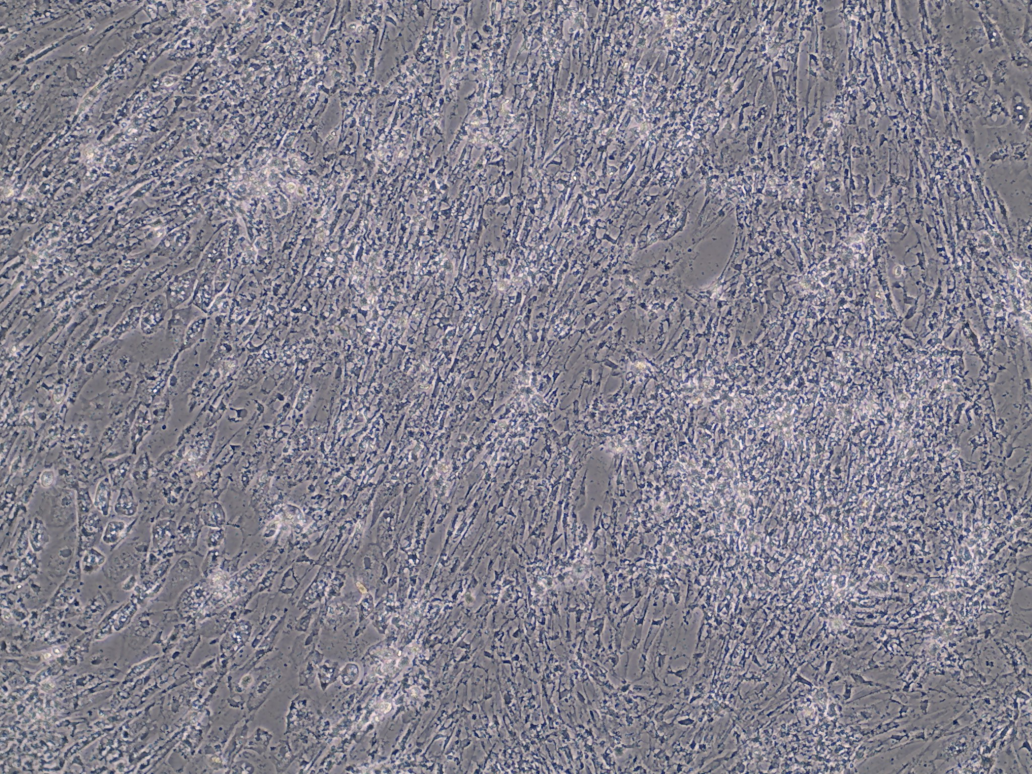
C
SHK-1 + P. sal + DFO
11 DPI

Slide 4
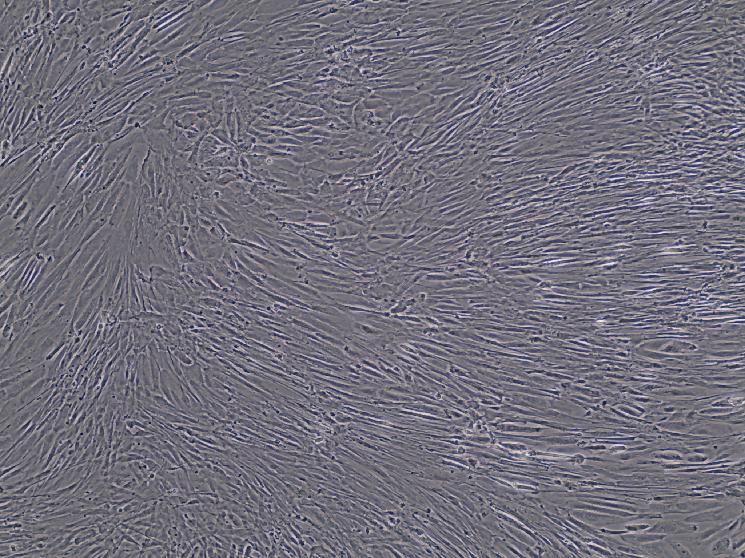
D
SHK-1 + DFO
4 DPI

Slide 5
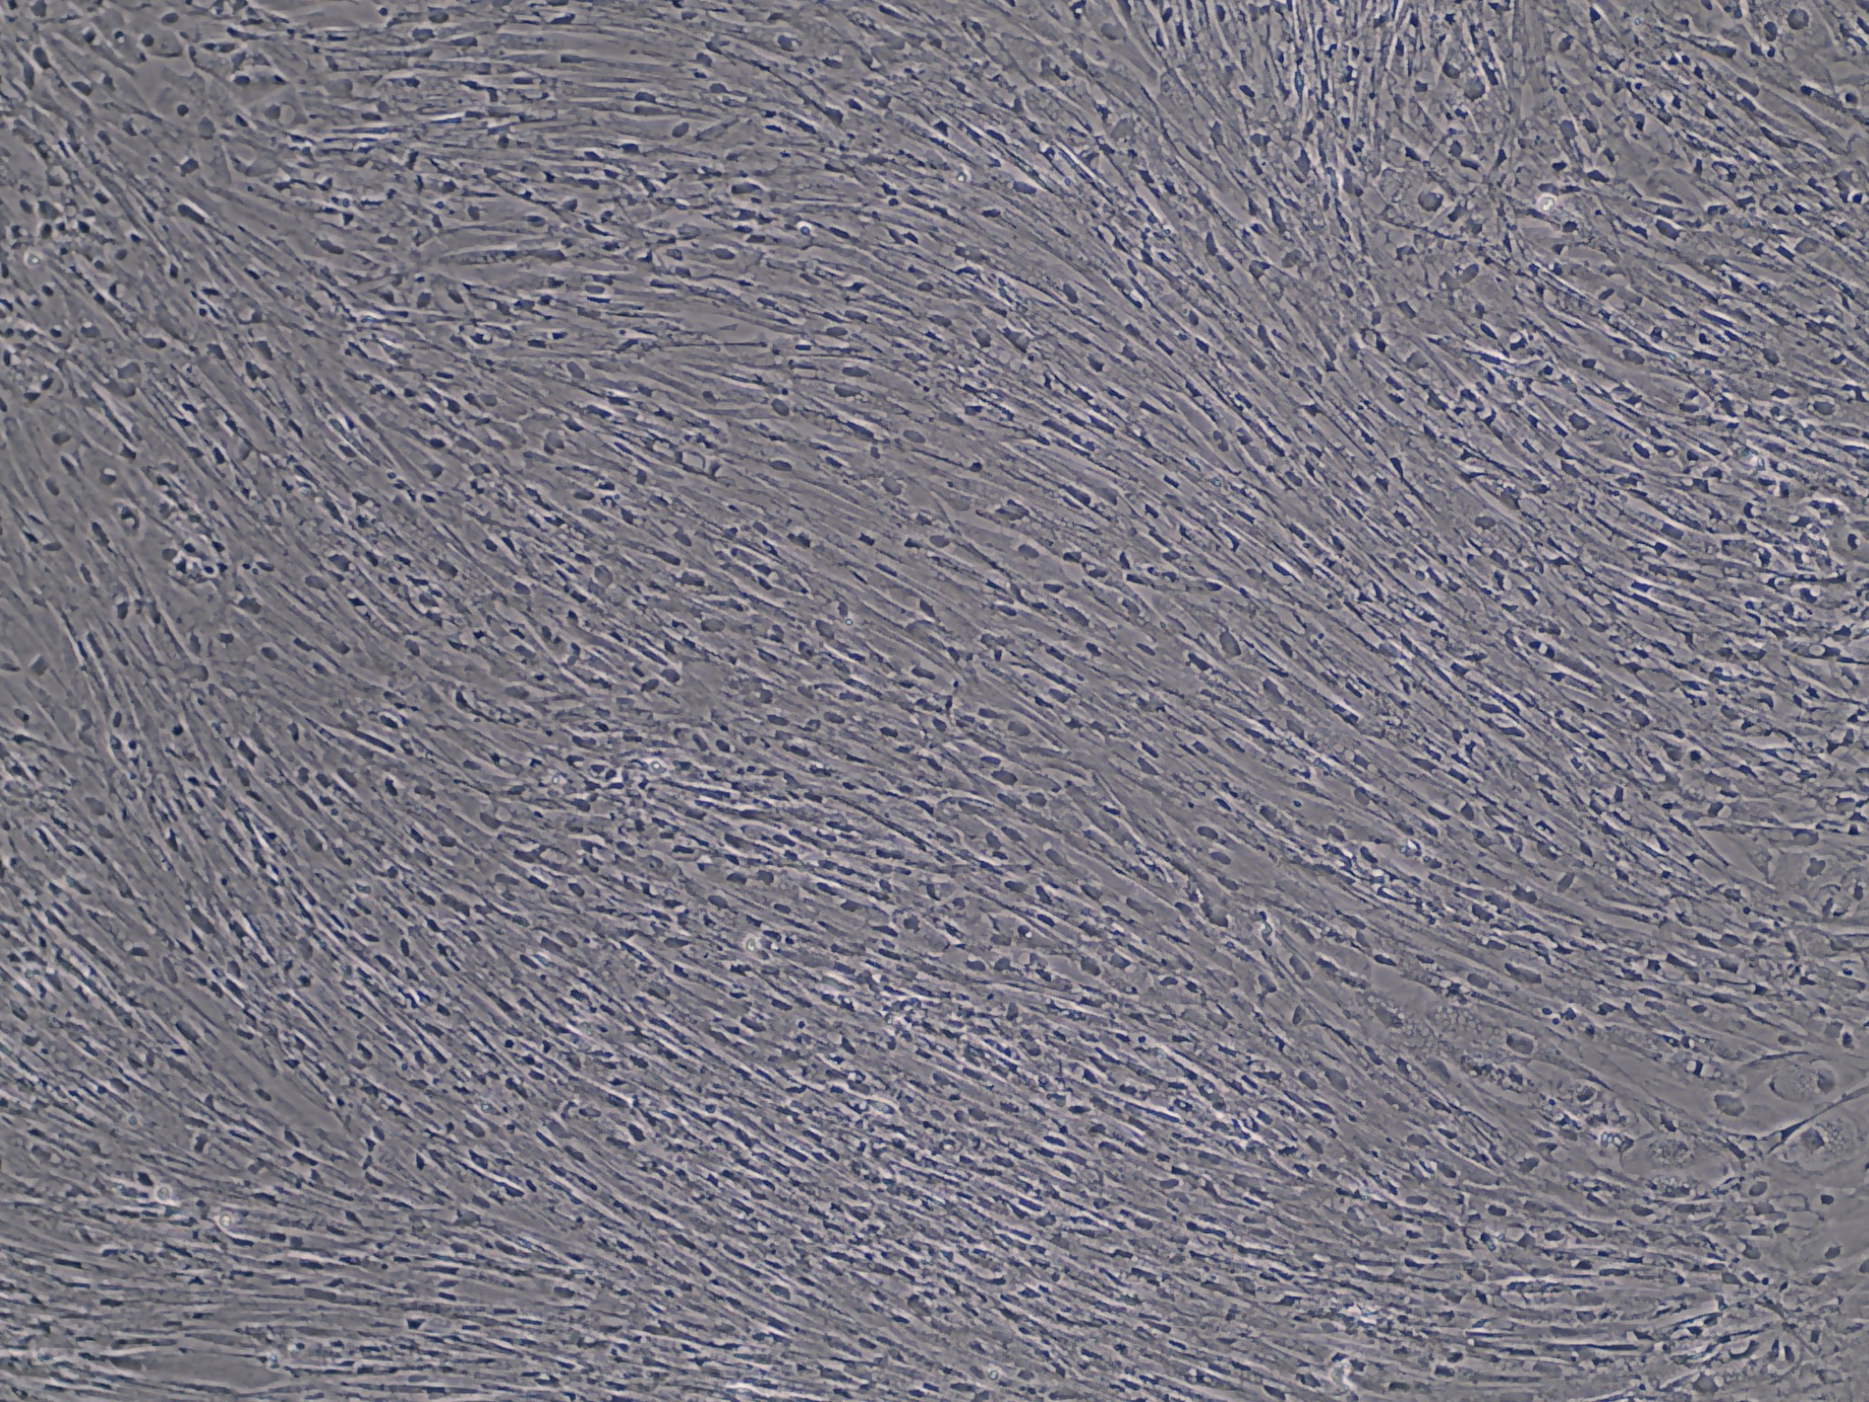
E
SHK-1 + DFO
7 DPI

Slide 6
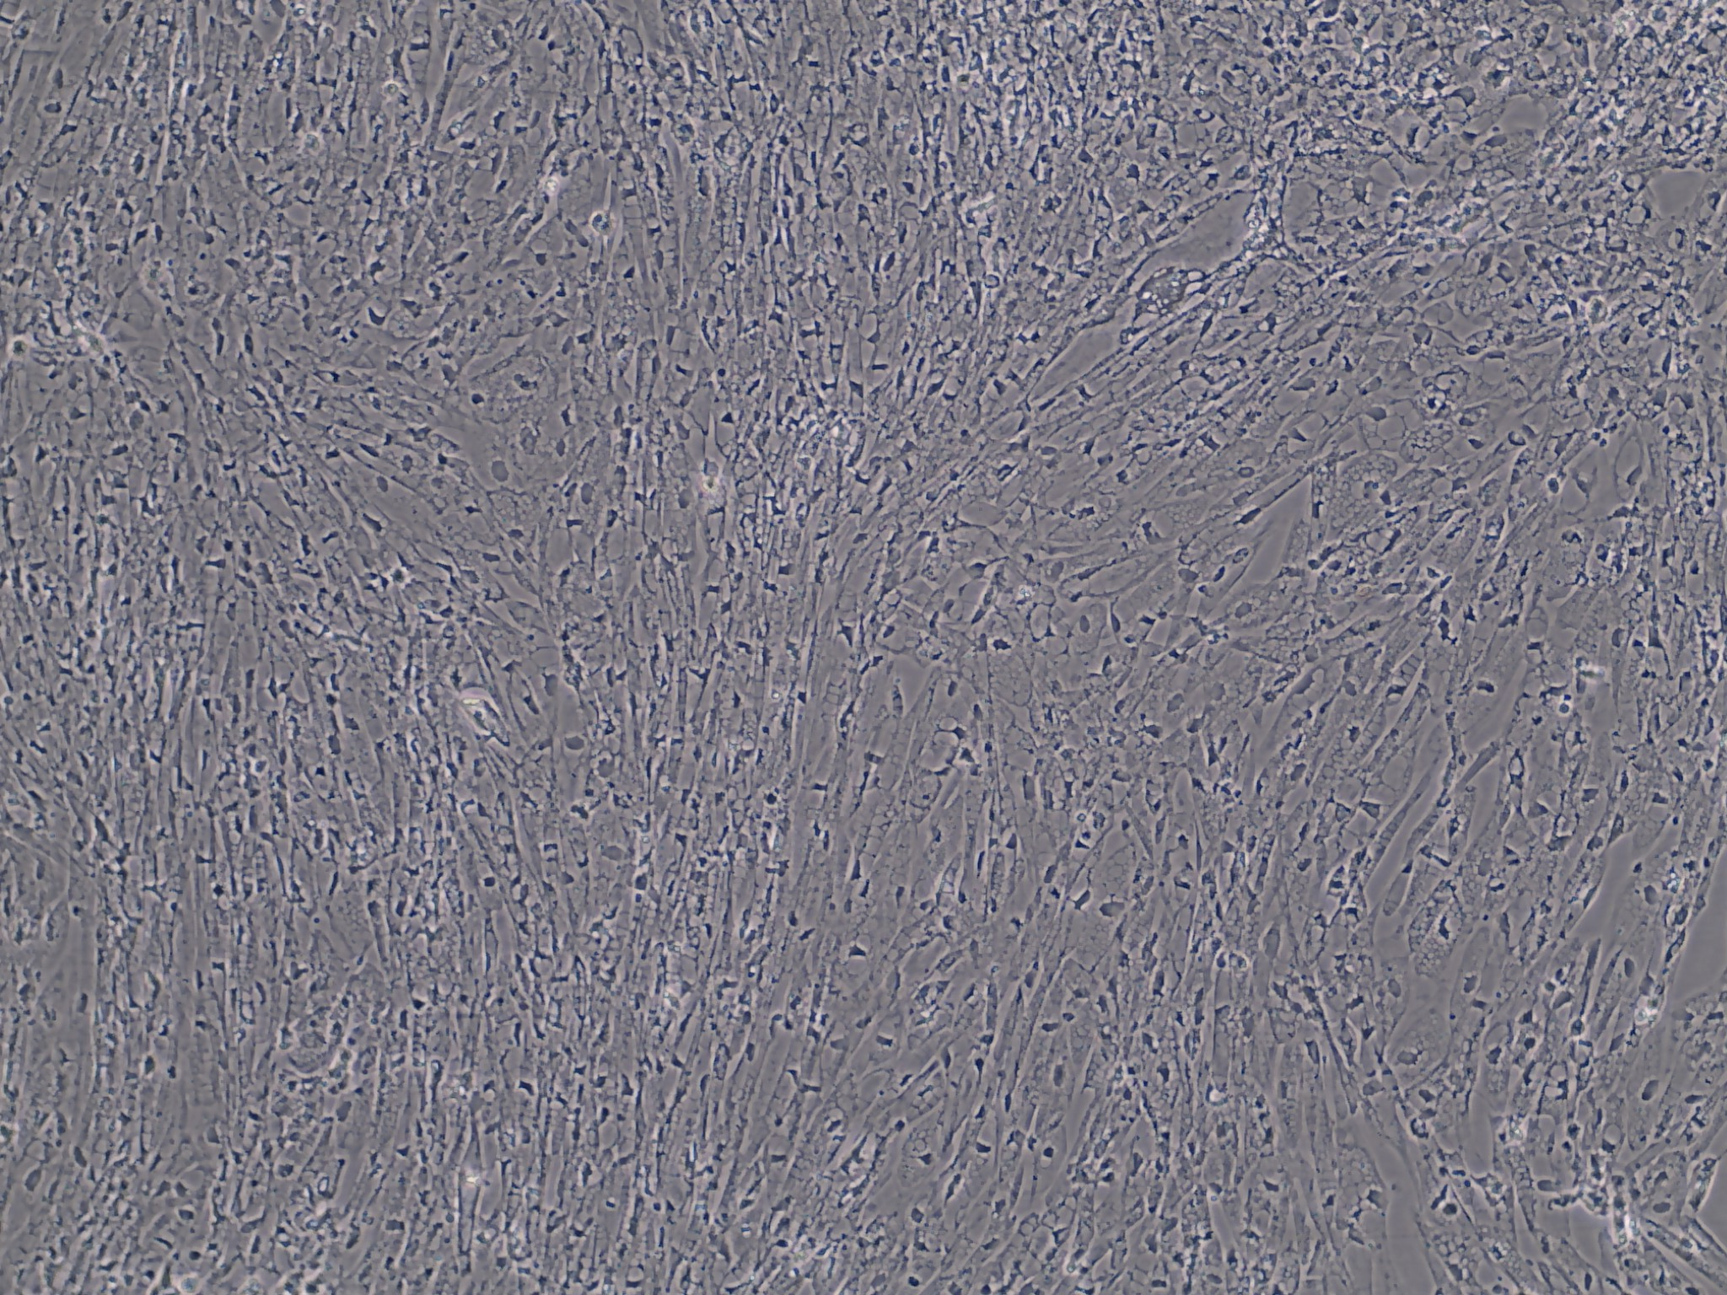
F
SHK-1 + DFO
11 DPI

Slide 7
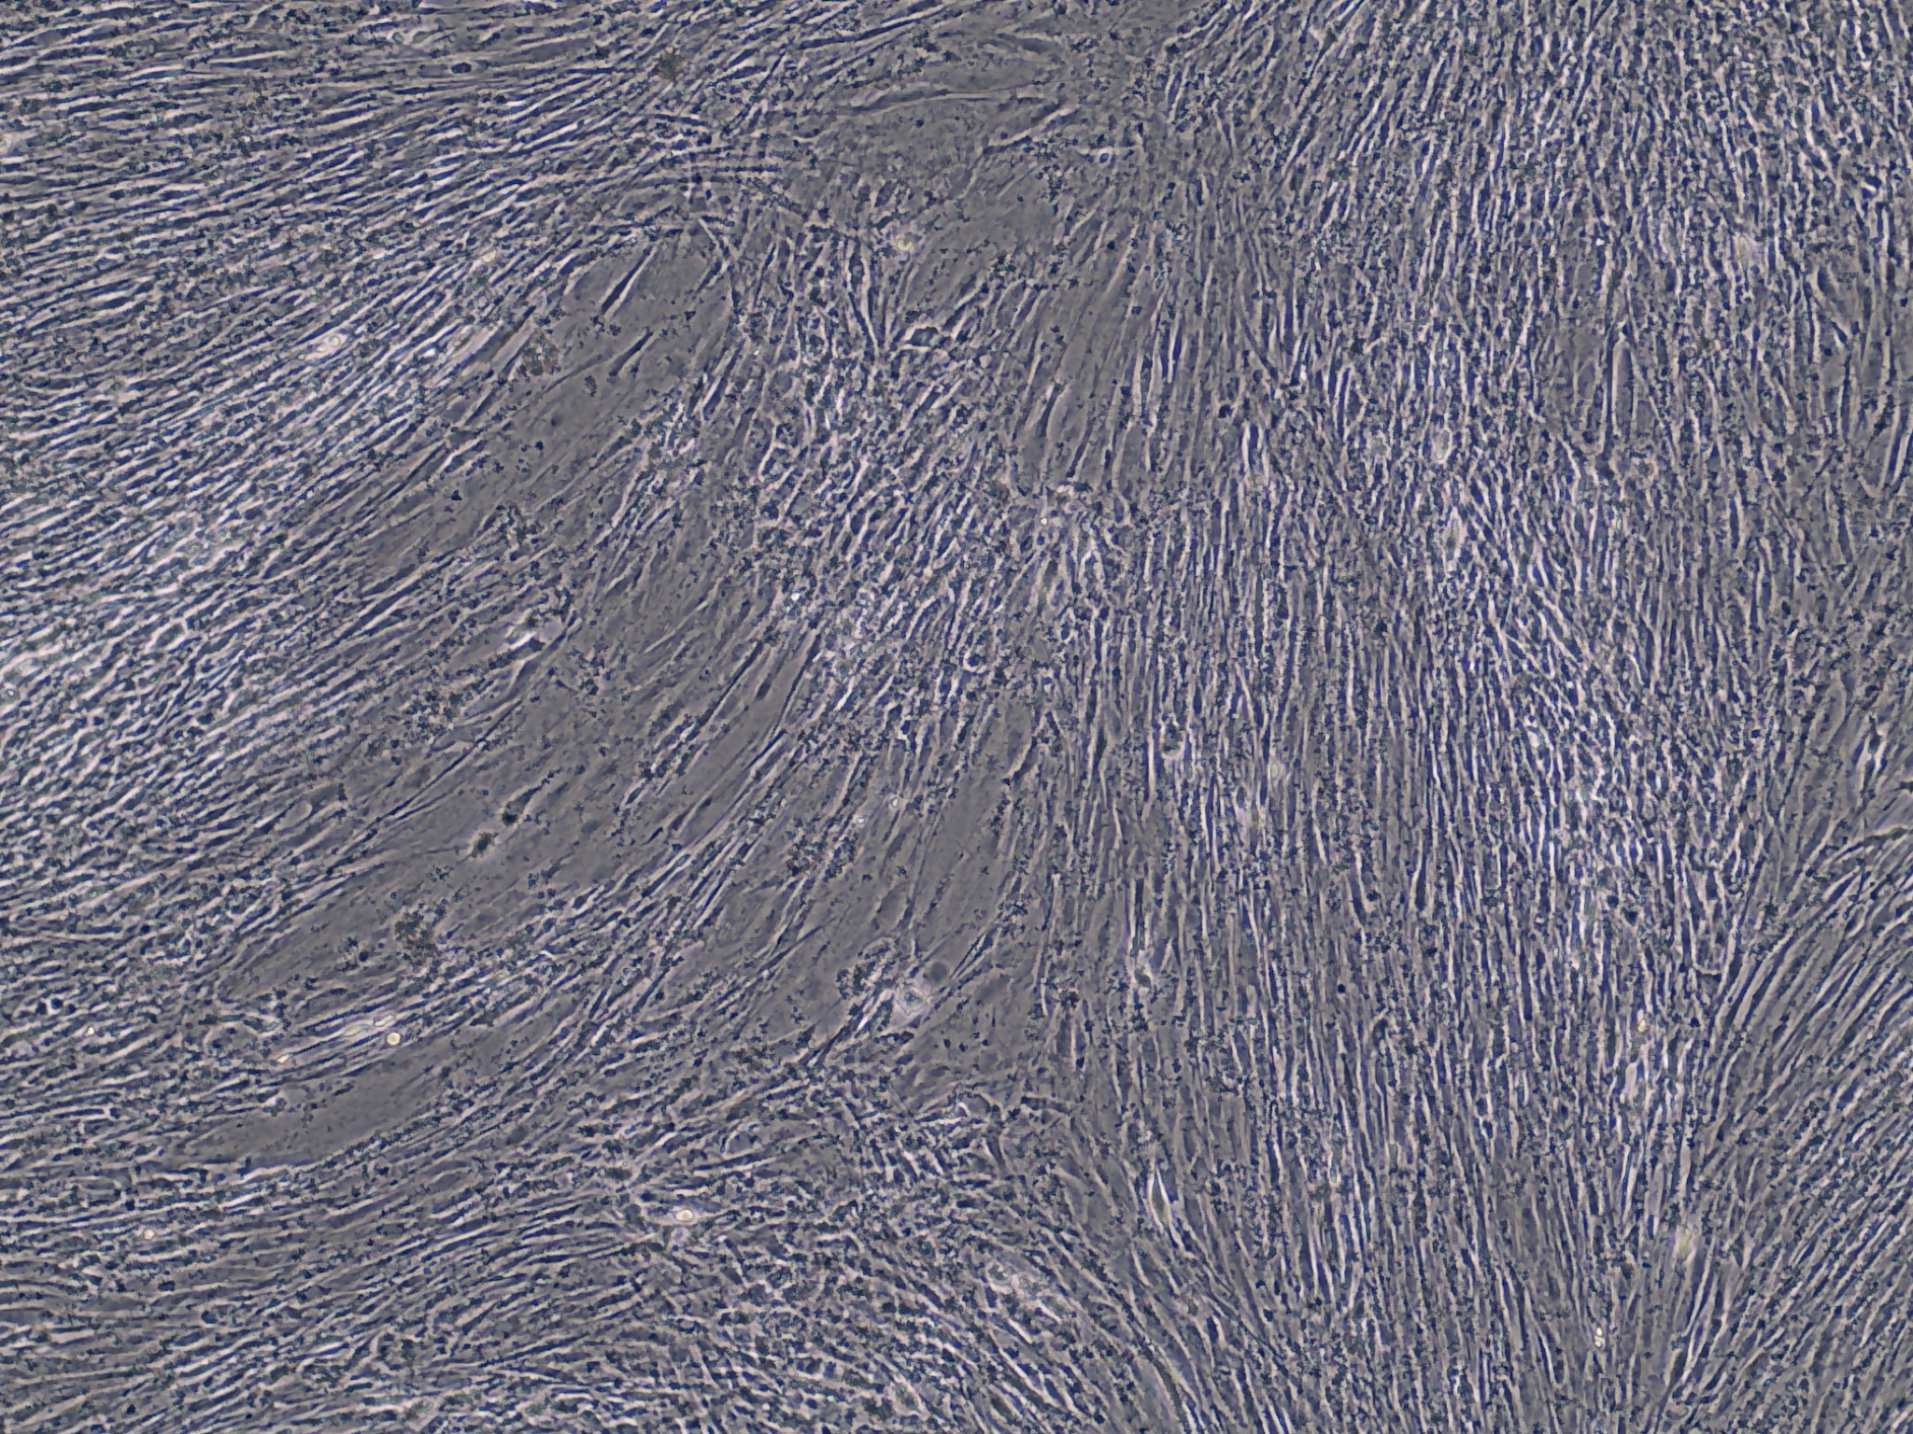
G
SHK-1 + P. sal
4 DPI

Slide 8
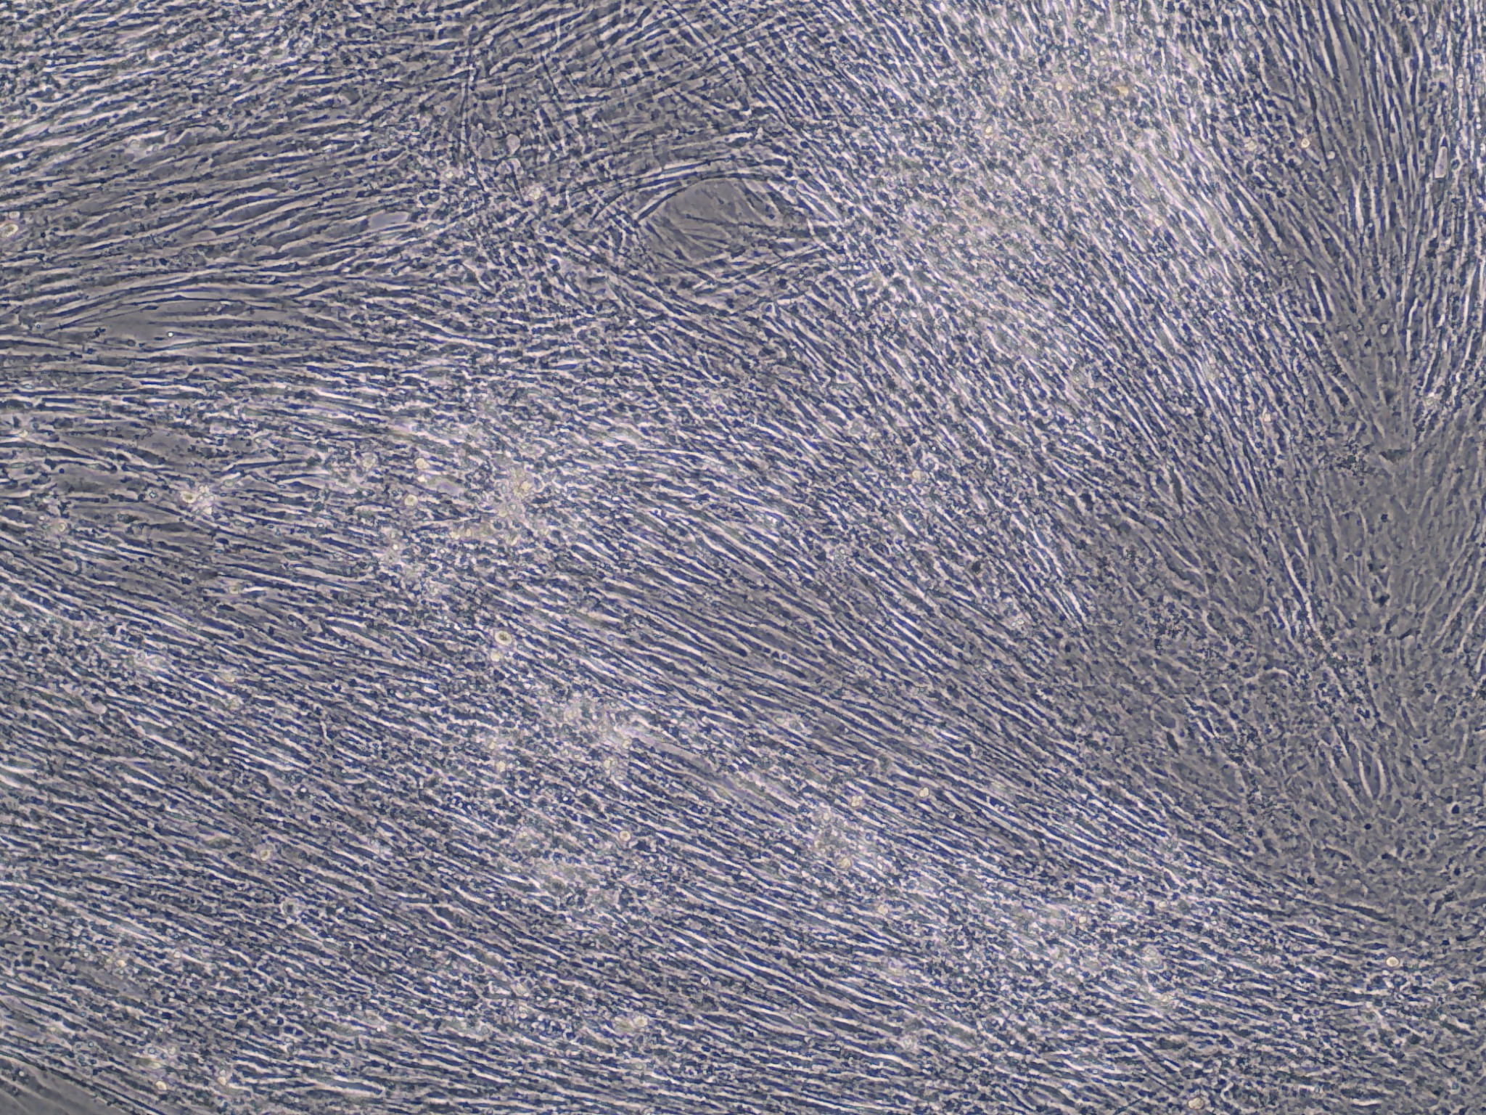
H
SHK-1 + P. sal
7 DPI

Slide 9
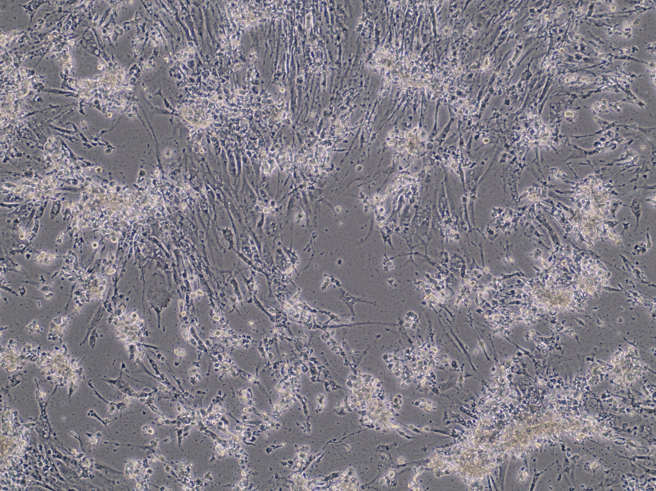
I
SHK-1 + P. sal
11 DPI

Slide 10
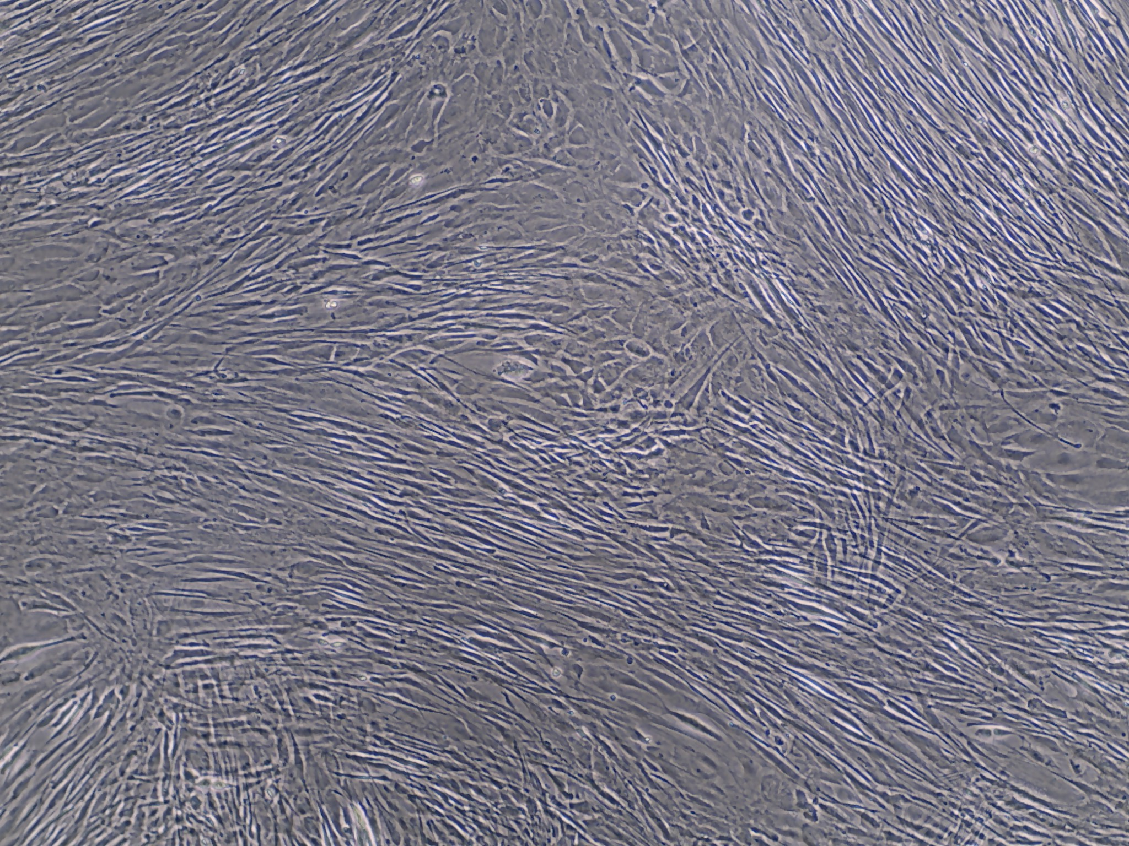
J
SHK-1
4 DPI

Slide 11
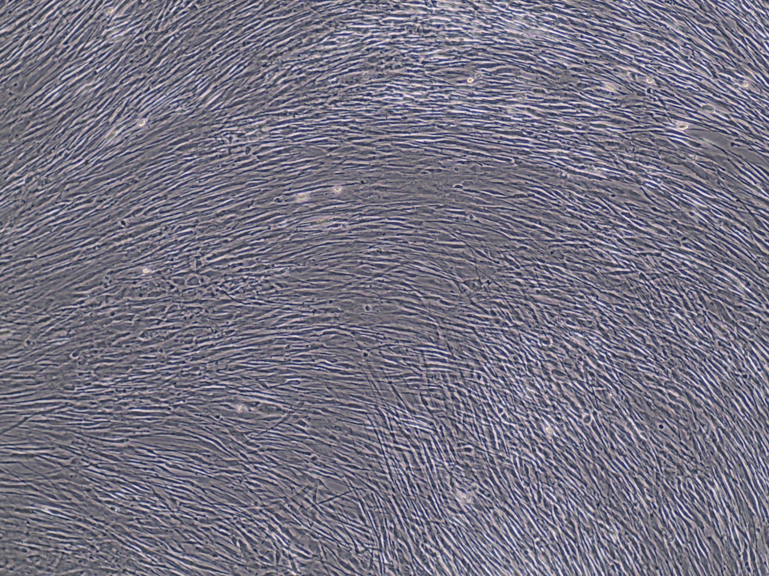
K
SHK-1
7 DPI

Slide 12
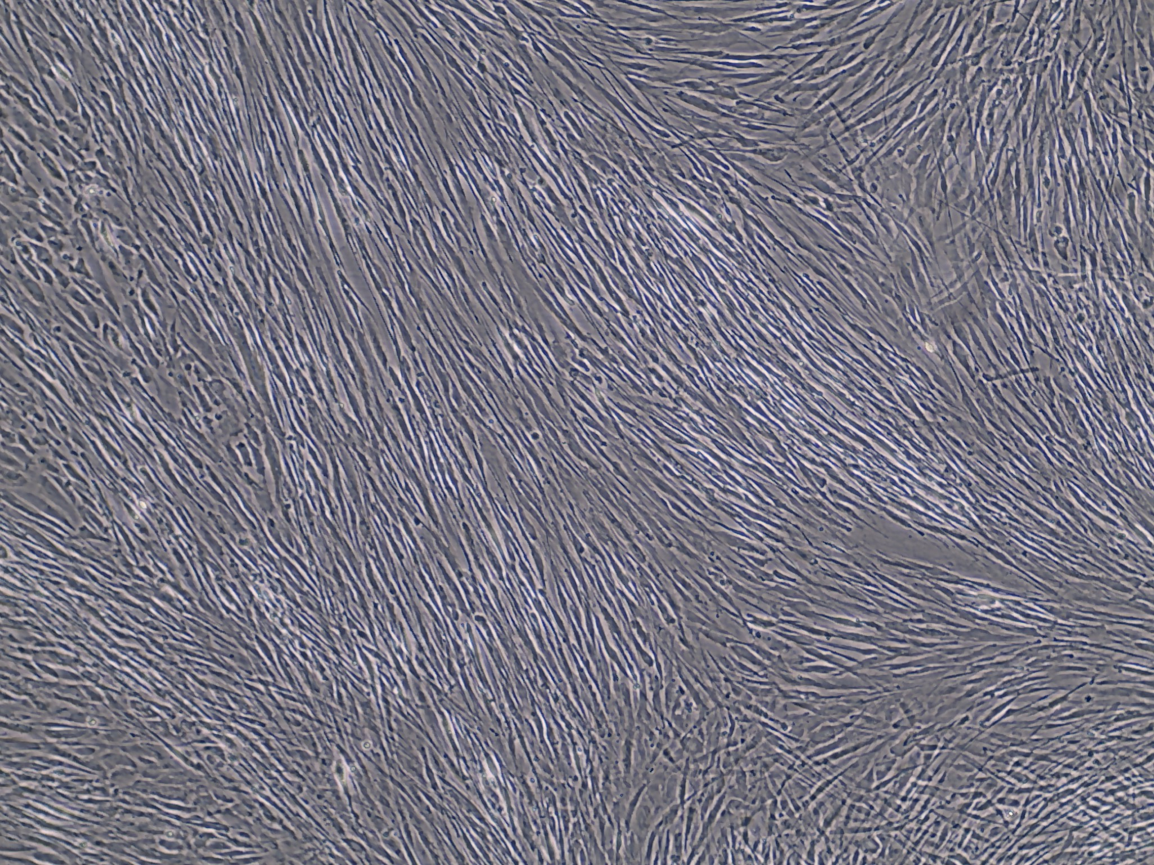
M
SHK-1
11 DPI

Slide 13
Supplementary file 1 A-M
The evaluation of cytopathic effects in SHK-1 cells infected with P. salmonis Separate cell culture images under four experimental conditions at days 4, 7 and 11 (dpi): non-infected SHK-1 not treated with DFO (SHK-1), non-infected SHK-1 cells treated with DFO (SHK-1 + DFO), infected SHK-1 cells not treated with DFO (SHK-1 + P. sal) and SHK-1 cells infected with P. salmonis and treated with DFO (SHK-1 + P. sal + DFO). Images were taken with the EVOS® FL Color Imaging System (Invitrogen, Thermo Fisher Scientific Inc, Carlsbad, CA, USA) using 10X objective after 3 PBS-1X washes. The scale bar was added by using the image analysis ImageJ 1.37 software (National Institutes of Health, Bethesda, MD, USA). Scale bar = 260 µM.

