Slide 1
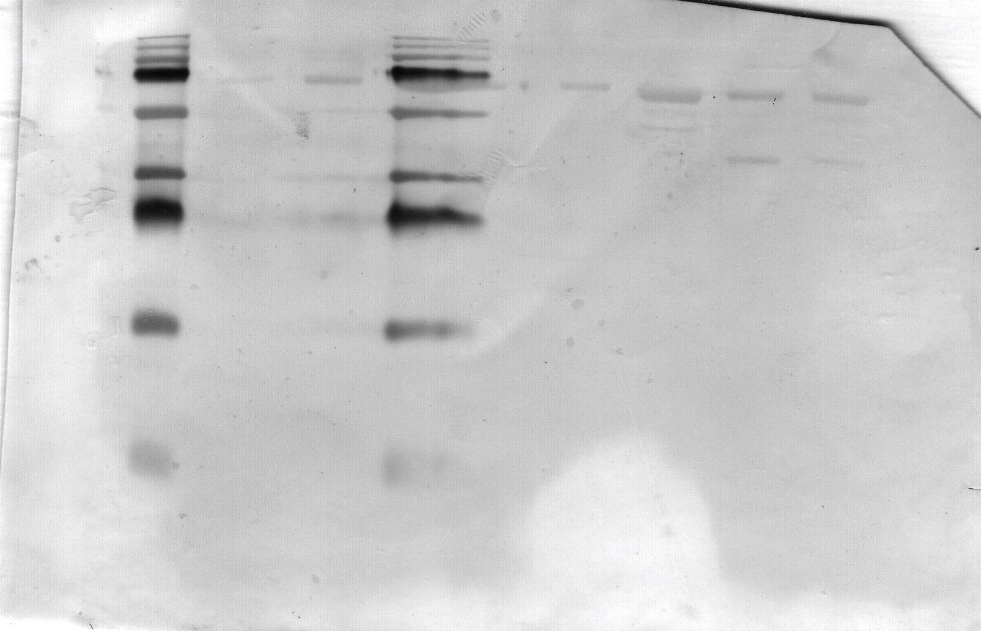
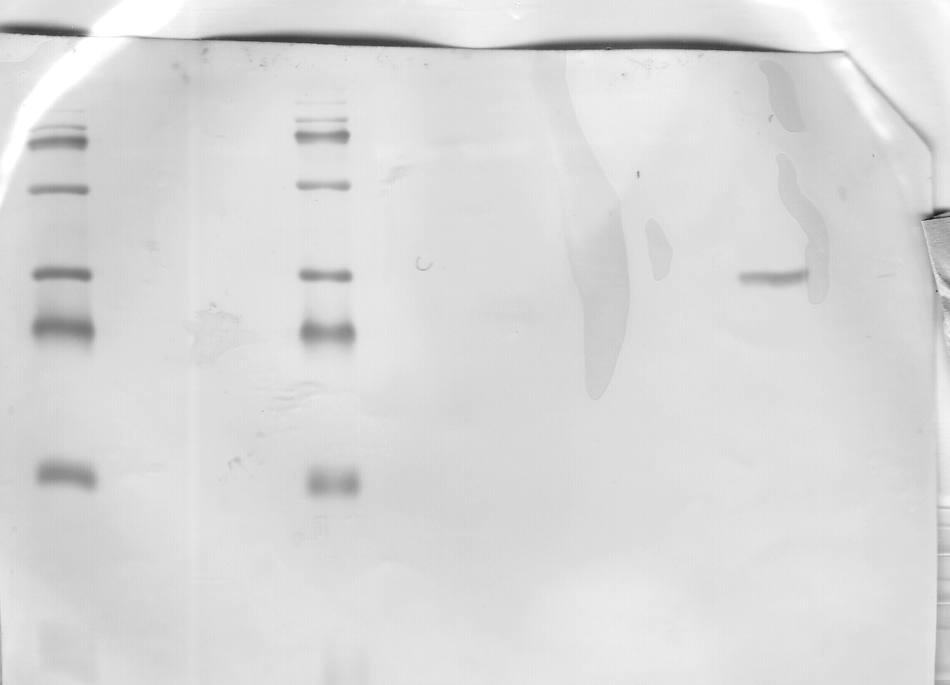
Supplemental S1 Denaturing Western blot of TDP-43-detecting antibodies
A) Commercial polyclonal anti-TDP-43
B) FTD-TDP2 scFv
1 2 3 4 5 6 7 8
1 2 3 4 5 6 7 8 9
Lanes 1, 4 – Marker
Lanes 2, 3 - TDP-43 immunoprecipitated from FTD
Lanes 5, 6 – Healthy control tissue
Lanes 7, 8 – TDP-43 immunoprecipitated from healthy controls
Lanes 1, 4 – Marker
Lanes 2, 3 - TDP-43 immunoprecipitated from FTD
Lanes 5, 6 – Healthy control tissue
Lanes 7, 8 – TDP-43 immunoprecipitated from healthy controls
Lane 9 – Control 30kDa scFv

Slide 2
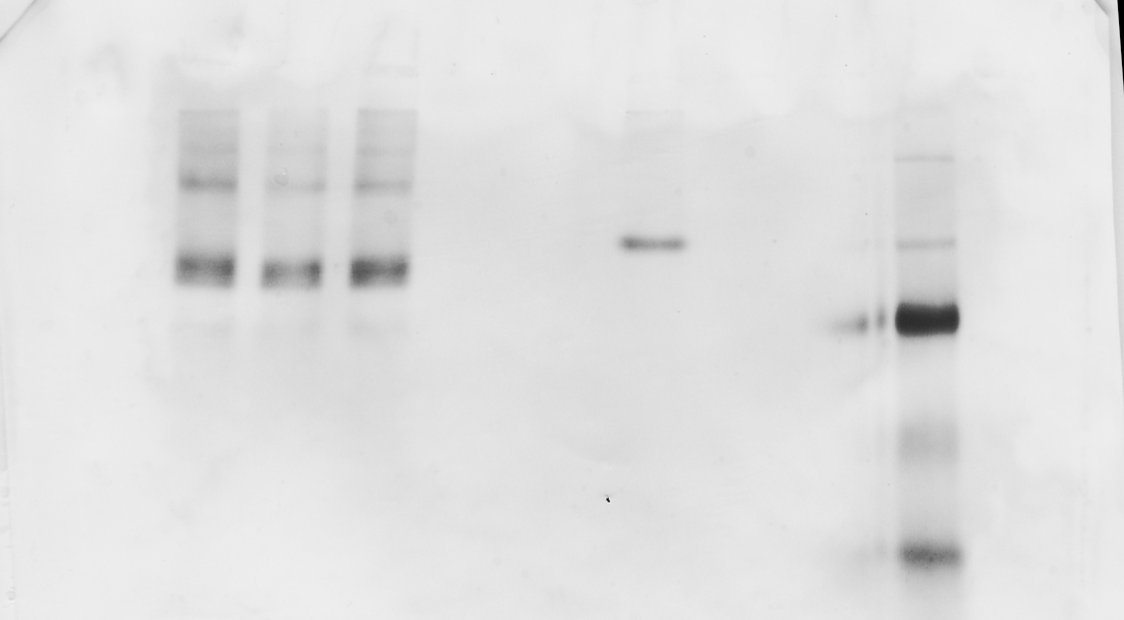
Supplemental S2 source for Figure 4
A) Commercial polyclonal anti-TDP-43
B) FTD-TDP2 scFv
1 2 3 4 5 6 7
1 2 3 4 5 6 7 8 9
Lanes 1, 2 - TDP-43 immunoprecipitated from FTD
Lanes 3 – Markers
Lanes 4, 5– Healthy control tissue
Lanes 6, 7 – TDP-43 immunoprecipitated from healthy controls
Lanes 1, 2, 3- TDP-43 immunoprecipitated from FTD
Lanes 4, 5– Healthy control tissue
Lanes 6 – control 30kDa scFv
Lanes 7, 8 – TDP-43 immunoprecipitated from healthy controls
Lanes 9 – Markers

