Slide 1
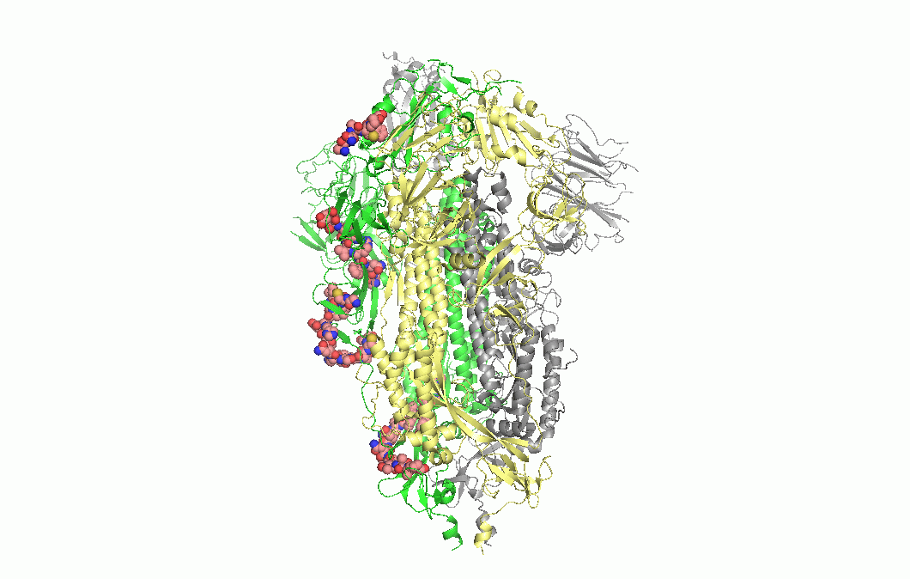
Linear B-cell epitopes were highlighted as sphere in prefusion structure of trimer spike protein.

