Slide 1
AMB Express
The single recombinant M. tuberculosis protein DPPD provides enhanced performance of skin testing among HIV-infected tuberculosis patients
Roberto Badaro^{1,2}, Bruna. A. S. Machado¹, Malcolm S Duthie^{3,4}, C.A. Araujo-Neto¹, D. Pedral-Sampaio¹, Maria Nakatani¹, and Steven G. Reed^{3,4}
From ¹SENAI Institute of Innovation (ISI) in Advanced Health Systems (CIMATEC ISI SAS), University Center SENAI/CIMATEC, National Service of Industrial Learning – SENAI, Bahia, Brazil; ²Department of Medicine, Federal University of Bahia, Brazil; ³Infectious Disease Research Institute, Seattle, Washington, USA and ⁴HDT Bio Corp, Seattle, Washington, USA
Address correspondence and reprint requests
HDT Bio Corp, 1616 Eastlake Ave E, Seattle, WA 98102
e-mail address: steven.reed@hdt.bio

Slide 2
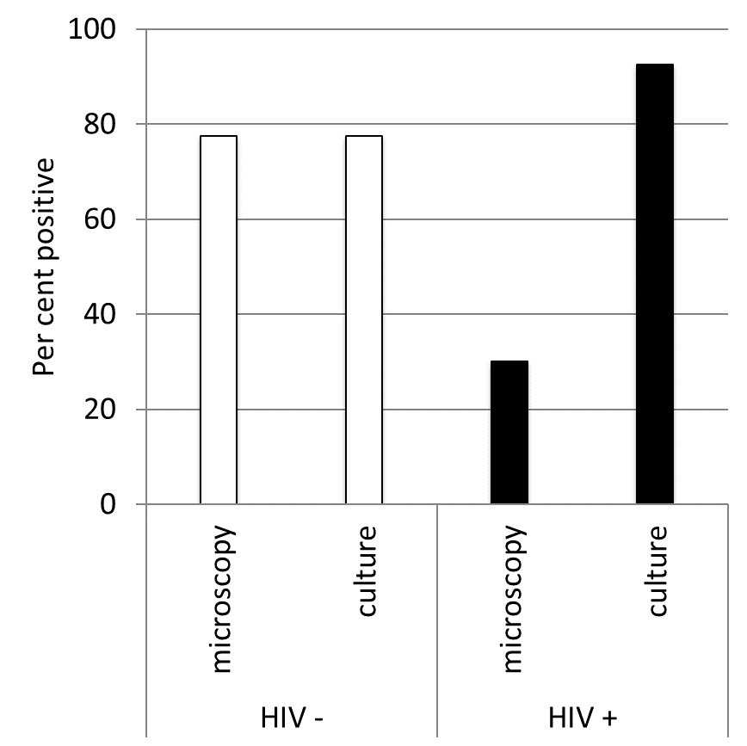
Badaro et al., Fig S1
Fig S1. Active TB was defined by clinical signs and symptoms of pulmonary disease consistent with active tuberculosis and a chest radiograph prior to treatment consistent with active pulmonary TB. Among such patients, a sputum sample was evaluated for the presence of M. tuberculosis by either Ziehl–Neelsen staining (microscopy) or outgrowth from culture in Lowenstein-Jensen medium (culture). Per cent positive among HIV-negative and HIV-positive TB patients is shown.

