Slide 1
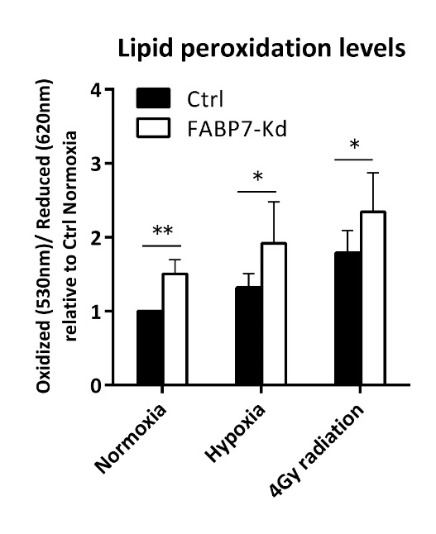
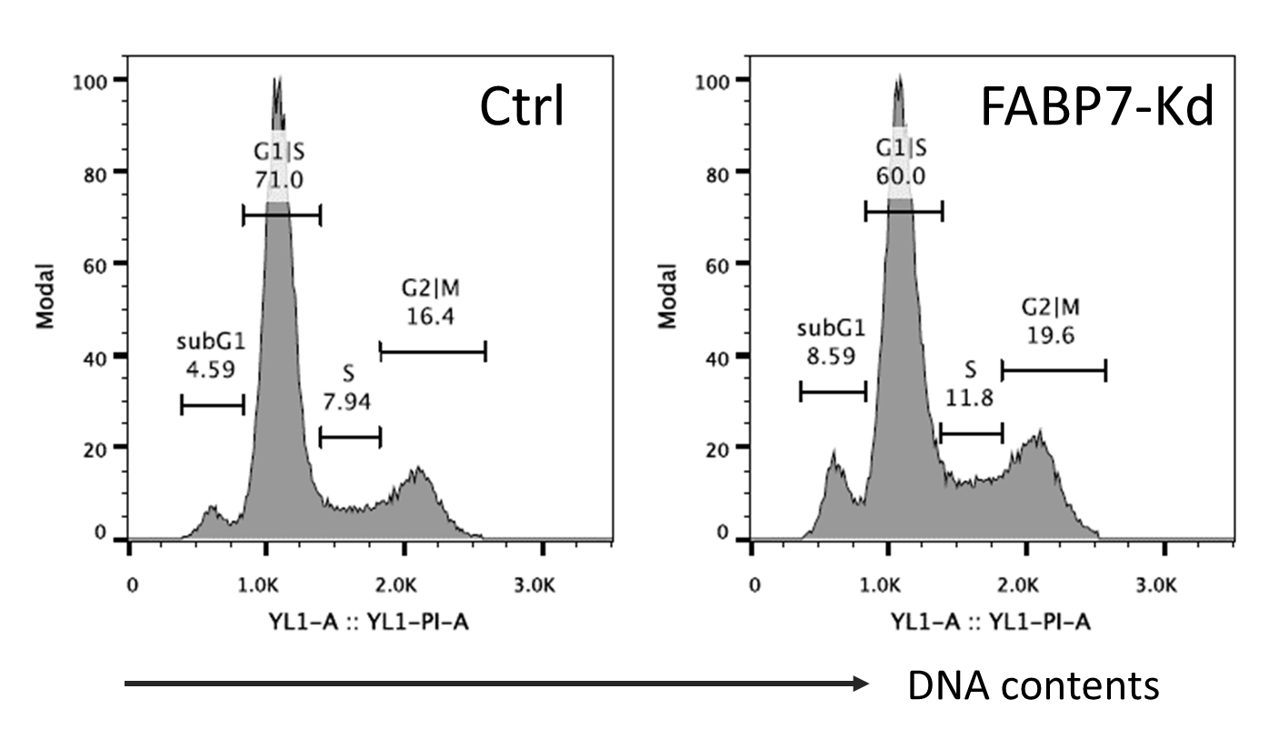
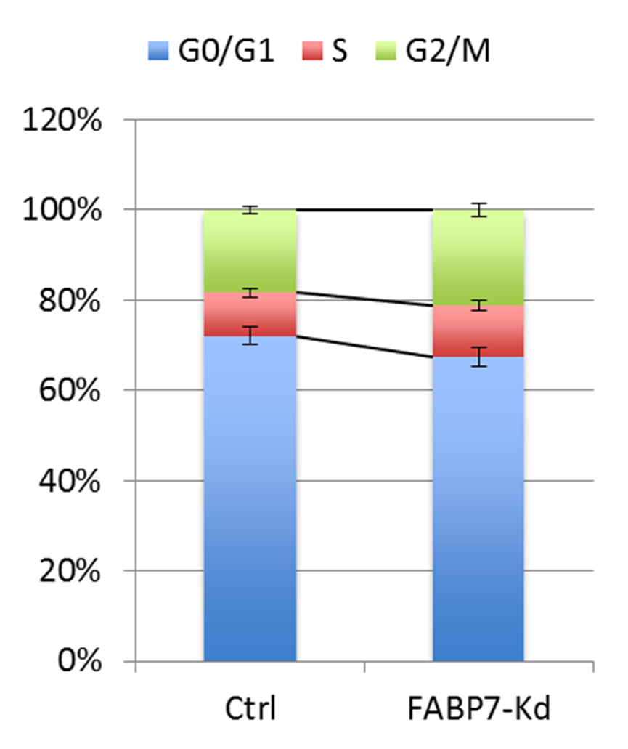
Fig. S5
a
b
c
d
n.s.
FABP7-knockdown (FABP7-Kd) induced lipid peroxidation and led to the increase of sub-G1 phase in cell-cycle analysis. a Comparison of lipid peroxidation levels between control (Ctrl) and FABP7-Kd under normoxia, hypoxia (0.1% O2, 24 hr), and 24 hr after ionizing radiation (4Gy). b, c, d Cell-cycle analysis of Ctrl and FABP7-Kd. b Representative cell-cycle distribution. c Difference of the proportion of sub-G1 population. d Cell-cycle distribution without sub-G1 phase. Error bars, SD; *p < 0.05, **p < 0.01; n = 3.

