Slide 1
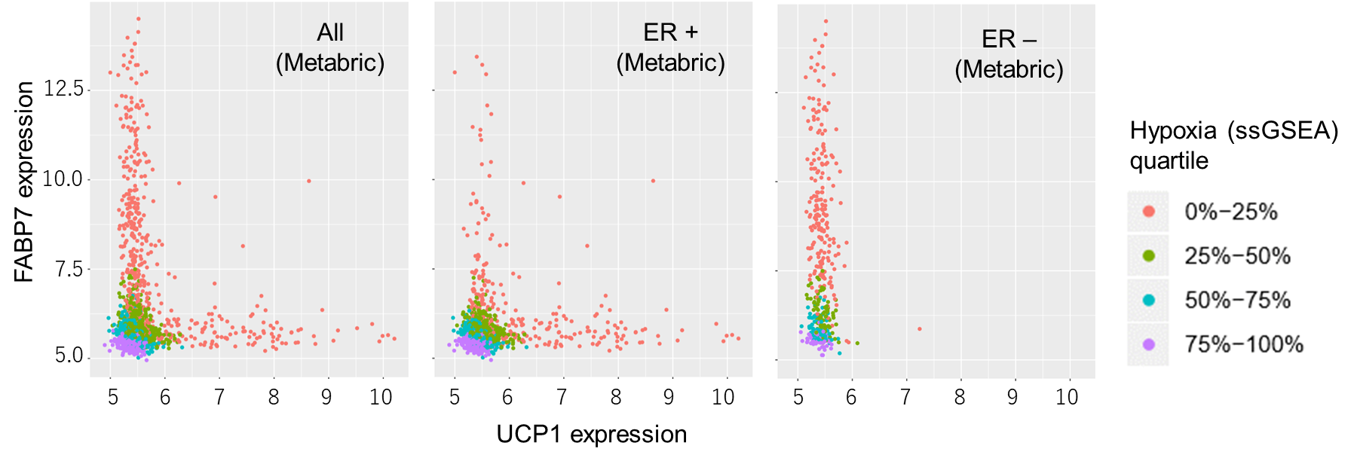
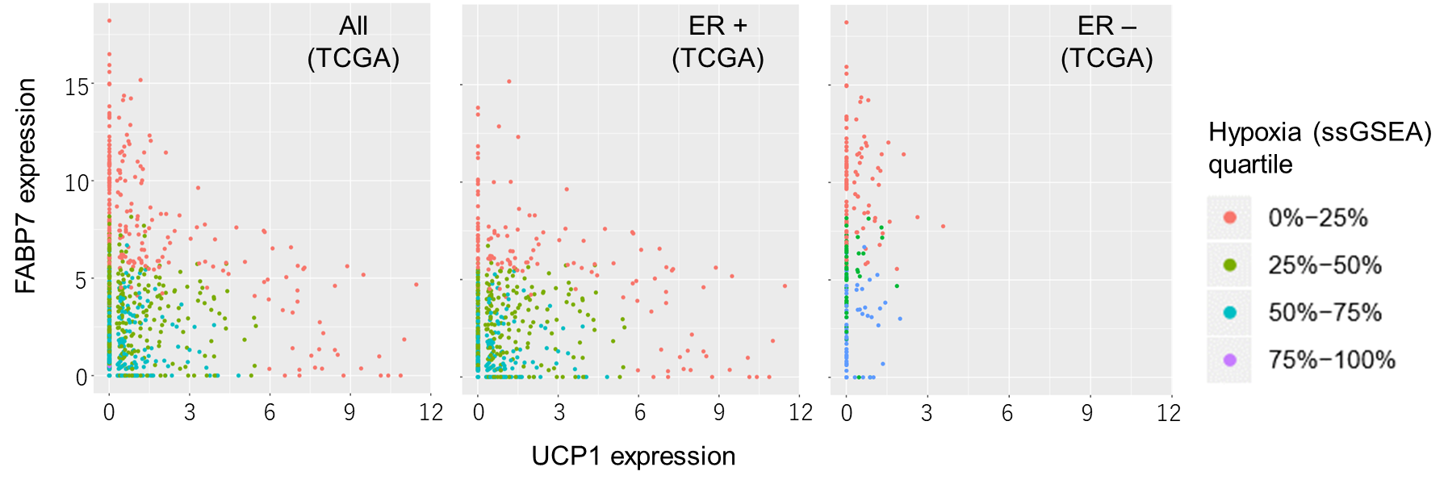
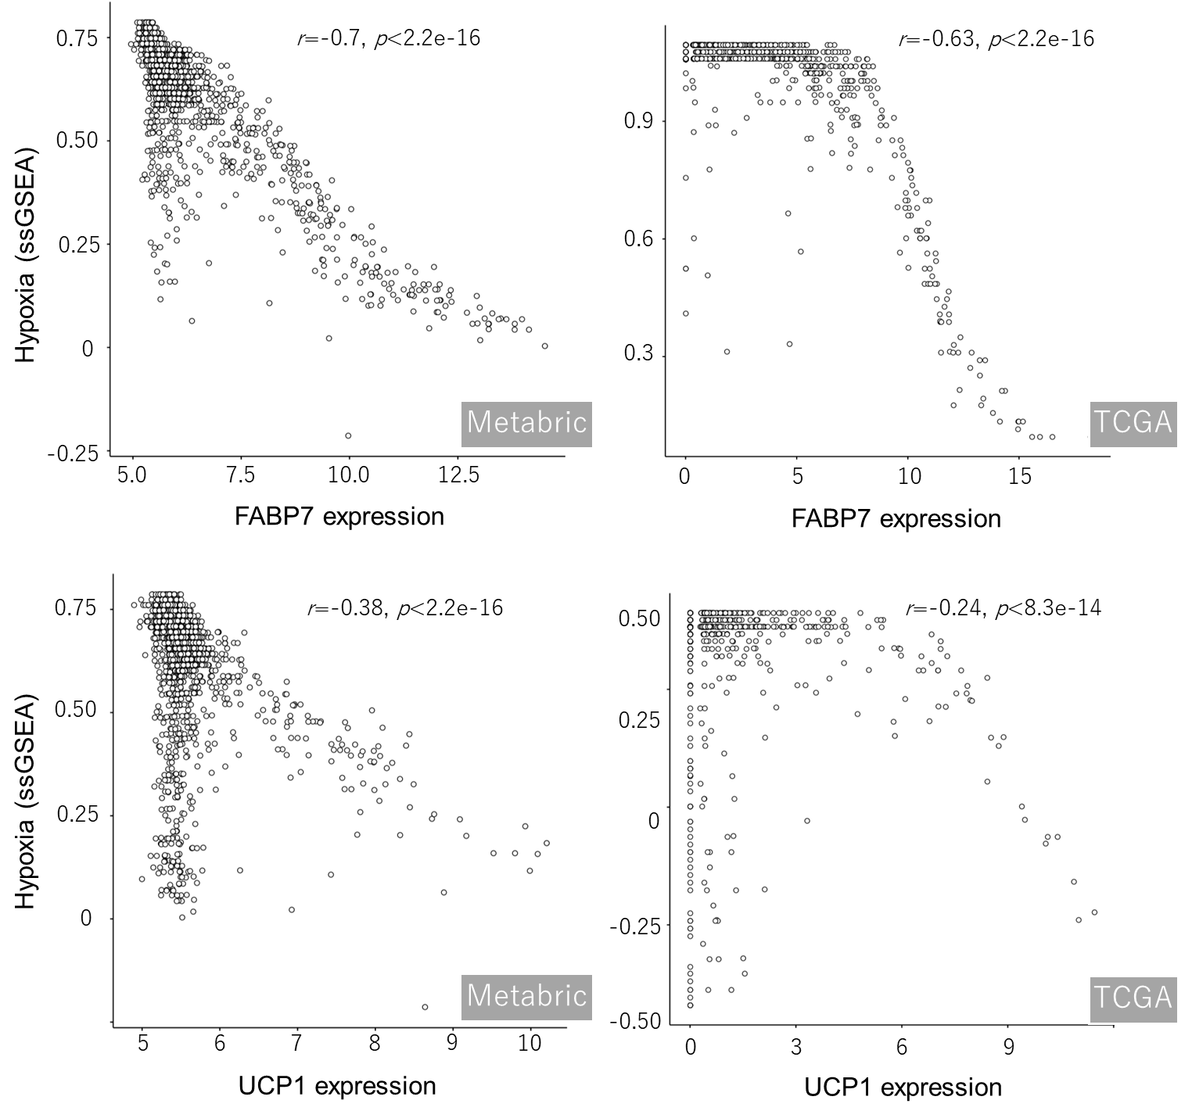
Fig. S1
a
b
a Association of FABP7, UCP1, and hypoxia ssGSEA quartile in the Metabric (n = 1904, upper panels) and TCGA (n = 960, lower panels) breast cancer cohorts. The scatter plots of all samples (left), ER+ tumors (middle) and ER negative tumors (right) are shown. X and y axes show UCP1 and FABP7 mRNA expression, respectively. Hypoxia ssGSEA quartiles were indicated using different colors (orange, green, blue and purple). b Correlation analyses of hypoxia ssGSEA with FABP7 (upper panels) and UCP1 expression (lower panels).

