Slide 1
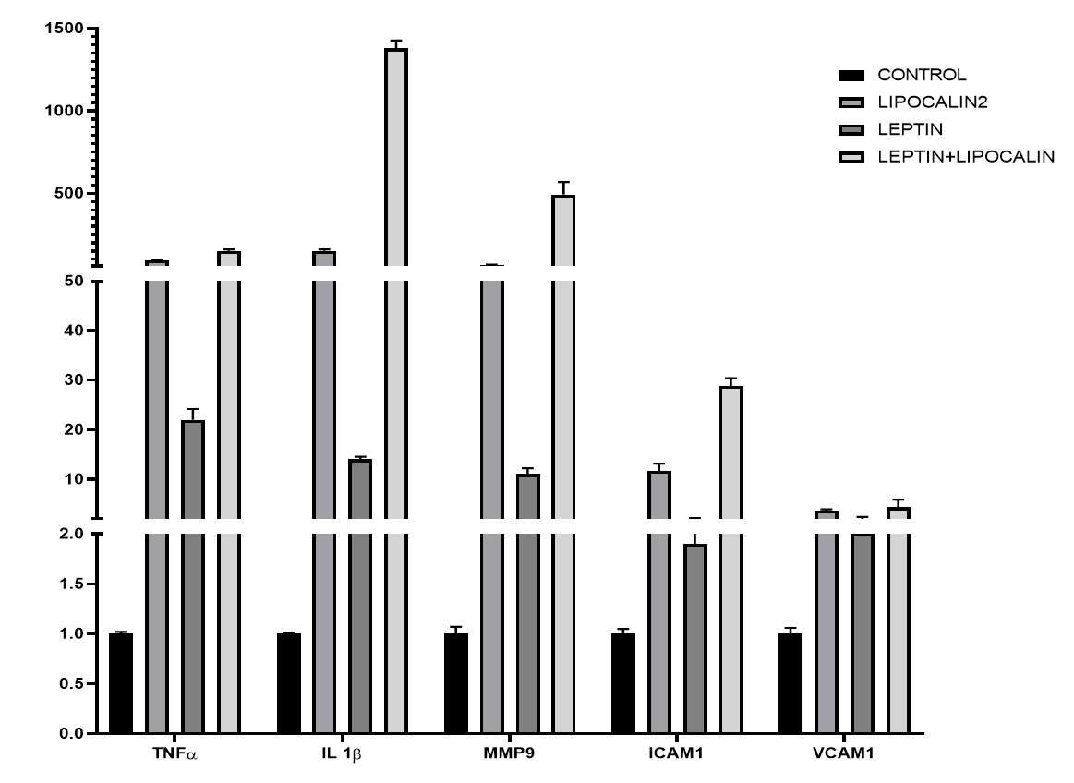
Supplementary Fig.1
A.
B.
***P<0.001
Normalized mRNA expression
(× CONTROL)

Slide 2
Supplementary Fig.2
A.
B.
Untreated
Lcn2
Untreated
MCD
Lcn2
MCD
23 kDa
Claudin5
42 kDa
β-actin
24p3R+
24p3R -

