Slide 1
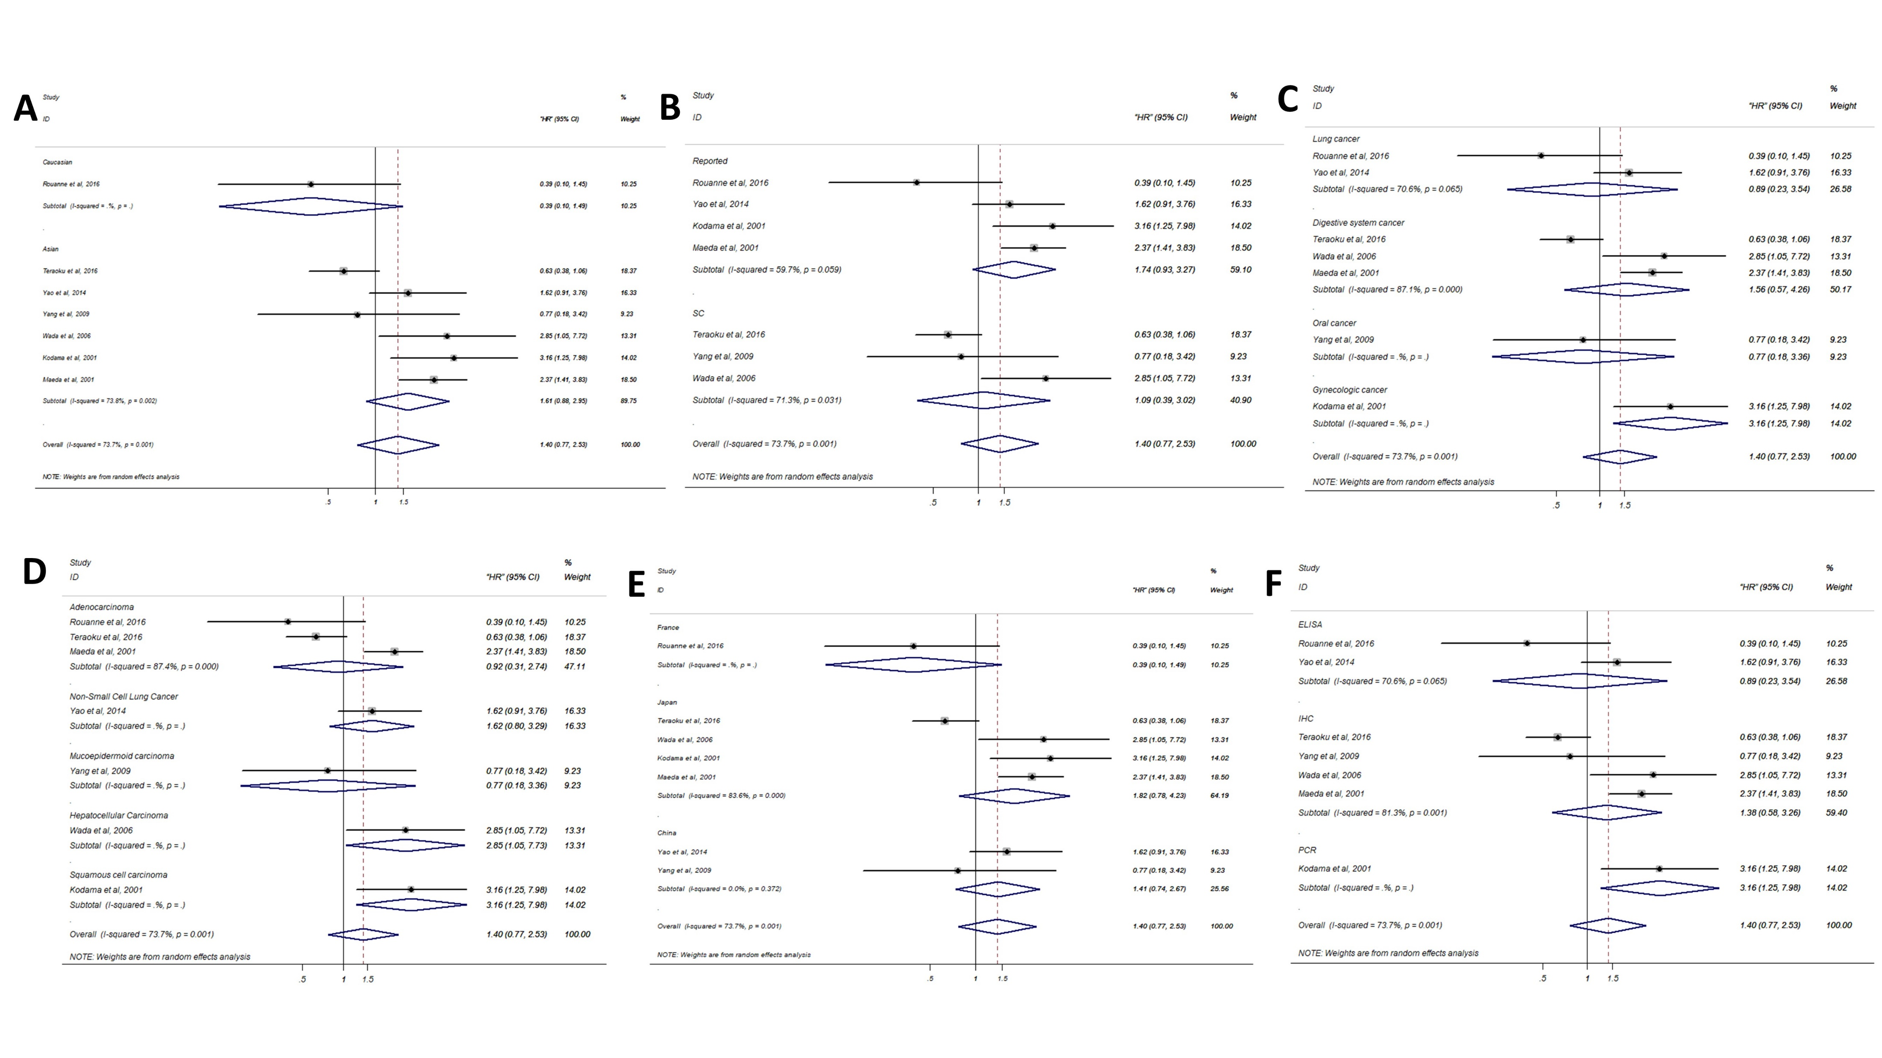
Notes:
Figure S1: Forest plots of merged analyses for DFS/RFS associated with TSP-1 expression. Notes: (A) Forest plots for the subgroup analysis in different ethnicities; (B) Forest plots for the subgroup analysis in different source of HR; (C) Forest plots for the subgroup analysis in different disease types; (D) Forest plots for the subgroup analysis in different pathological types; (E) Forest plots for the subgroup analysis in different nationalities; (F) Forest plots for the subgroup analysis in different assay methods. Abbreviations: HR, Hazard ratio; SC: survival curve; PCR, polymerase chain reaction; IHC, immunohistochemistry; ELISA, enzyme linked immunosorbent assay.

Slide 2
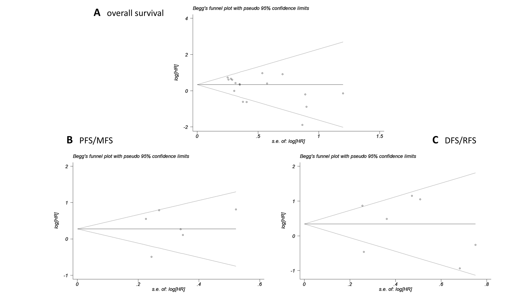
Notes:
Figure S2: Begg’s funnel plots of the publication bias. Notes: (A) Begg’s funnel plots of the publication bias for overall merged analysis of OS. Each point represents a separate study. (B) Begg’s funnel plots of the publication bias for overall merged analysis of PFS/MFS. (C) Begg’s funnel plots of the publication bias for overall merged analysis of DFS/RFS. Abbreviations: OS, overall survival; PFS, progression-free survival; MFS, metastasis-free survival; RFS, recurrence-free survival; DFS, disease-free survival.

