Slide 1
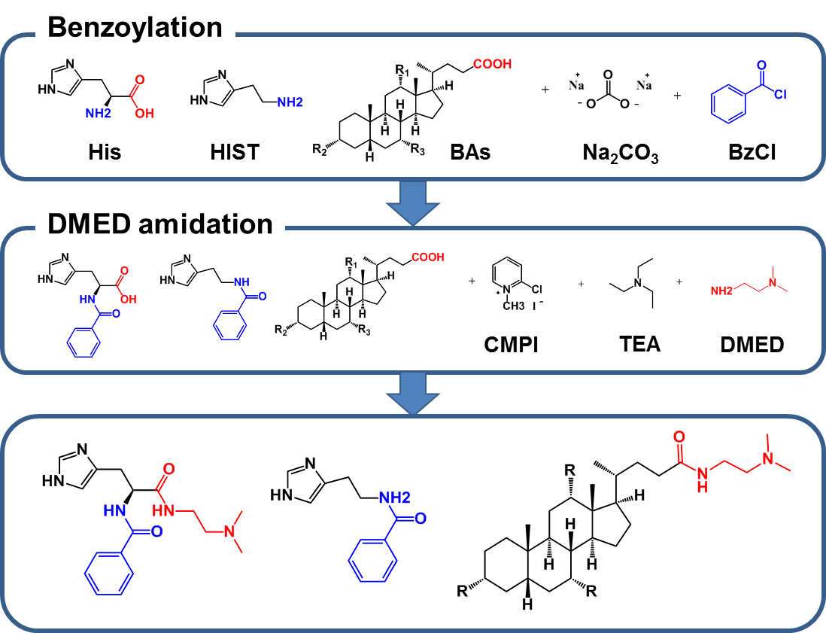
Suppl. Fig. 1. Serial derivatization procedures to primary amine and carboxylate groups on HIST, His, and BAs

Slide 2
(A) DMED derivatization → Benzoylation
7.5e4
HIST
3.5e4
UDCA
CDCA
CA
DCA
LCA
Intensity
0
6
12
(B) Benzoylation → DMED derivatization
8.3e4
LCA
UDCA
HIST
4.0e4
CDCA
His
CA
DCA
0
6
12
Time (min)
Suppl. Fig. 2. MRM chromatograms of HIST, His, and 5 BAs according to derivatization order: (A) DMED-Bz derivatization and (B) Bz-DMED derivatization

Slide 3
(A)
UDCA
7.0e4
HIST
Intensity
DCA
LCA
His
CDCA
CA
0
7.5
15
Time (min)
(B)
7.3e3
6.0e4
7.9e3
3.7e2
3.0e3
1.8e2
2.0e3
2.1
2.25
2.5
3.1
3.25
3.4
4.6
4.85
5.1
5
5.25
5.5
8.3
8.5
8.7
8.7
8.85
9
10
10.25
10.5
His-¹³C₆
HIST-d₄
UDCA-d₄
CA-d₄
CDCA-d₄
DCA-d₄
LCA-d₄
Suppl. Fig. 3. MRM chromatograms of HIST, His, 5 BAs, and their corresponding internal standards in SGF (10 μg/mL for His and 1 μg/mL for HIST and 5 BAs)

Slide 4
Suppl. Table 1. MRM transitions and parameters
Compound name | Derivatization form | DP | CE for quantifier ion | Quantifier ion transition | CE for qualifier ion | Qualifier ion transition
His | Bz-DMED | 45 | 45 | 330>105* | 30 | 330>214
HIST | Bz | 35 | 25 | 216>95 | 33 | 216>105*
CA | DMED | 75 | 65 | 479>98 | 35 | 479>434**
UDCA | DMED | 80 | 41 | 463>418** | 80 | 463>72
CDCA | DMED | 75 | 40 | 463>418** | 50 | 463>400
DCA | DMED | 65 | 68 | 463>98 | 30 | 463>418**
LCA | DMED | 80 | 38 | 447>402** | 80 | 447>72
His-¹³C₆ | Bz-DMED | 45 | 45 | 336>105*
HIST-d₄ | Bz | 35 | 33 | 220>105*
CA-d₄ | DMED | 75 | 35 | 483>438**
UDCA-d₄ | DMED | 80 | 41 | 467>422**
CDCA-d₄ | DMED | 75 | 40 | 467>422**
DCA-d₄ | DMED | 65 | 30 | 467>422**
LCA-d₄ | DMED | 80 | 38 | 451>406**
* benzoyl fragment of Bz derivatives, ** the loss of dimethylamine of DMED derivatives His; L-Histidine, HIST; histamine, CA; cholic acid, UDCA; ursodeoxycholic acid, CDCA; chenodeoxycholic acid, DCA; deoxycholic acid, LCA; lithocholic acid

Slide 5
Suppl. Table 2. Derivatization yields for HIST, His, and BAs
Compound name | Derivatization form | Derivatization yields (%) | RSD (%)
His | Bz-DMED | 65.51 | 4.37
HIST | Bz | 78.23 | 3.92
CA | DMED | 95.85 | 0.70
UDCA | DMED | 97.29 | 0.71
CDCA | DMED | 96.65 | 0.60
DCA | DMED | 95.27 | 0.99
LCA | DMED | 97.84 | 1.10
His; L-Histidine, HIST; histamine, CA; cholic acid, UDCA; ursodeoxycholic acid, CDCA; chenodeoxycholic acid, DCA; deoxycholic acid, LCA; lithocholic acid

