Slide 1
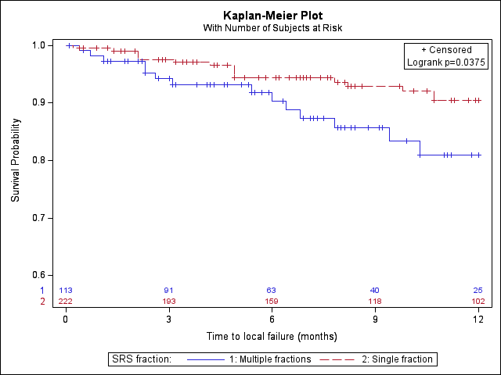
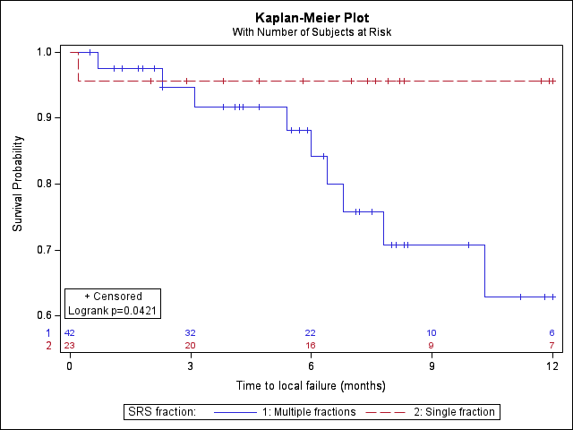
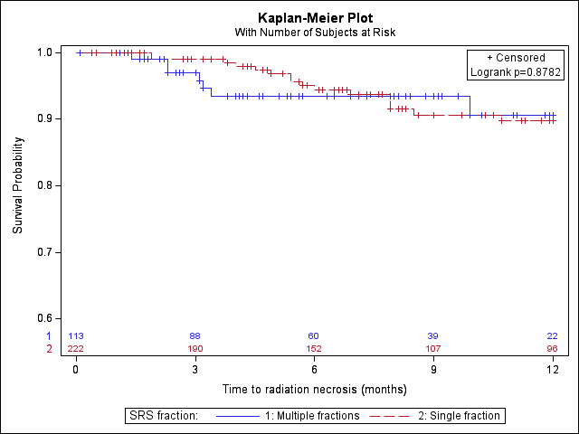
a
Probability of Local Control
Time (months)
b
c
Radiation Necrosis-Free Survival
Notes:
Supplemental Figure 1. Kaplan Meier curves (unadjusted for propensity score) showing (a) local control for the entire cohort, (b) local control for lesions > 2cm and (c) radiation necrosis-free survival. SF-SRS (red/dotted) and HF-SRS (blue/solid).
A) 90% vs 81% (o=0.04)
B) 96% vs 63% (p=0.04)
C) 90% vs 91% (p=0.88)

