Slide 1
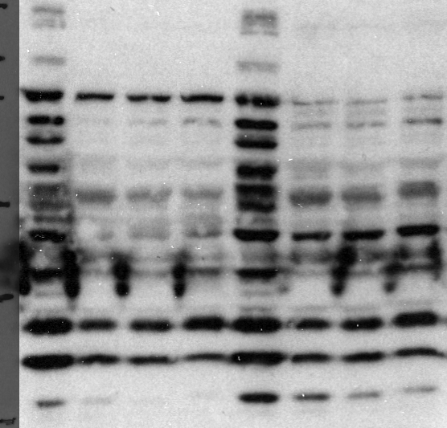
DLD1
HCT116
MS023 (uM)
0 150 175 200 0 150 175 200
150k
100k
75k
50k
37k
25k
β-actin
Supplementary Figure S3. Lim, Lee, Ha, Yu, Shin, Kim

