Slide 1
Supplementary Figure 1
Adult patients with diabetes receiving chronic hemodialysis (n = 972)
Dialysis vintage of less than 6 months or unknown (n = 40)
Malignant disease (n = 22)
Acute severe infection (n = 16)
Missing baseline profiles values (n = 6)
Liver cirrhosis (n = 7)
Dysthyroidism (n = 40)
Analyzed patients (n = 841)
A flow diagram of the study population

Slide 2
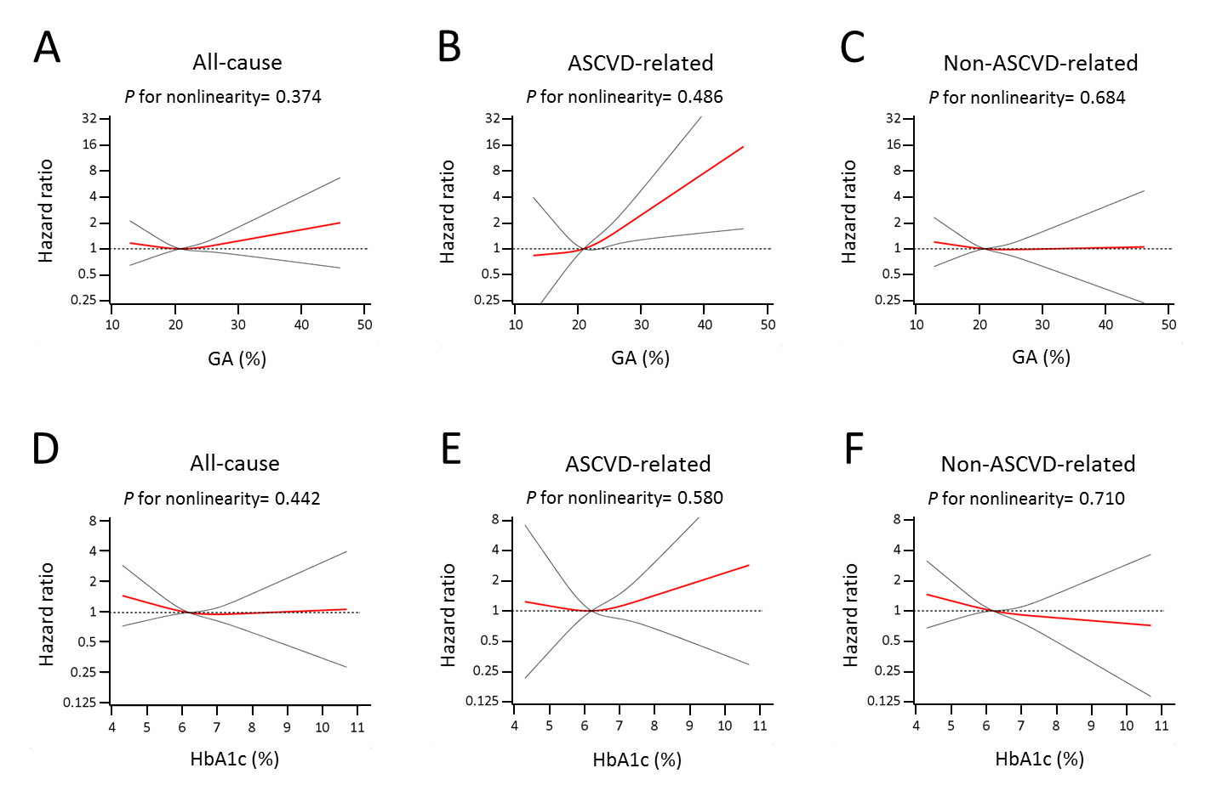
Supplementary Figure 2
Multivariable-adjusted restricted cubic spline curves (95% confidence interval) of the association between mean glycated albumin (A-C) or hemoglobin A1c levels (D-F) and each endpoint. Reference: median of glycated albumin (20.8 %) or hemoglobin A1c (6.2 %).

