Slide 1
Additional Information
Promoter tools for further development of Aspergillus oryzae as a platform for fungal secondary metabolite production
Maiko Umemura, Kaoru Kuriiwa, Linh Viet Dao, Tetsuya Okuda, and Goro Terai

Slide 2
Figure S1. Construction of transformants for promoter activity test
≈1 kb
1.9 kb
≈1 kb
≈1 kb
ustR.5F
pyrG.F
p0X.F
ustR.3F
ustR
5’-UTR
pyrG
Promoter
ustR.5R
pyrG.R
p0X.R
ustR.3R
Fusion PCR
ustR
5’-UTR
pyrG
Promoter
Transformation of A. oryzae
ustR
5’-UTR

Slide 3
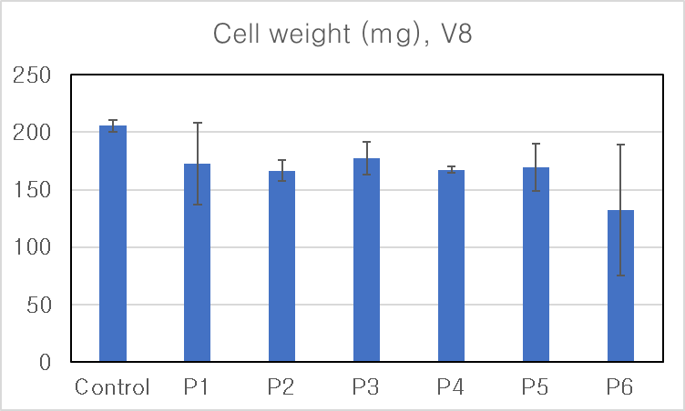
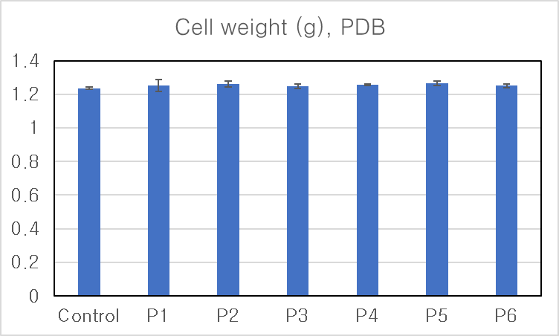
Figure S2. Fungal cell weight after 10 days in V8 and 20 days in PDB liquid medium culture

