Slide 1
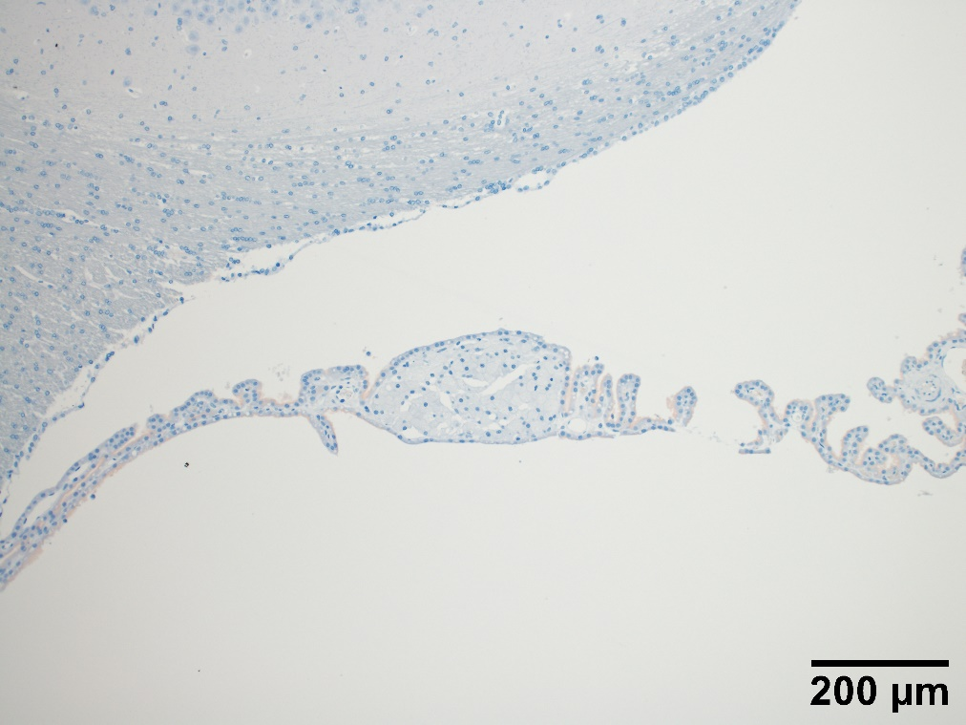
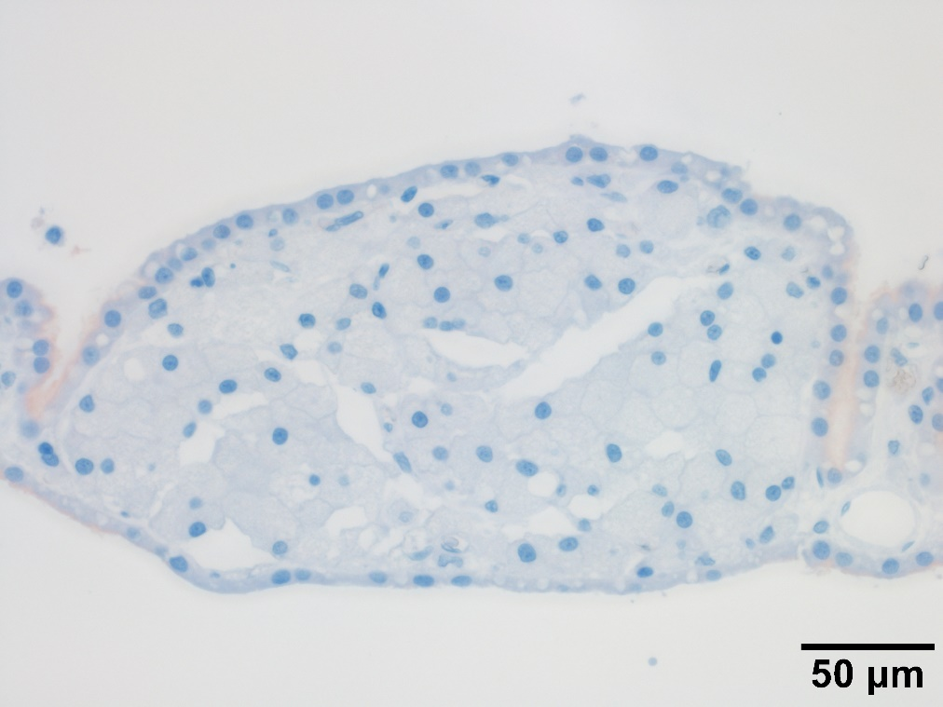
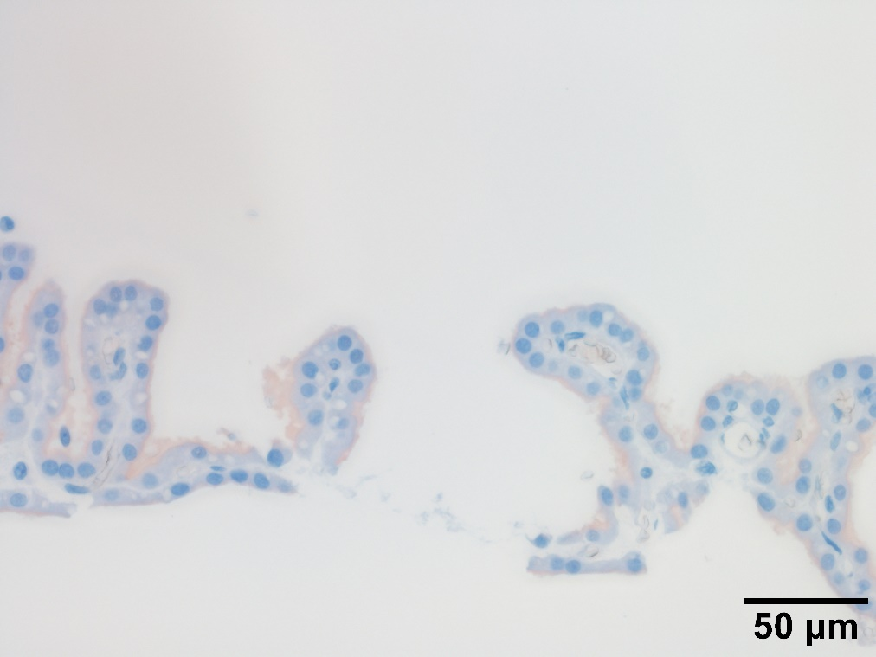
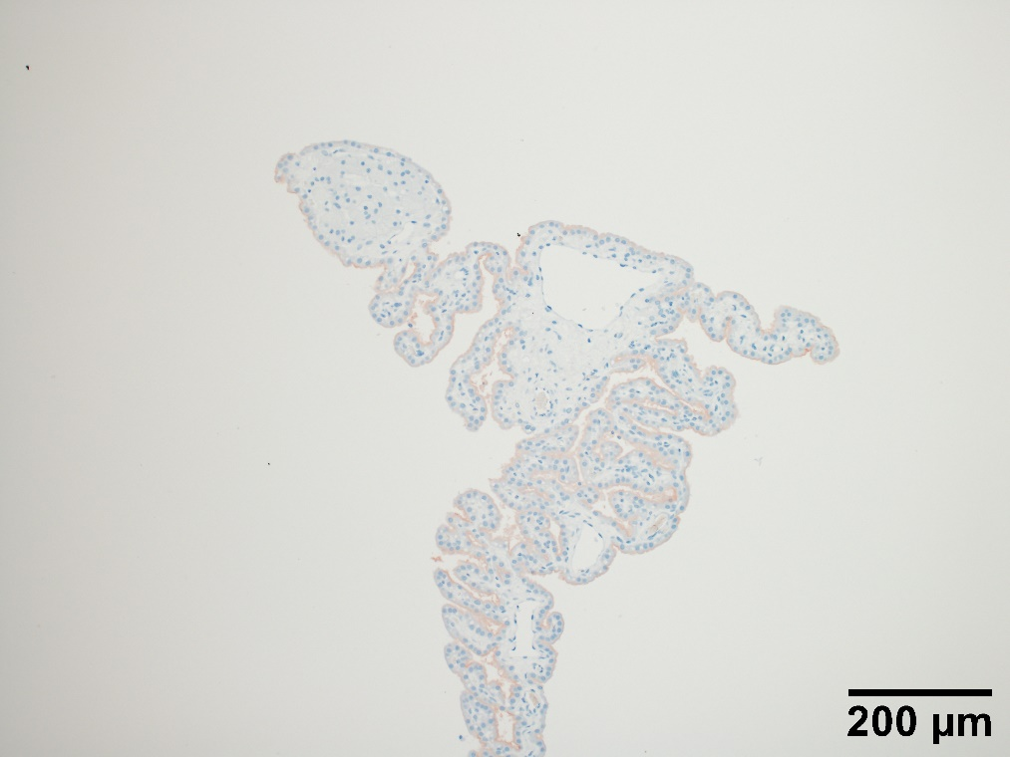
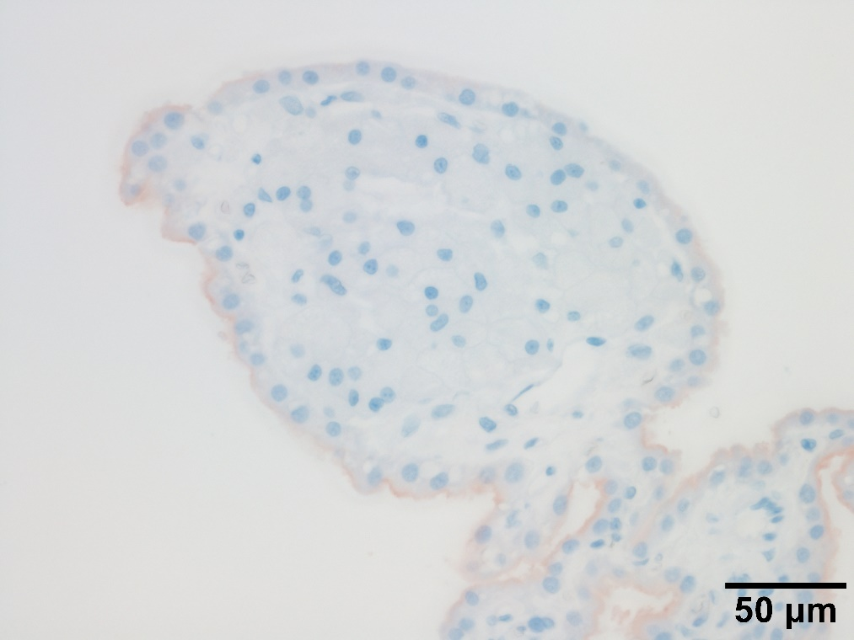
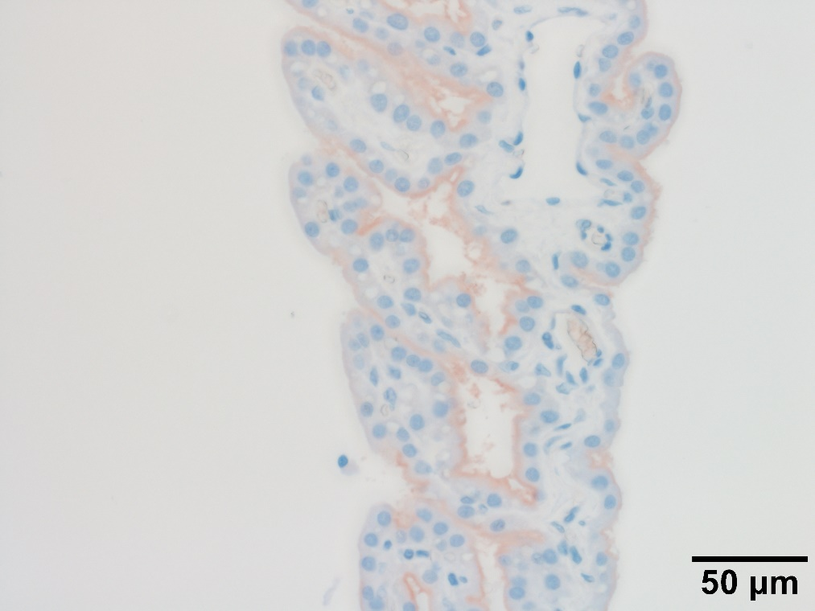
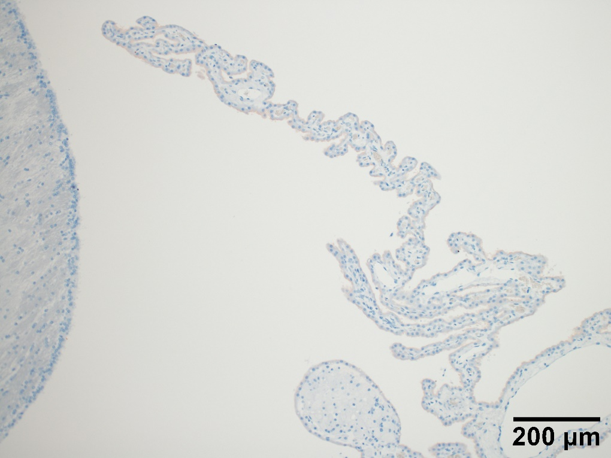
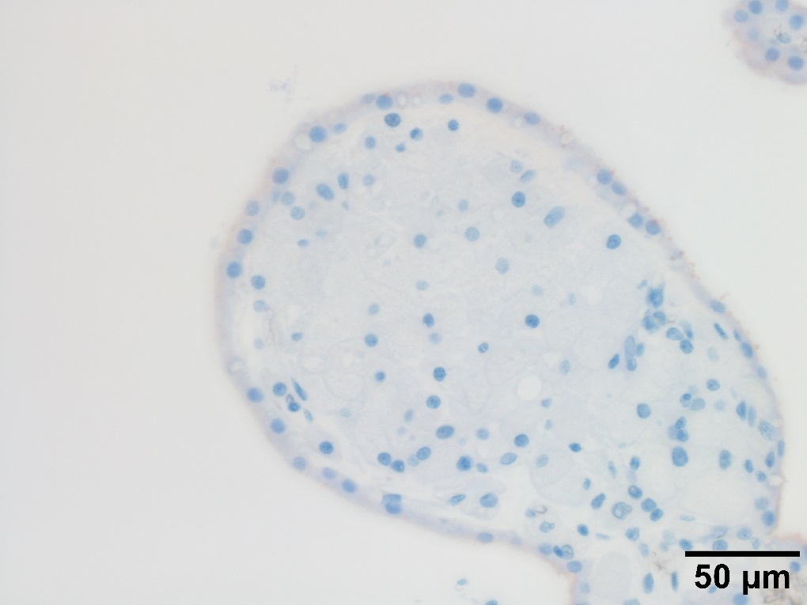
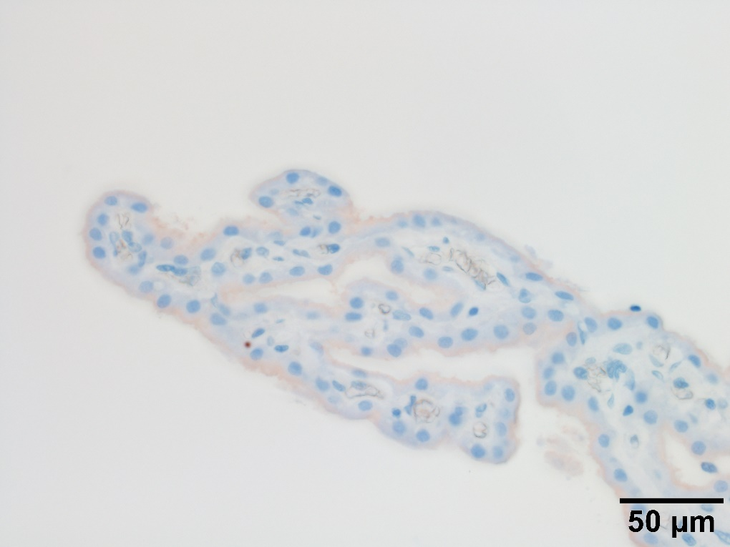
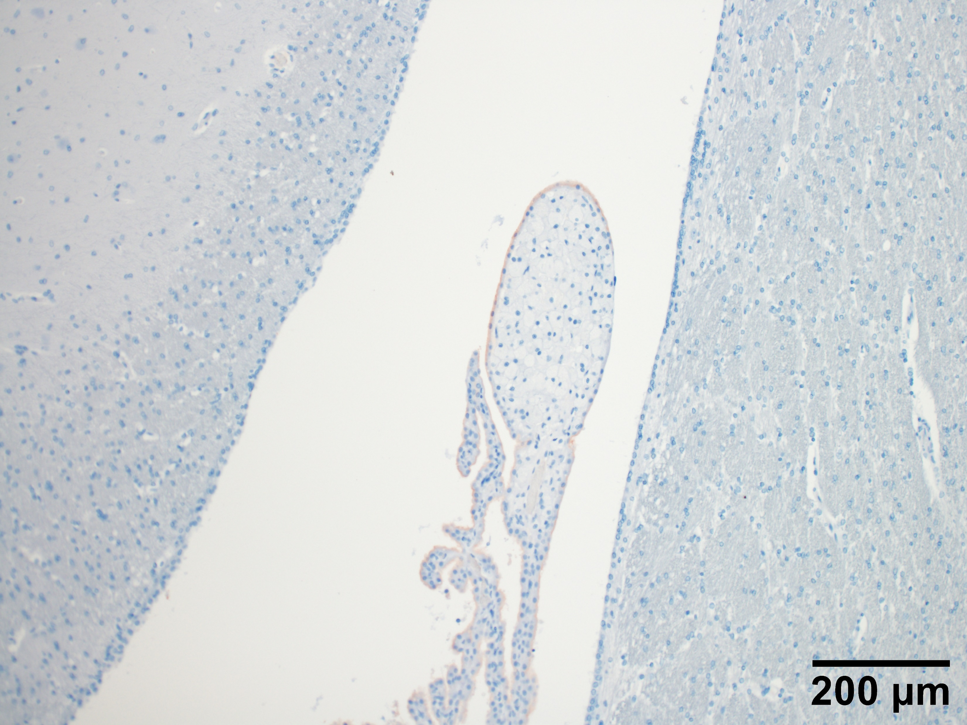
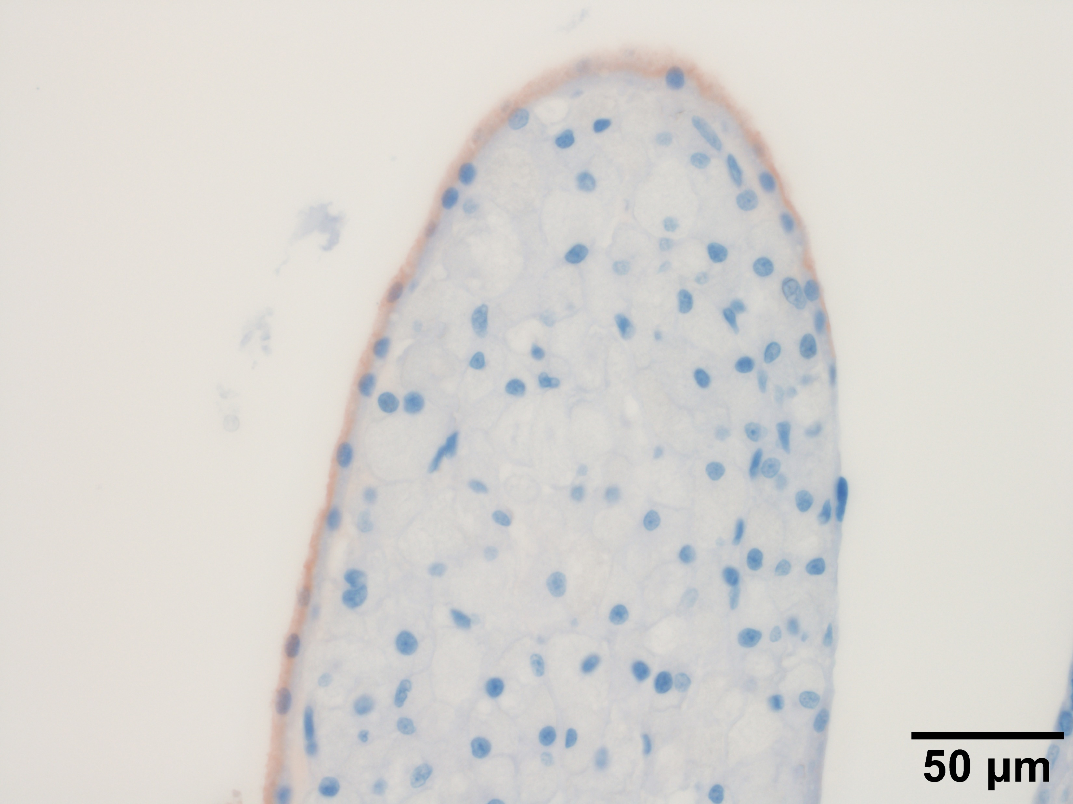
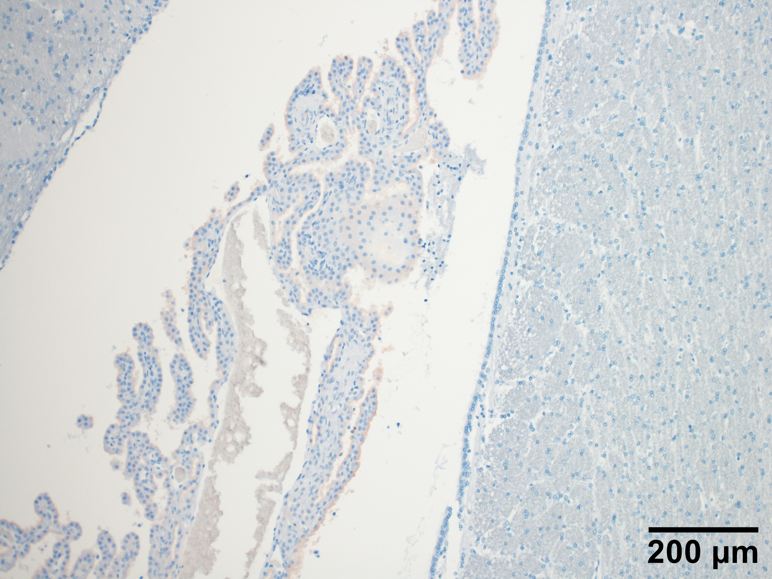
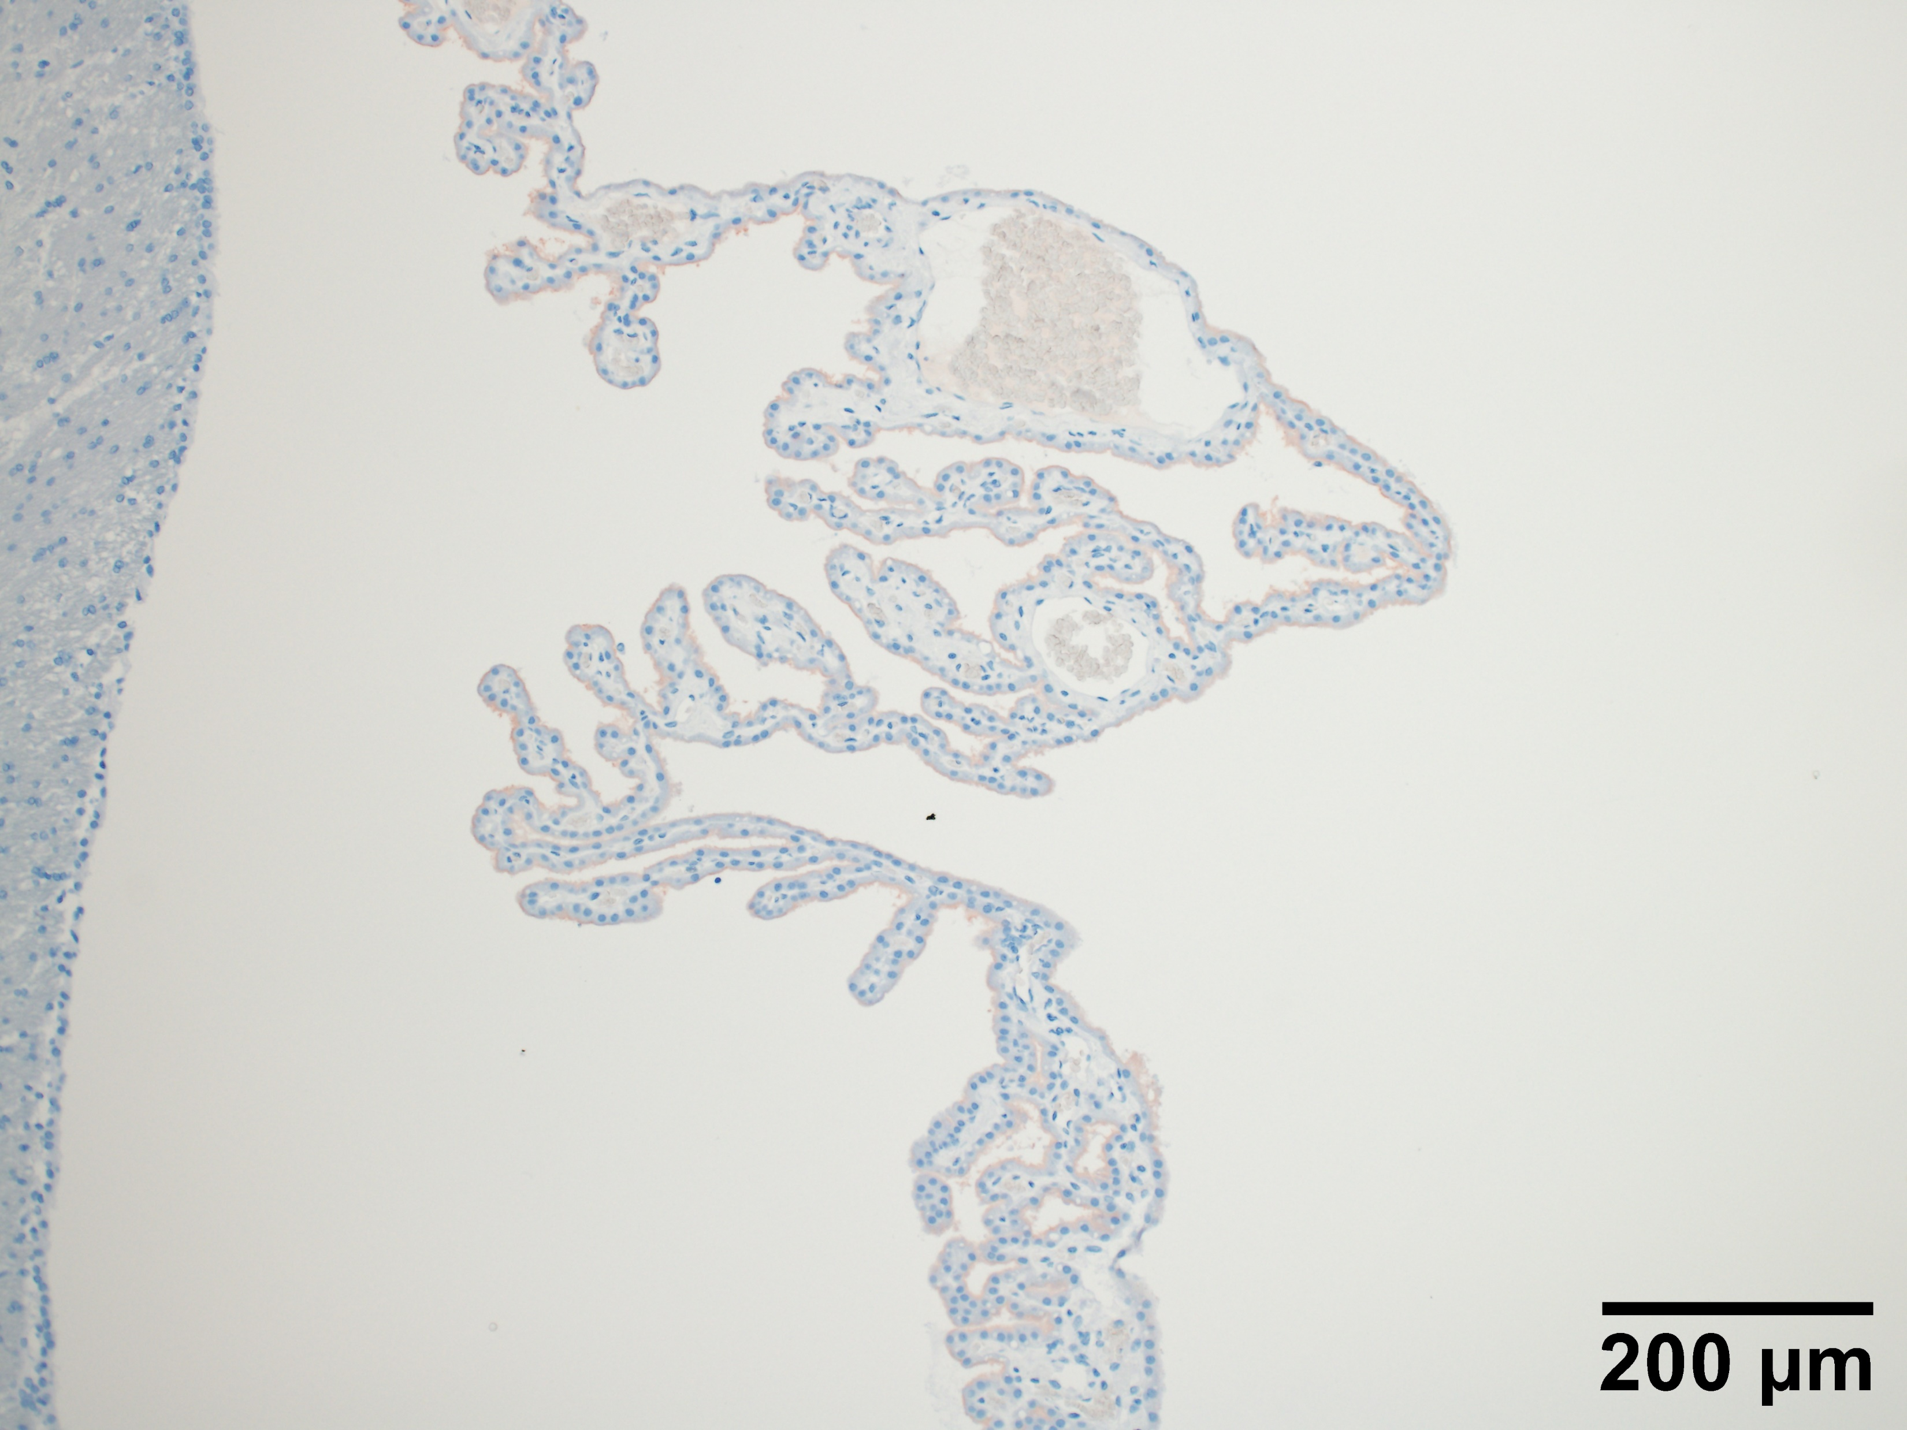
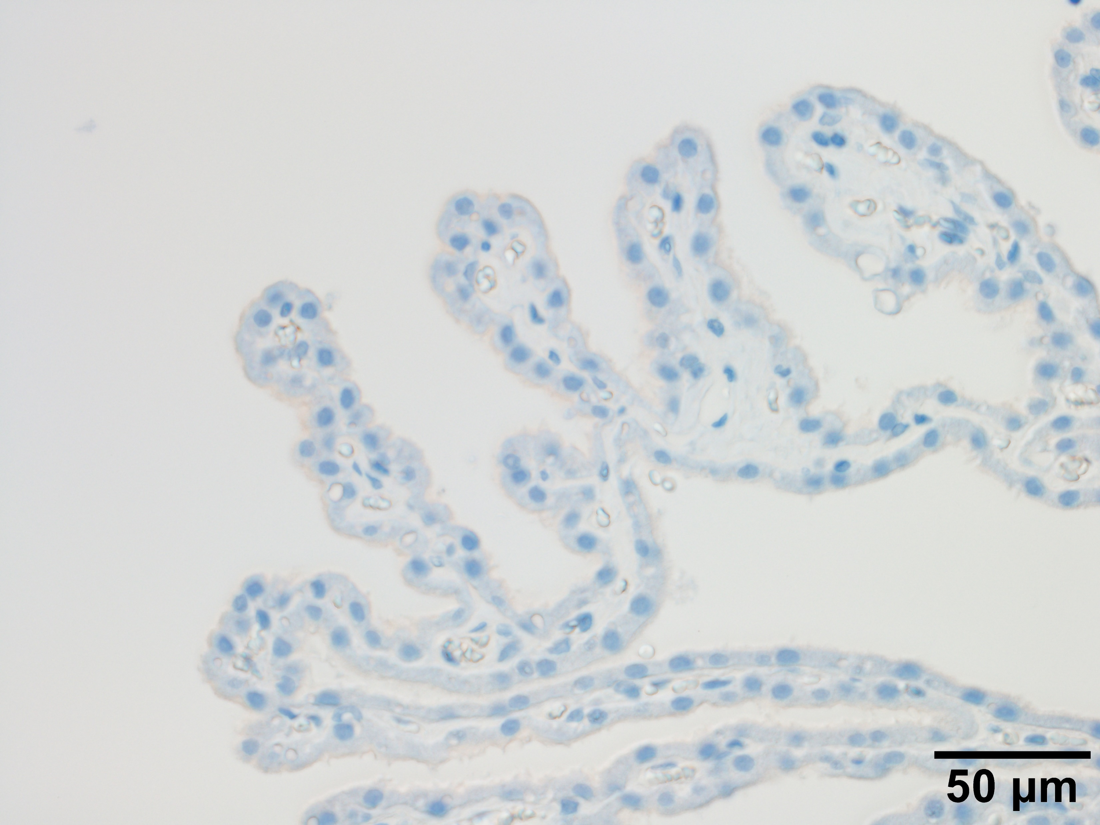
A
B
C
b
c
D
E
E
F
e
f
G
h
H
I
i
J
K
L
k
M
N
n
Notes:
AQP1 IHC appearance from WHHL 32w rabbits (n=5).
AQP1 immunoreaction (red) is observed in rabbit 1 (A-C), 2 (D-F), 3 (G-I), 4 (J-L) and 5 (M-N). Insets (b and c) in (A) are shown in (B) and (C), respectively in higher magnification. Insets (e and f) in (D) are shown in (E) and (F), respectively in higher magnification. Insets (h and i) in (G) are shown in (H) and (I), respectively in higher magnification. Inset (k) in (J) is shown in (K) in higher magnification. (L) shows another part of CP in the LV from rabbit 4. Inset (n) in (M) is shown in (N) in higher magnification. Scale bars in A, D, G, J, L and M are 200 μm, whereas bars in B, C, E, F, H I, K and N are 50 μm. Regions of CPEC with foam cells, where AQP1 immunoreactivity is diminished are marked with arrowheads.

