Slide 1
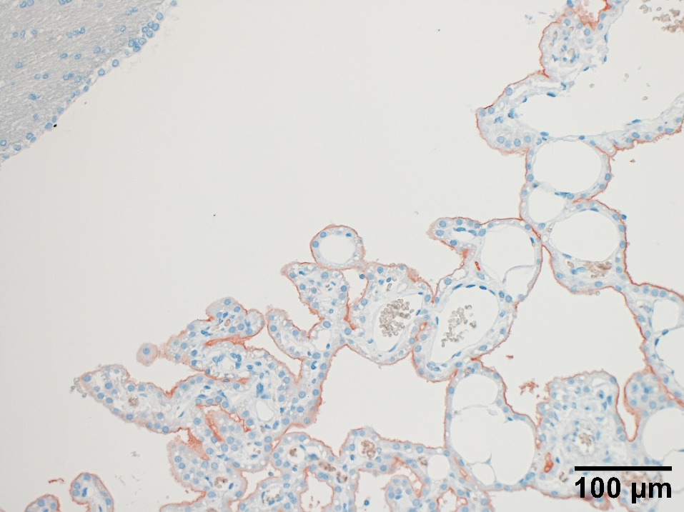
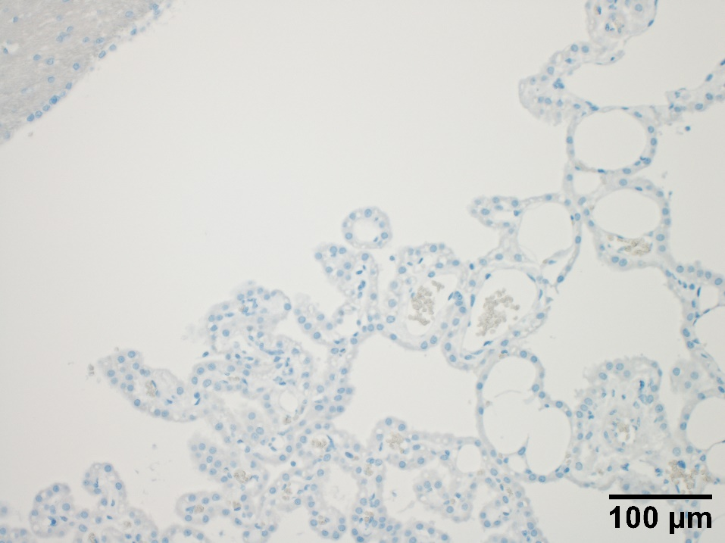
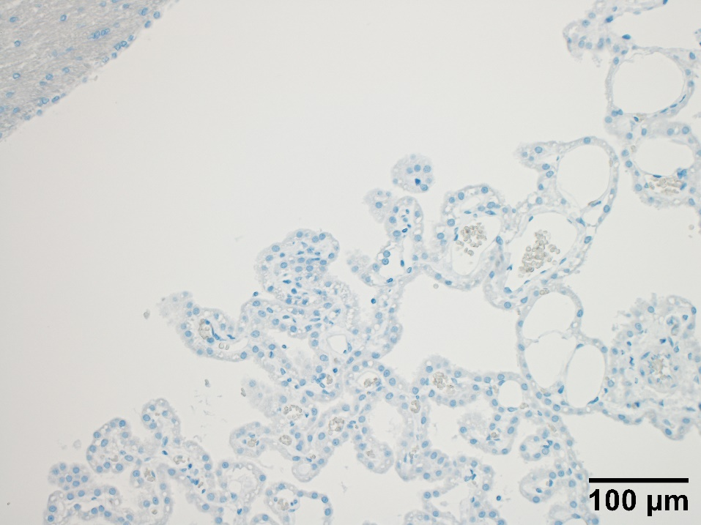
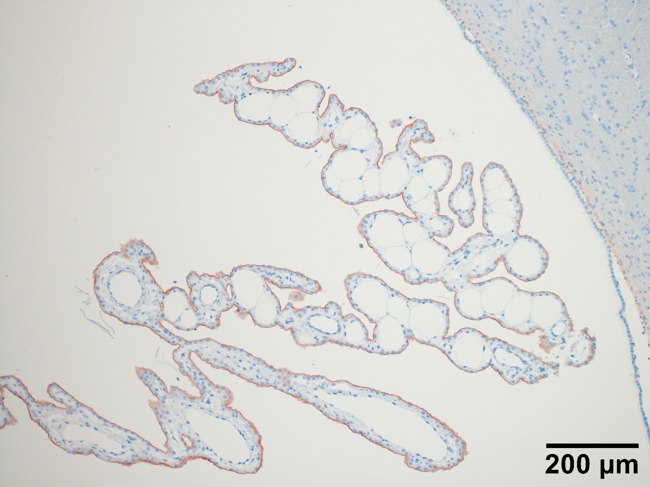
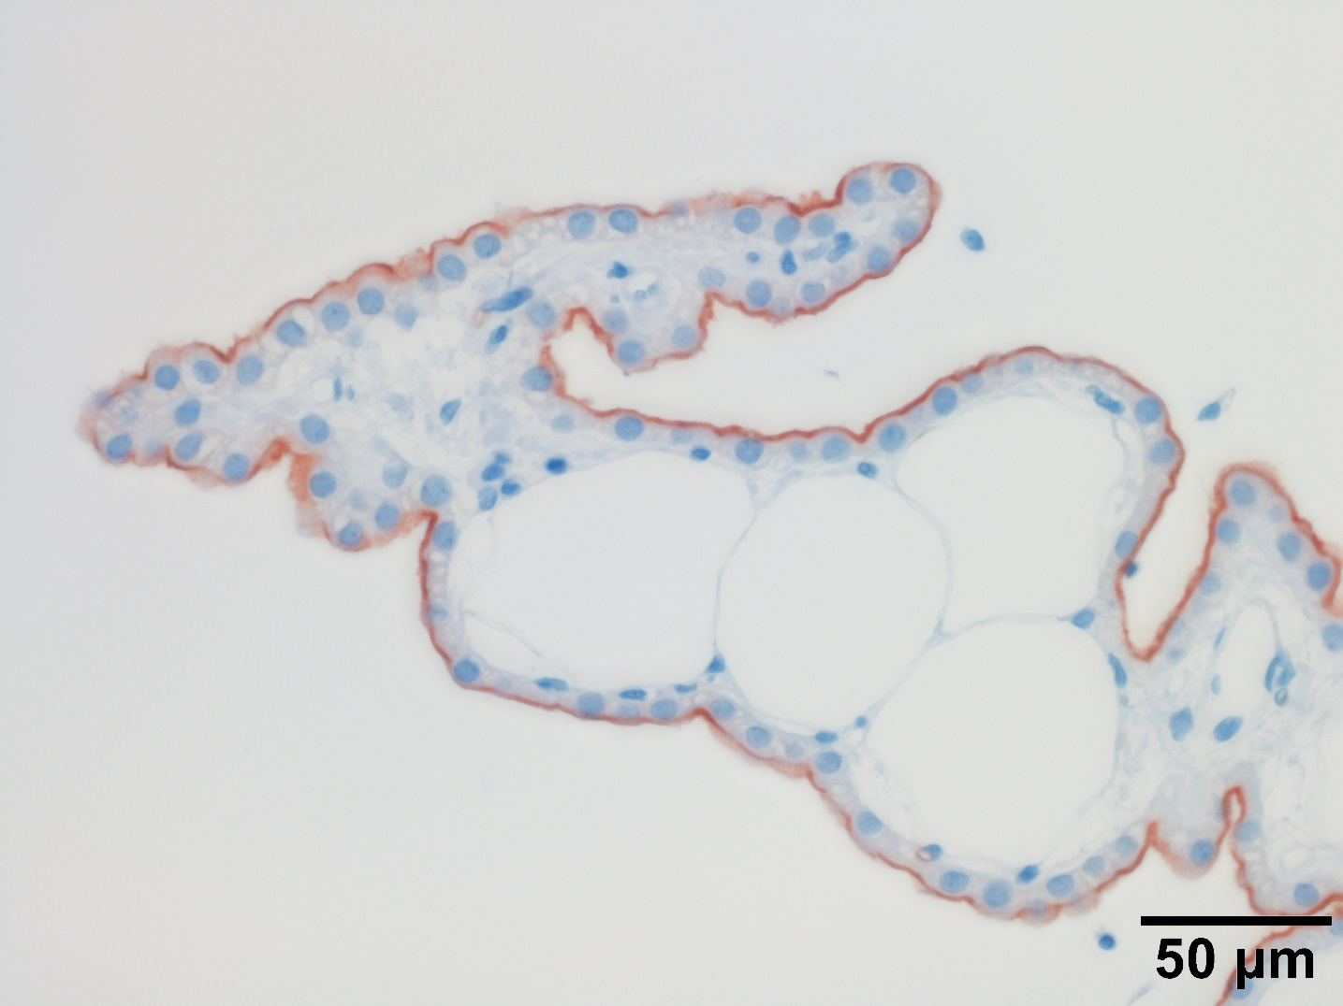
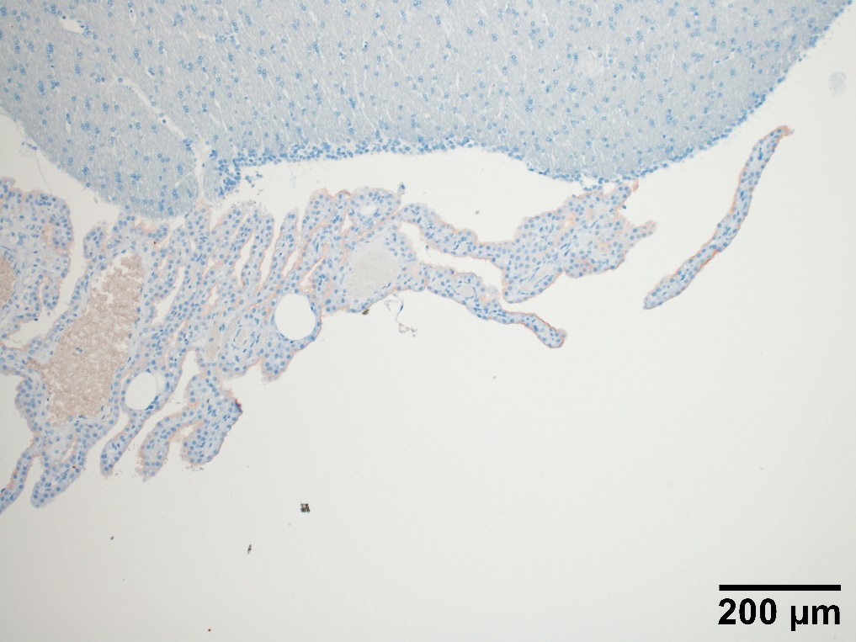
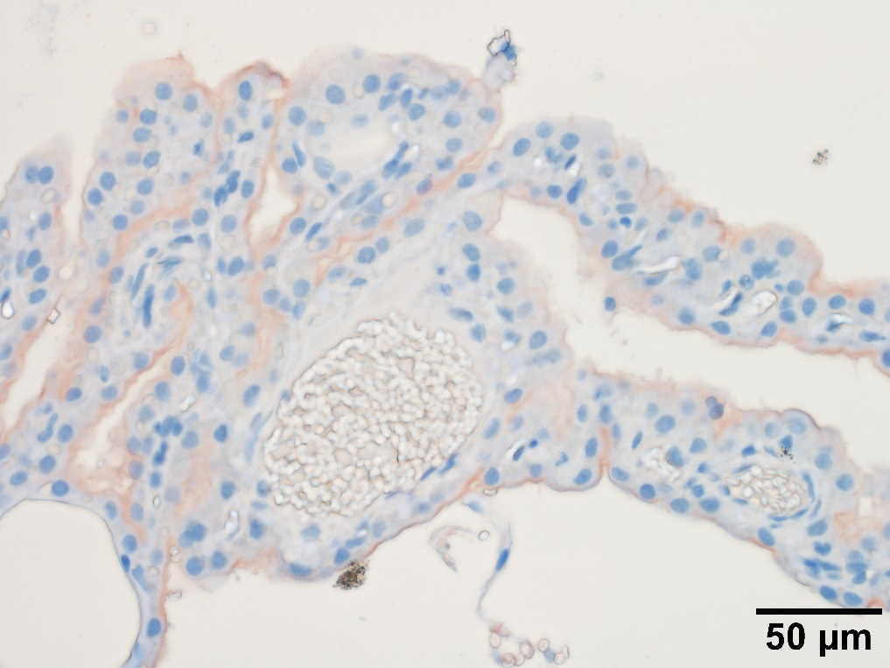
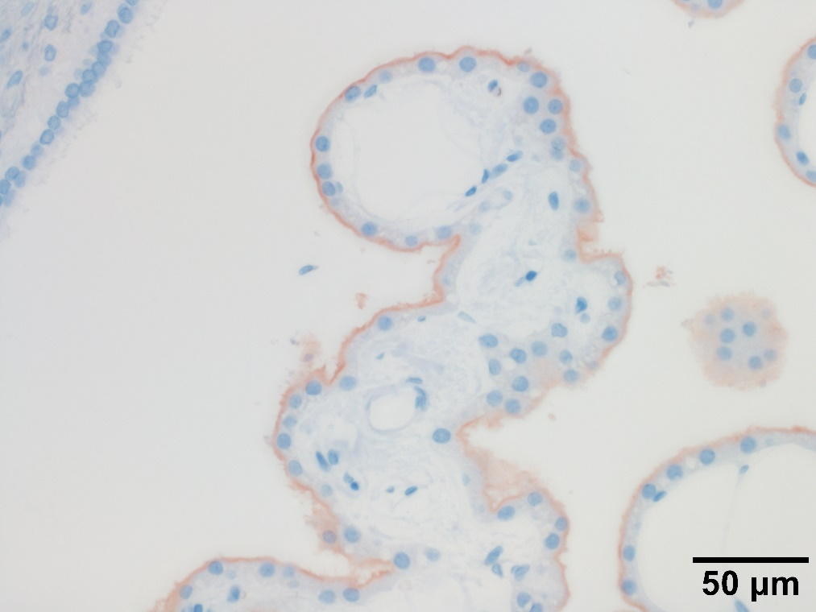
A
B
C
D
e
E
F
G
H
g
Notes:
A) Working concentration of rabbit polyclonal anti-AQP-1 antibody (0.5 μg/mL), B) normal rabbit IgG (0.5 μg/mL) control or C) PBS buffer (primary antibody-omitted control) were used on CP sections from a 0% cholesterol diet rabbit. D) AQP-1 IHC on a different 0% cholesterol diet rabbit than (A). Inset (e) is shown in a magnified field in (E). Apical side of CPECs are clearly AQP-1 positive. An AQP-1 IHC from a dHC rabbit (F) with inset (g), which is magnified in (G). Another dHC rabbit AQP-1 IHC in CP (H). AQP-1 stain of apical CPECs is weaker than 0% cholesterol diet rabbits.

