Slide 1
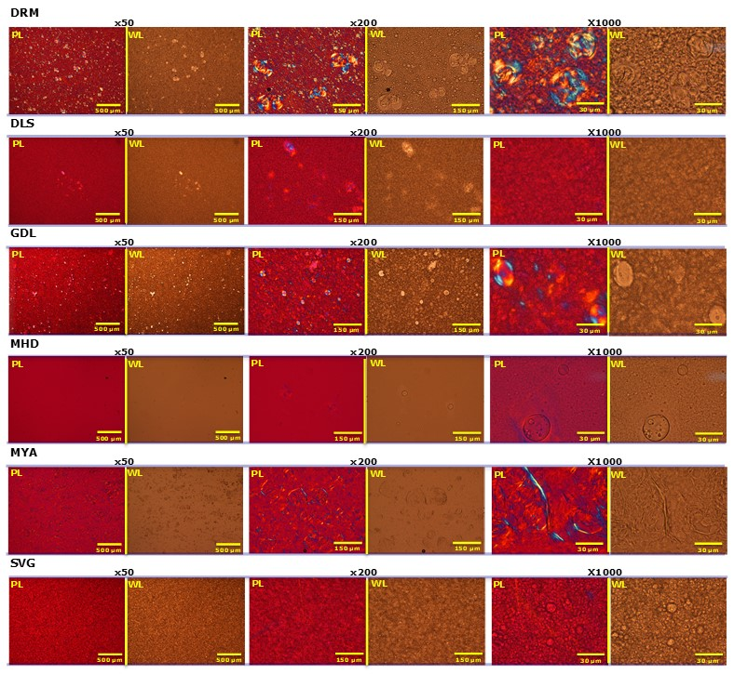
Fig. S2 Yamamoto et al.
Fig. S2 Microscopic images of CLB cream formulations. Magnification: ×50, ×200, and ×1000.
PL: polarized light; WL: white light.

