Slide 1
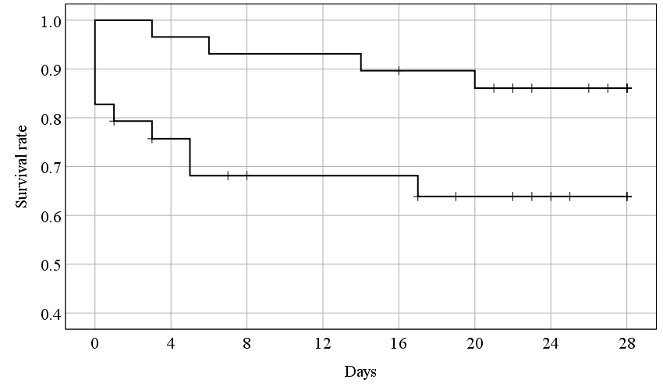
Fibrinogen concentrates group
Control Group
p = 0.034
Supplement figure 1.

Slide 2
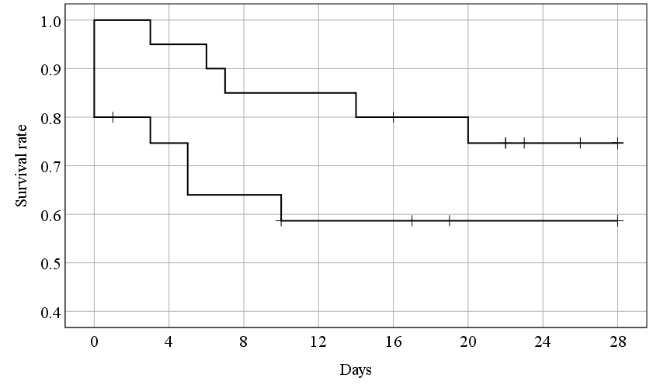
Fibrinogen concentrates group
Control Group
p = 0.174
Supplement figure 2.

