Slide 1
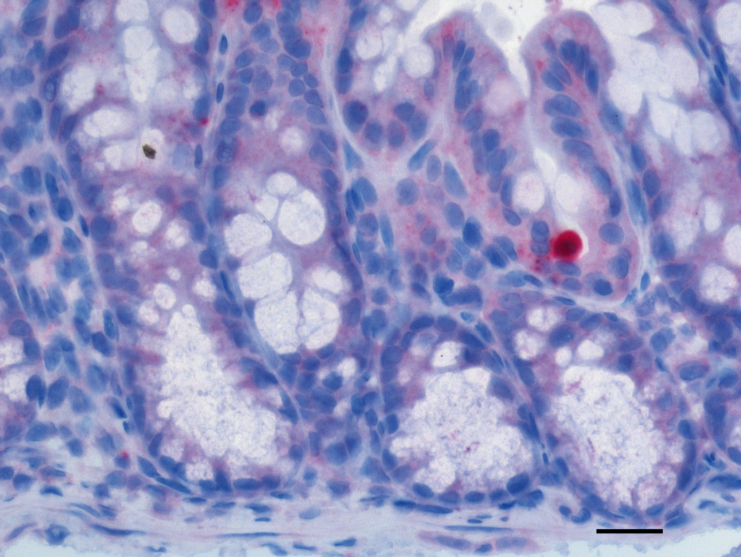
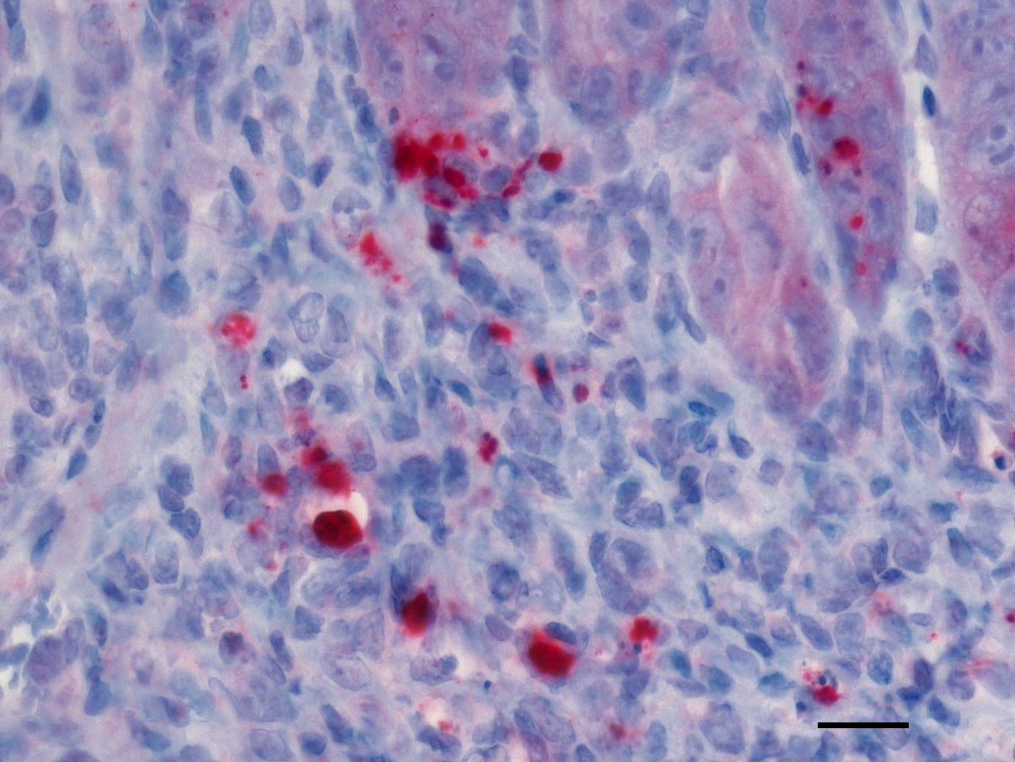
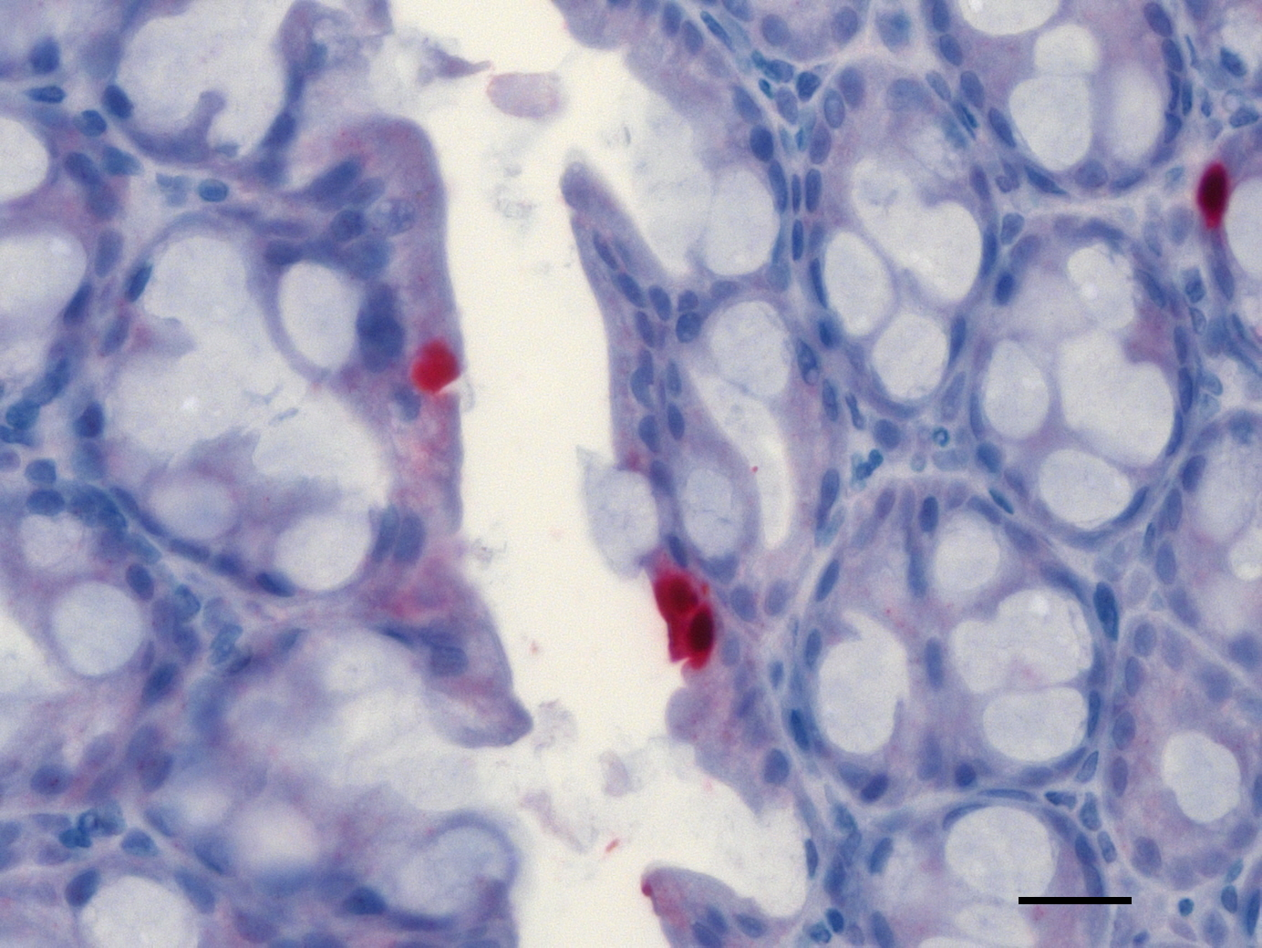
A
Apoptotic Cells (COLON)
Naive
Placebo
Carvacrol
(400 x magnification, scale bar 20 μm)

Slide 2
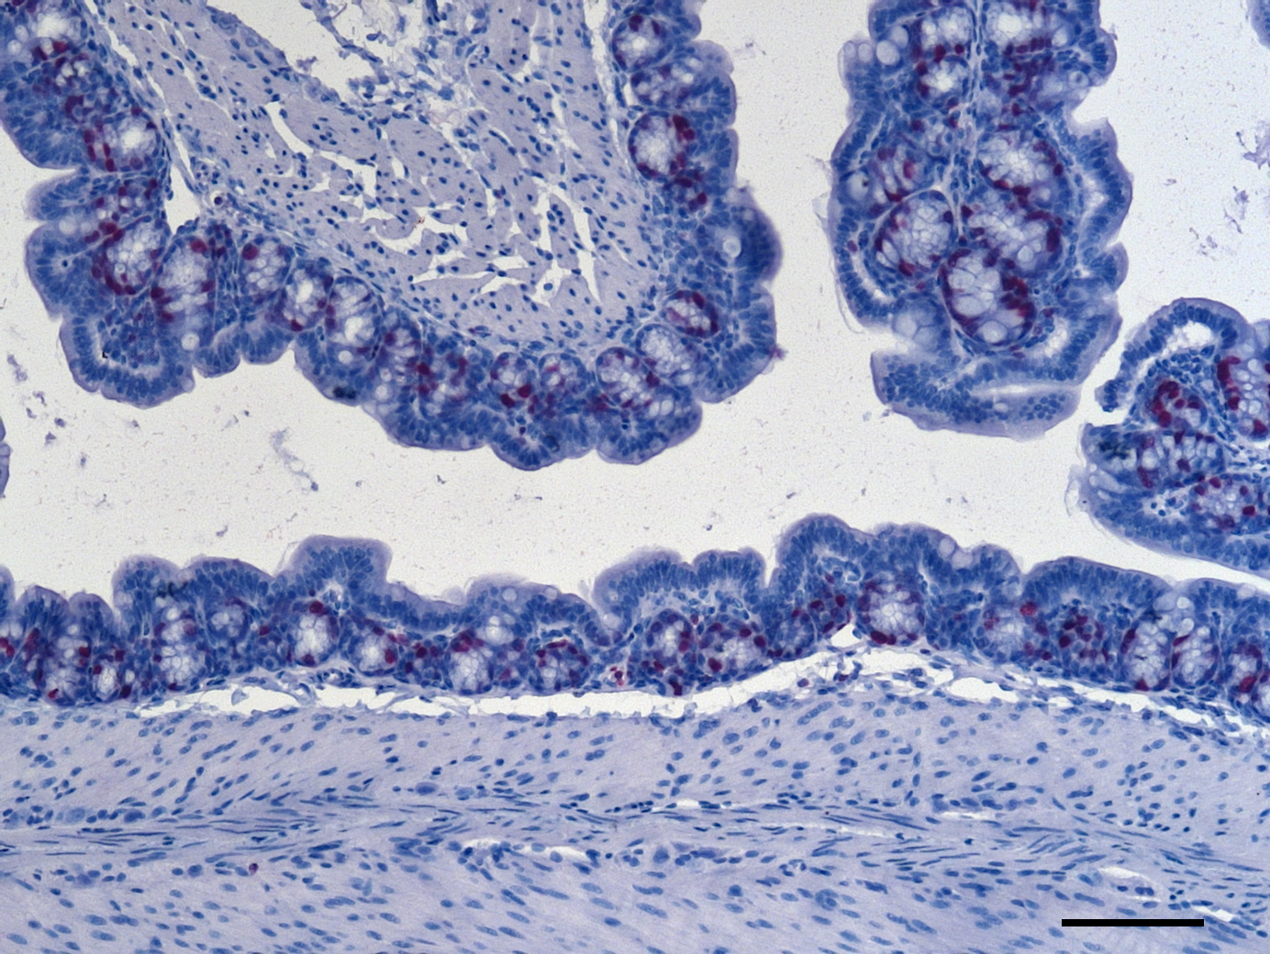
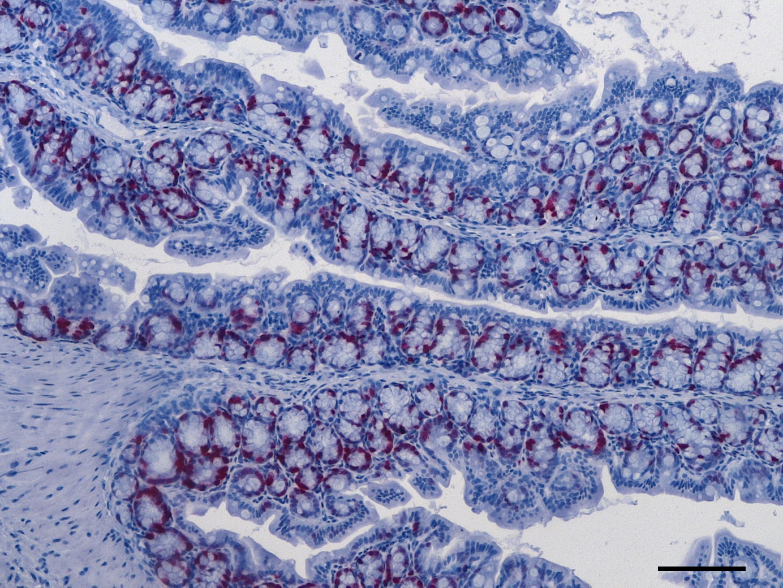
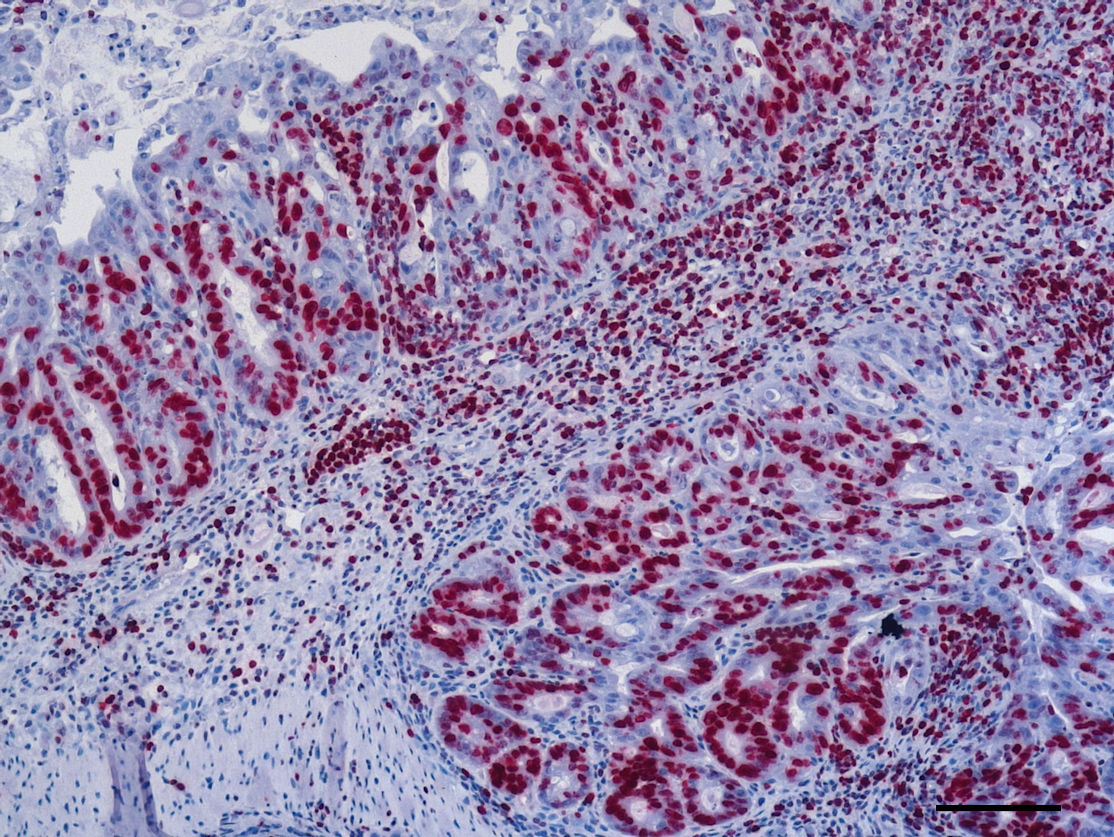
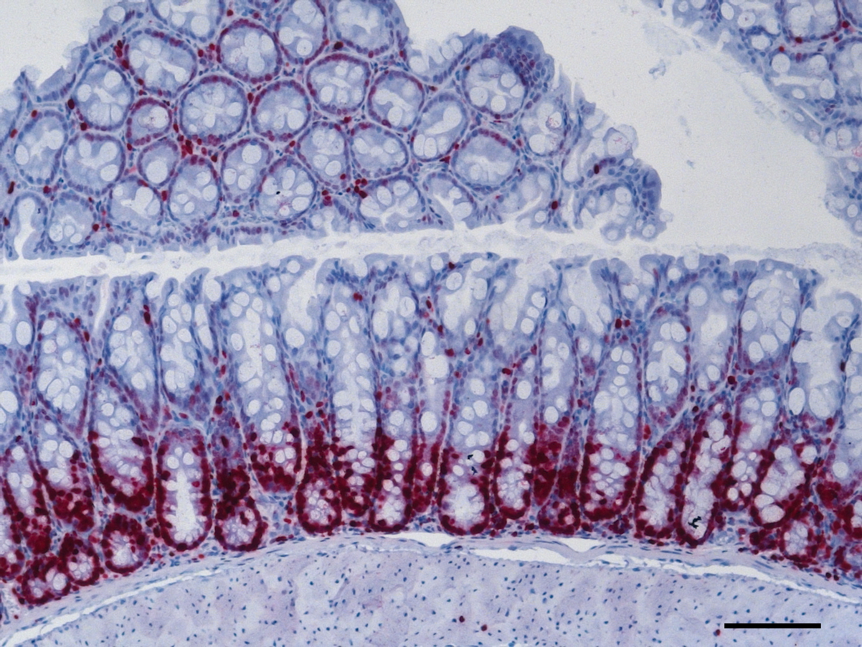
B
Proliferating Cells (COLON)
Naive
Placebo
Carvacrol
(100 x magnification, scale bar 100 μm)

Slide 3
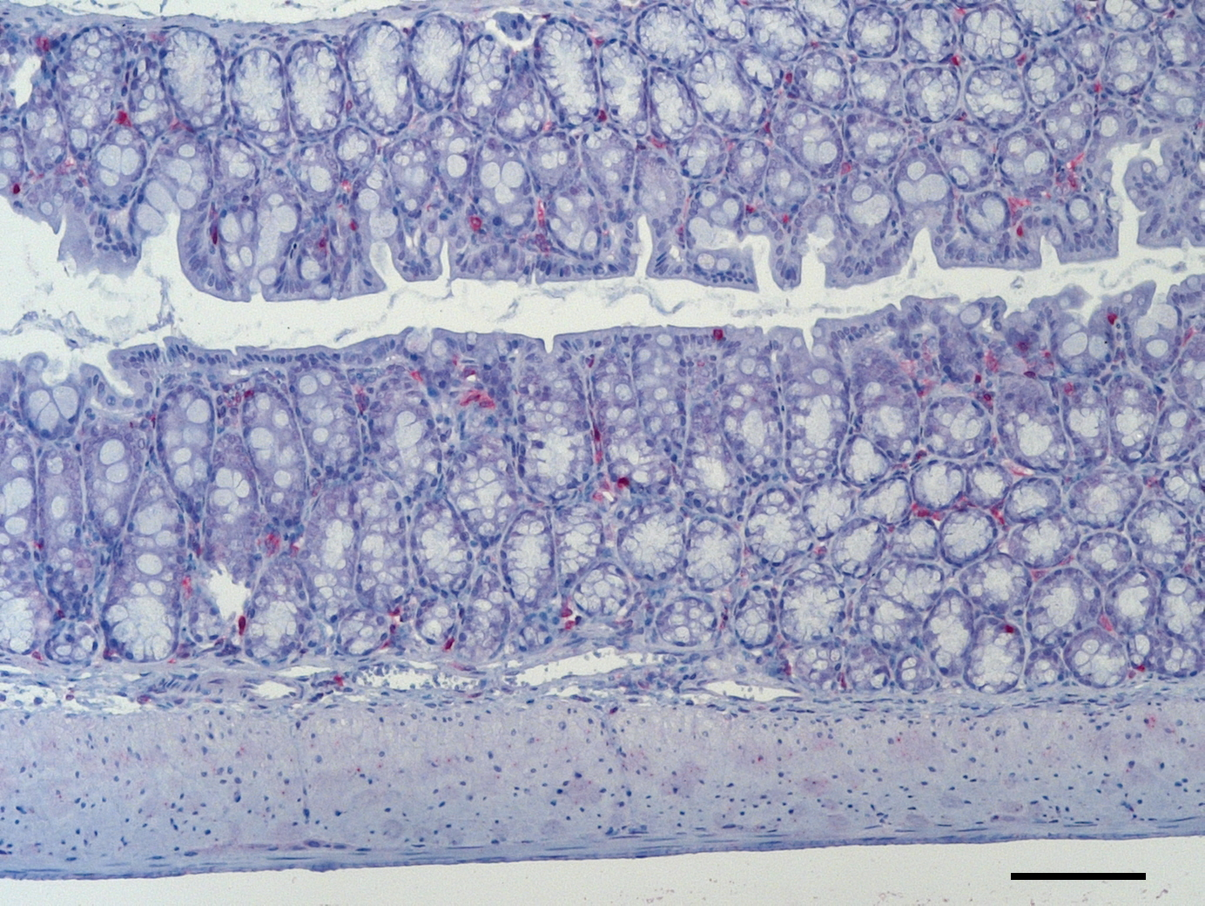
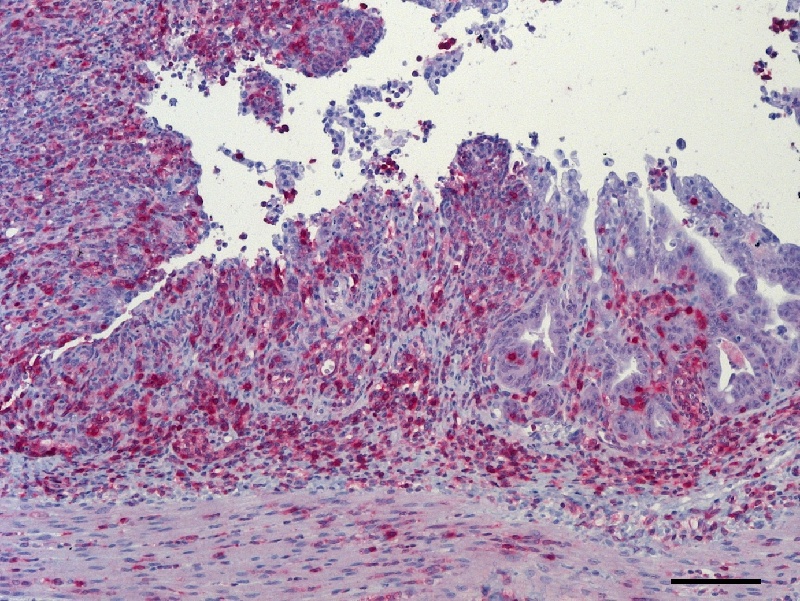
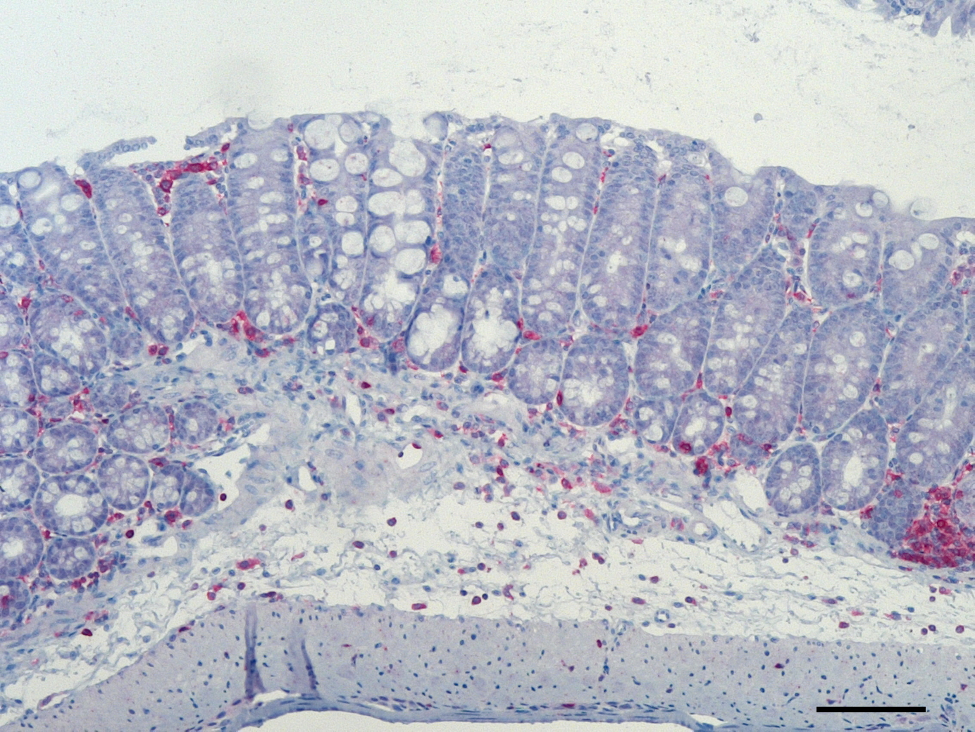
C
T Lymphocytes (COLON)
Naive
Placebo
Carvacrol
(100 x magnification, scale bar 100 μm)

Slide 4
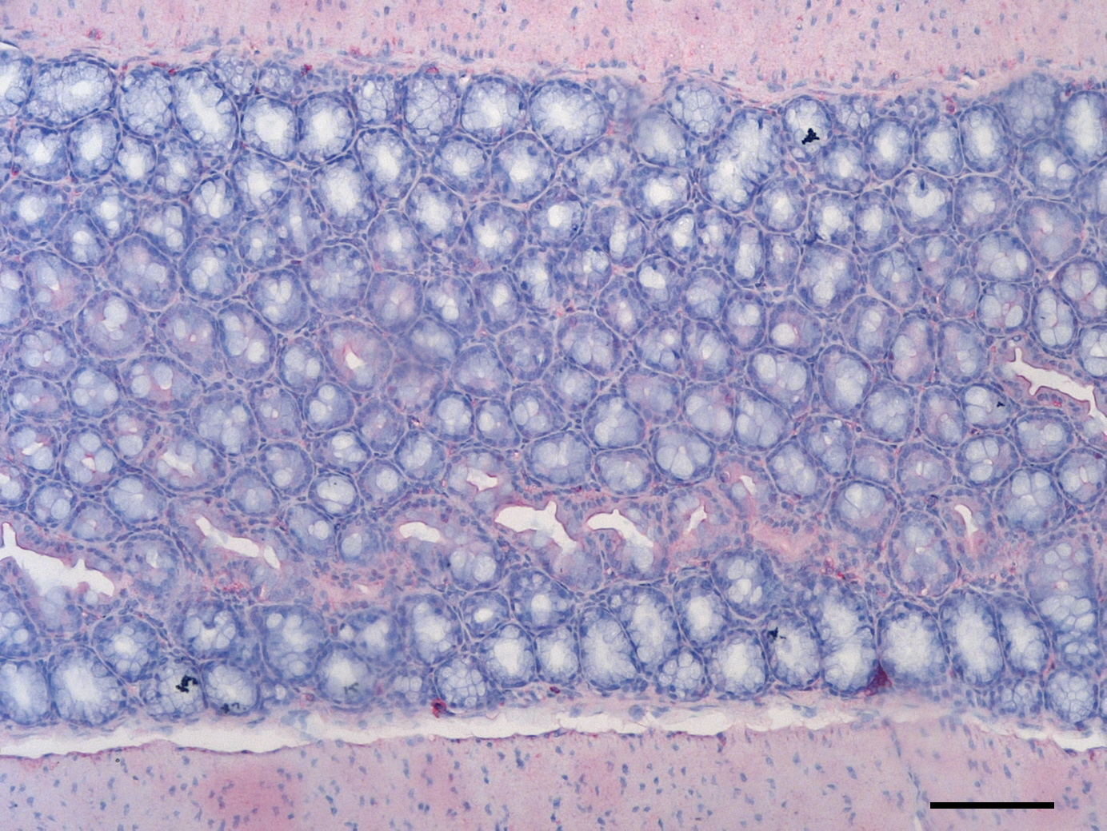
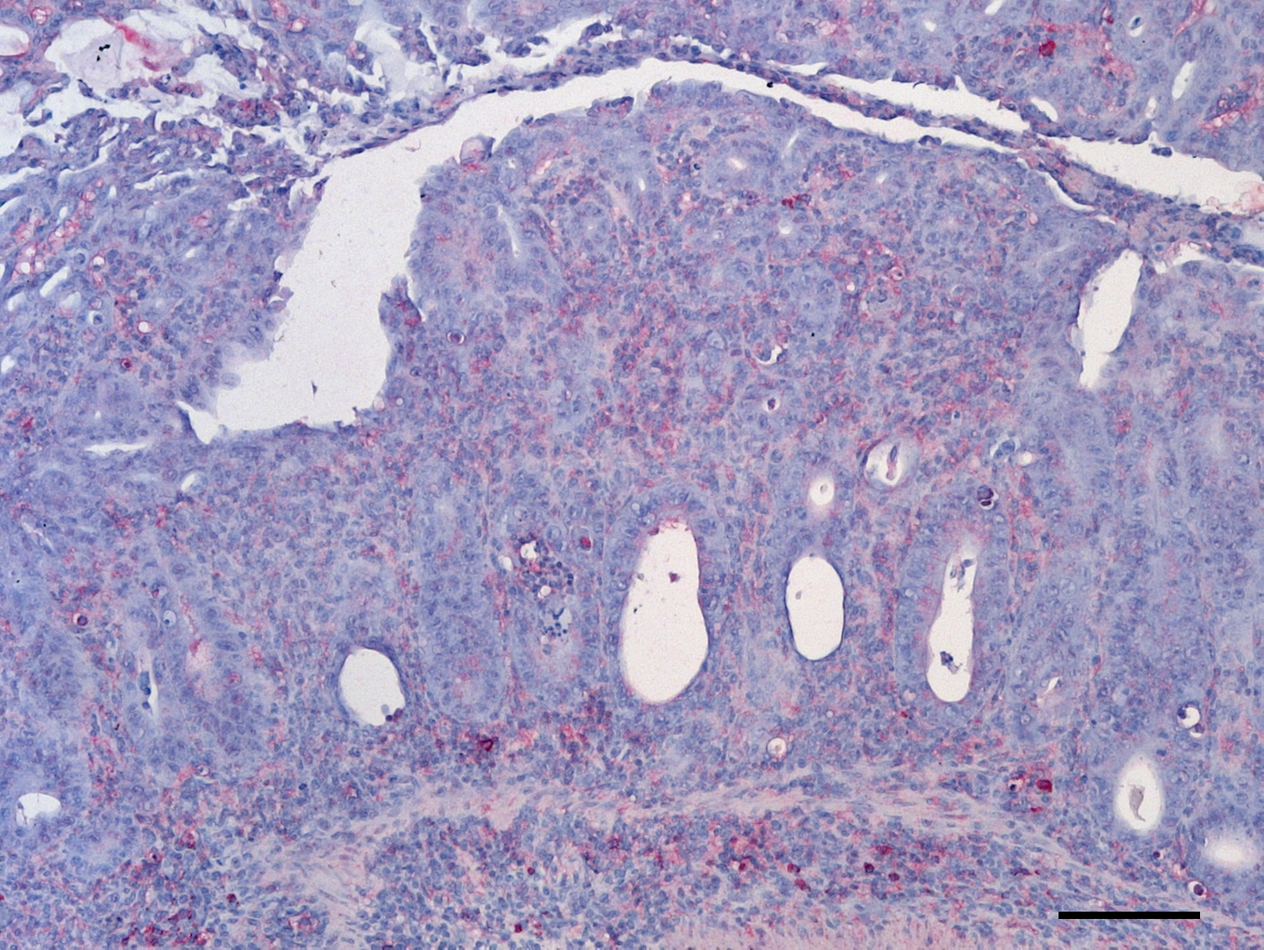
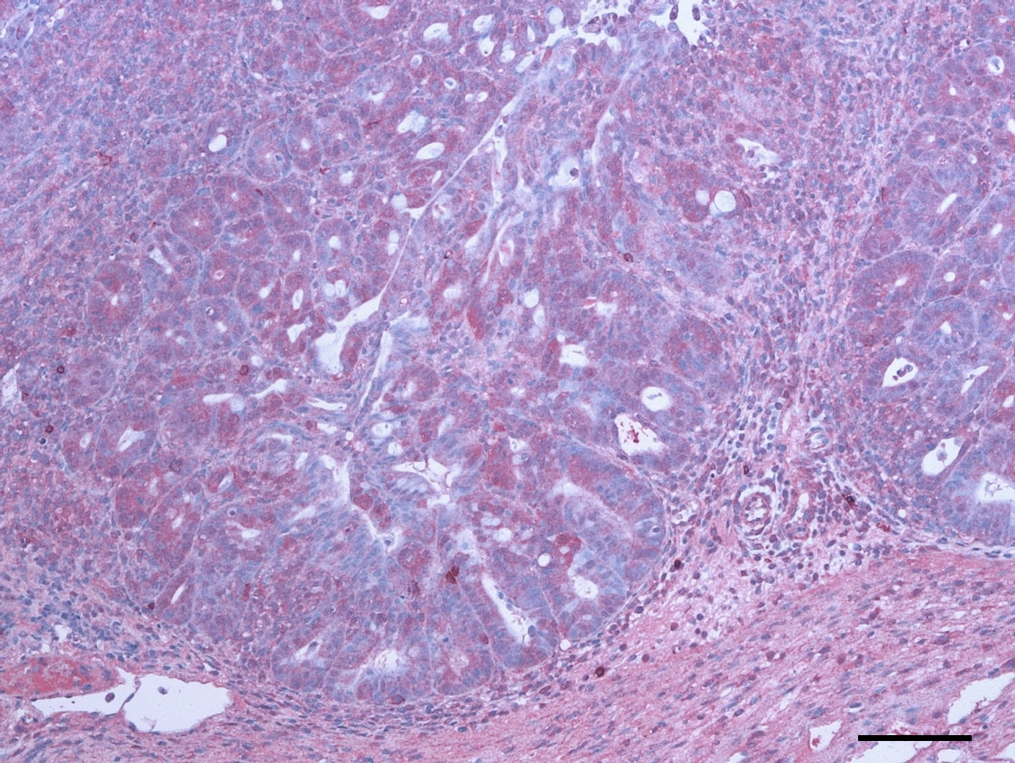
D
B Lymphocytes (COLON)
Naive
Placebo
Carvacrol
(100 x magnification, scale bar 100 μm)

