Slide 1
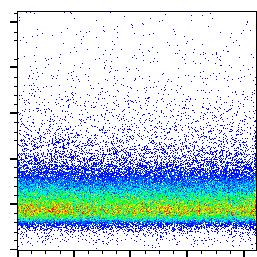
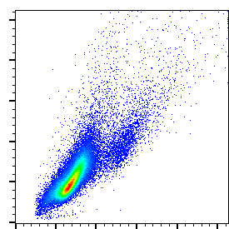
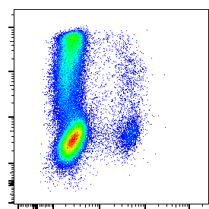
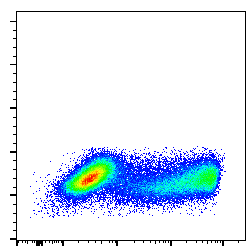
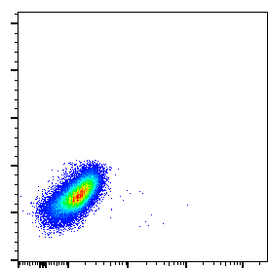
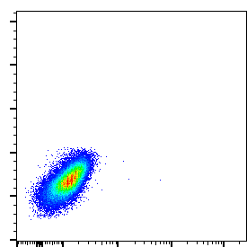
A
SSC-A
SSC-A
IL-13 mRNA
FSC-A
Time
FSC-A
VDeFluor780
IL-13 mRNA
B
Label probe control
IL-13 target probe
IL-13 transfected
0.02
33.6
FSC-A
Porcine IgE transfected
0
0.01
Alexa Fluor 647
IL-13 mRNA

