Slide 1
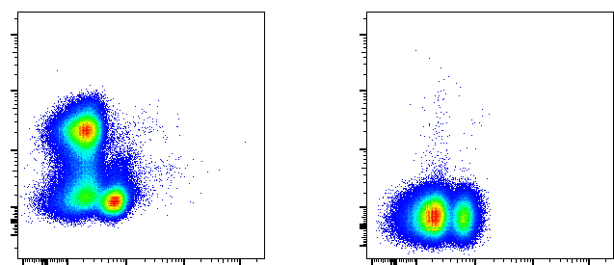
A
SSC-A
FSC-W
SSC-W
SSC-A
IFN-γ
Time
FSC-H
SSC-H
FSC-A
VDeFluor780
CD8β
IFN-γ
IFN-γ
IFN-γ
CD4
CD4
CD8β
CD4
B
SSC-A
FSC-W
SSC-W
SSC-A
IL-13
Time
FSC-H
SSC-H
FSC-A
VDeFluor780
CD8β
IL-13
CD4
CD4

