Slide 1
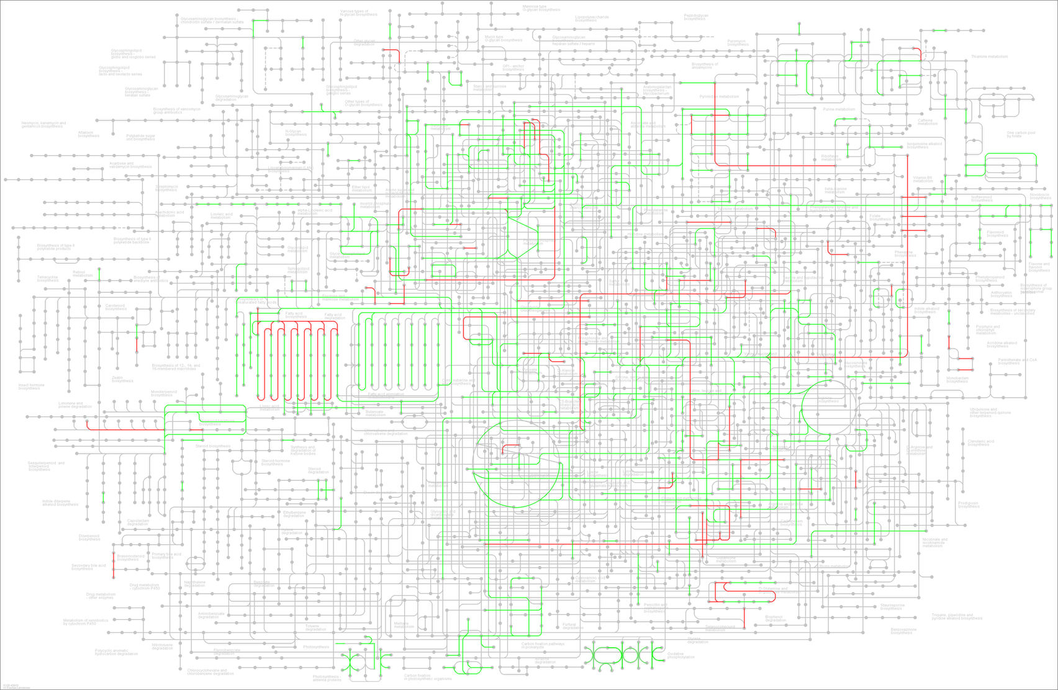
700masl Metabolic pathways
Nucleotide metabolism
Amino Acid metabolism
Lipid metabolism
Carbohydrate metabolism
Energy metabolism
Biosynthesis of other secondary metabolites
Metabolism of other Amino Acid
Additional file 7: Figure S5

