Slide 1
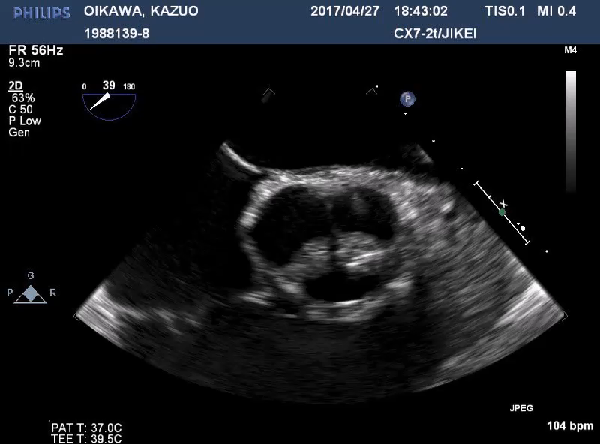
Unicuspid valve with unicommisural valve.
Eccentric orifice with commissural zone at NCC-LCC and one aortic leaflet with raphe

