Slide 1
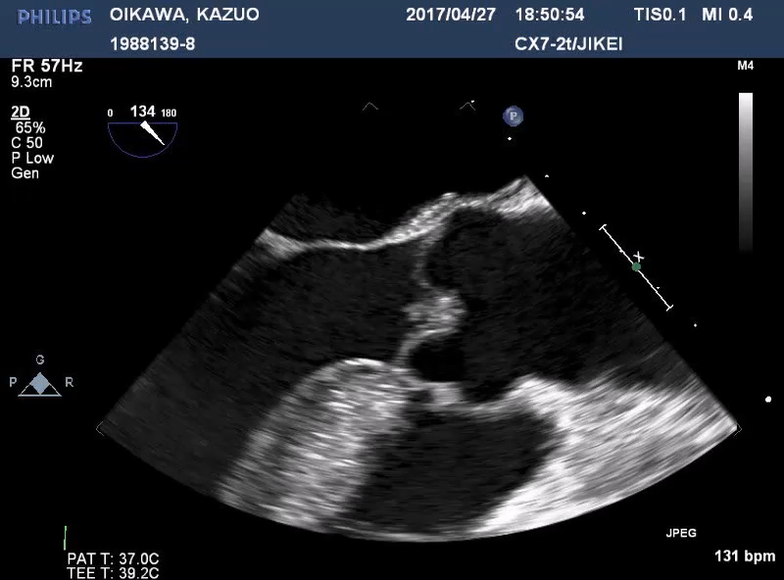
vegetation with a size of 5mm, calcified surface, border irregularity, and mobile during diastole

