Slide 1
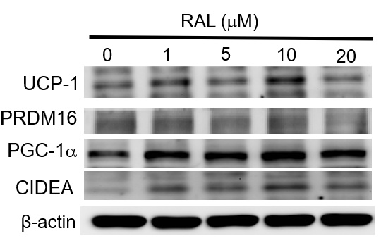
Supplemental figure.
1
2

