Slide 1
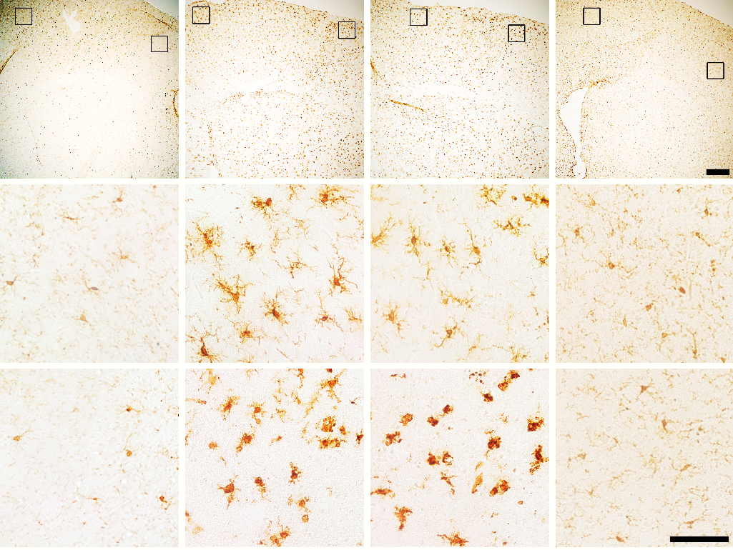
a
b
c
d
***
***
***
P
P
P
P
#
***
***
C
C
C
***
C
##
Periischemic
Periischemic
Ratio (amoeboid/ramified)
###
Periischemic
No. of Iba1⁺ cells/mm²
Soma size (µm²)
Sham
veh
shNC
shLPA₁
***
***
***
tMCAO+
***
Ischemic core
##
Ischemic core
###
Ischemic core
Sham
tMCAO+veh
tMCAO+shNC
tMCAO+shLPA₁
Sham
veh
shNC
shLPA₁
Sham
veh
shNC
shLPA₁
tMCAO+
tMCAO+

