Slide 1
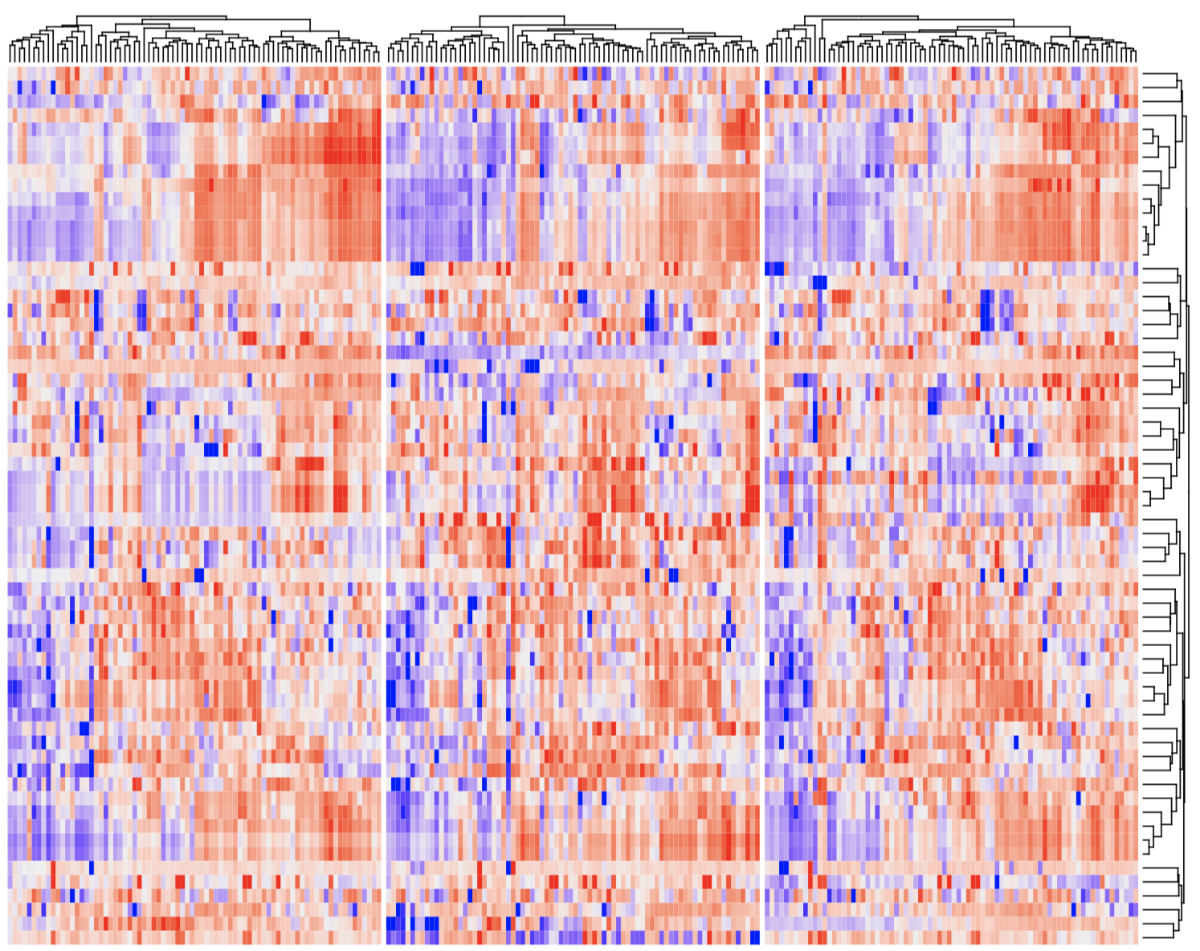
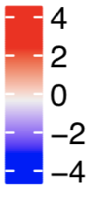
Pre-RCF
RCF
Post-RCF
Fig.S1. Heat map of clinical and nutritional readouts of the cohort before, during and after the fasting period.

Slide 2
A
G-CSF (pg/ml)
Galectin (pg/ml)
sCD14 (pg/ml)
Pre-RCF
RCF
Post-RCF
Pre-RCF
RCF
Post-RCF
Pre-RCF
RCF
Post-RCF
B
Creatinine (mg/dl)
BUN (mmol/l)
Pre-RCF
RCF
Post-RCF
Pre-RCF
RCF
Post-RCF
Fig. S2. A) Serum levels of G-CSF, Galectin, sCD14 measured by Multiplex.
B) Creatinine and BUN in plasma were measured by clinical laboratory tests.

