Slide 1
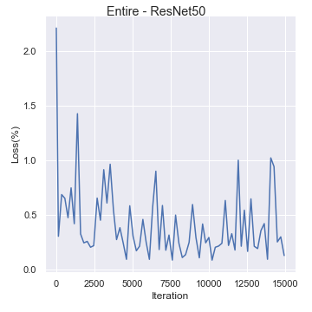
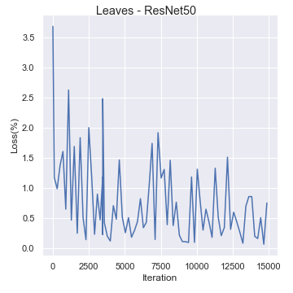
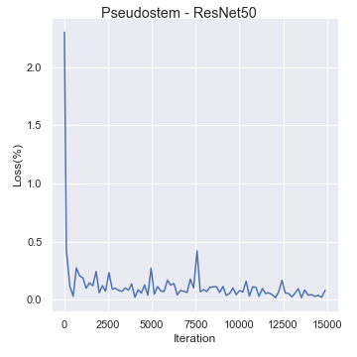
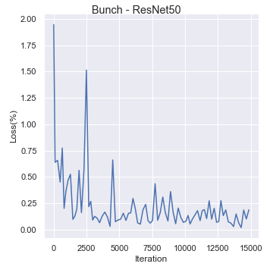
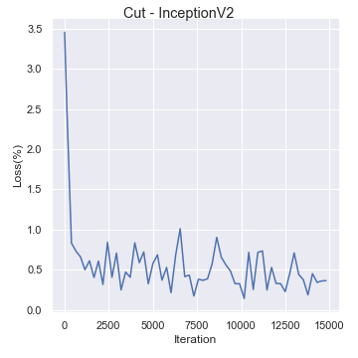
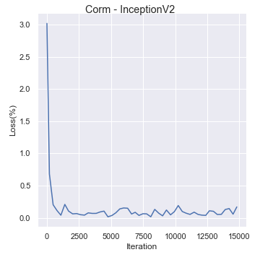
a
b
c
d
e
f
Figure S1. Loss function curve for best models. a Entire plant – ResNet, b Leaves – ResNet, c Pseudostem - ResNet, d Fruit bunch - ResNet, e Cut fruits – Inception, f Corm – Inception.

Slide 2
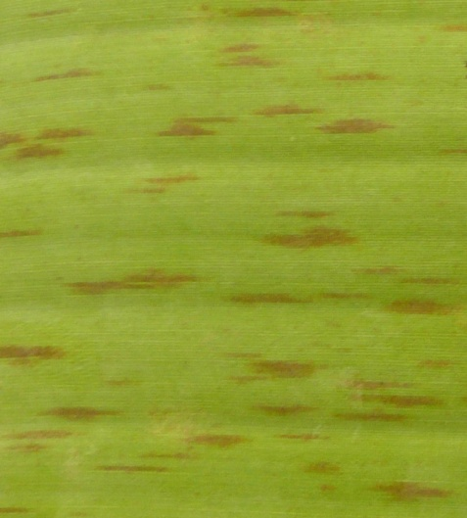
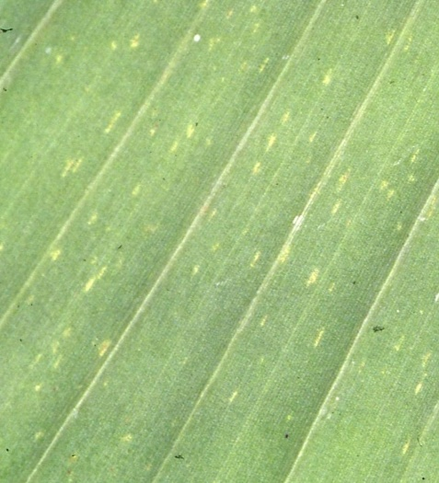
a
b
c
d
Figure S2. Early & late stage symptoms of banana leafspots. a Black sigatoka (BS) late stage, b Yellow sigatoka (YS) late stage, c Black sigatoka (BS) early stage, d Yellow sigatoka (YS) early stage

Slide 3
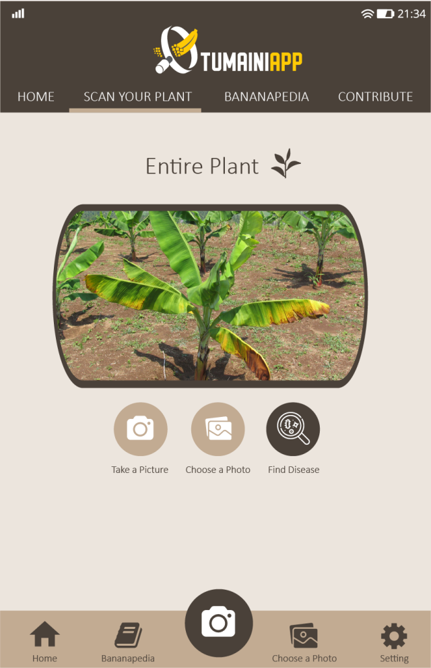
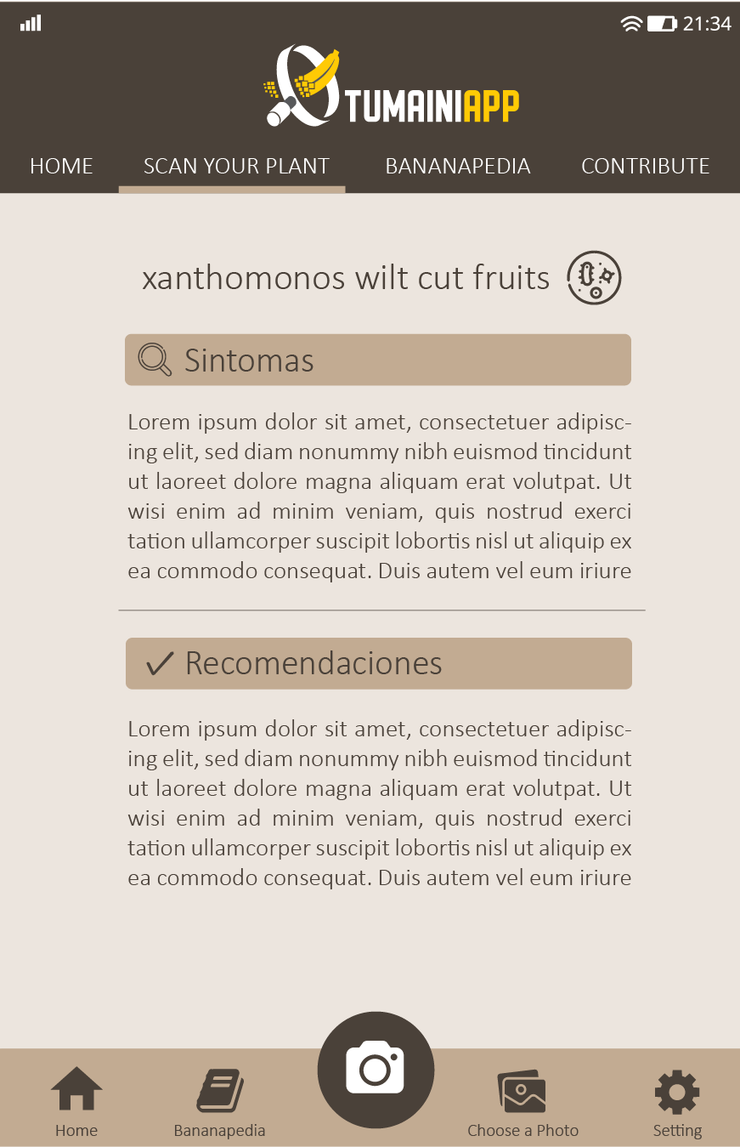
a
b
c
d
Figure S3. Developed mobile application for Banana disease and pest detection. a Initial screen, b Image taking and Scan, c Diagnostic screen, d Recommendations and management.

