Slide 1
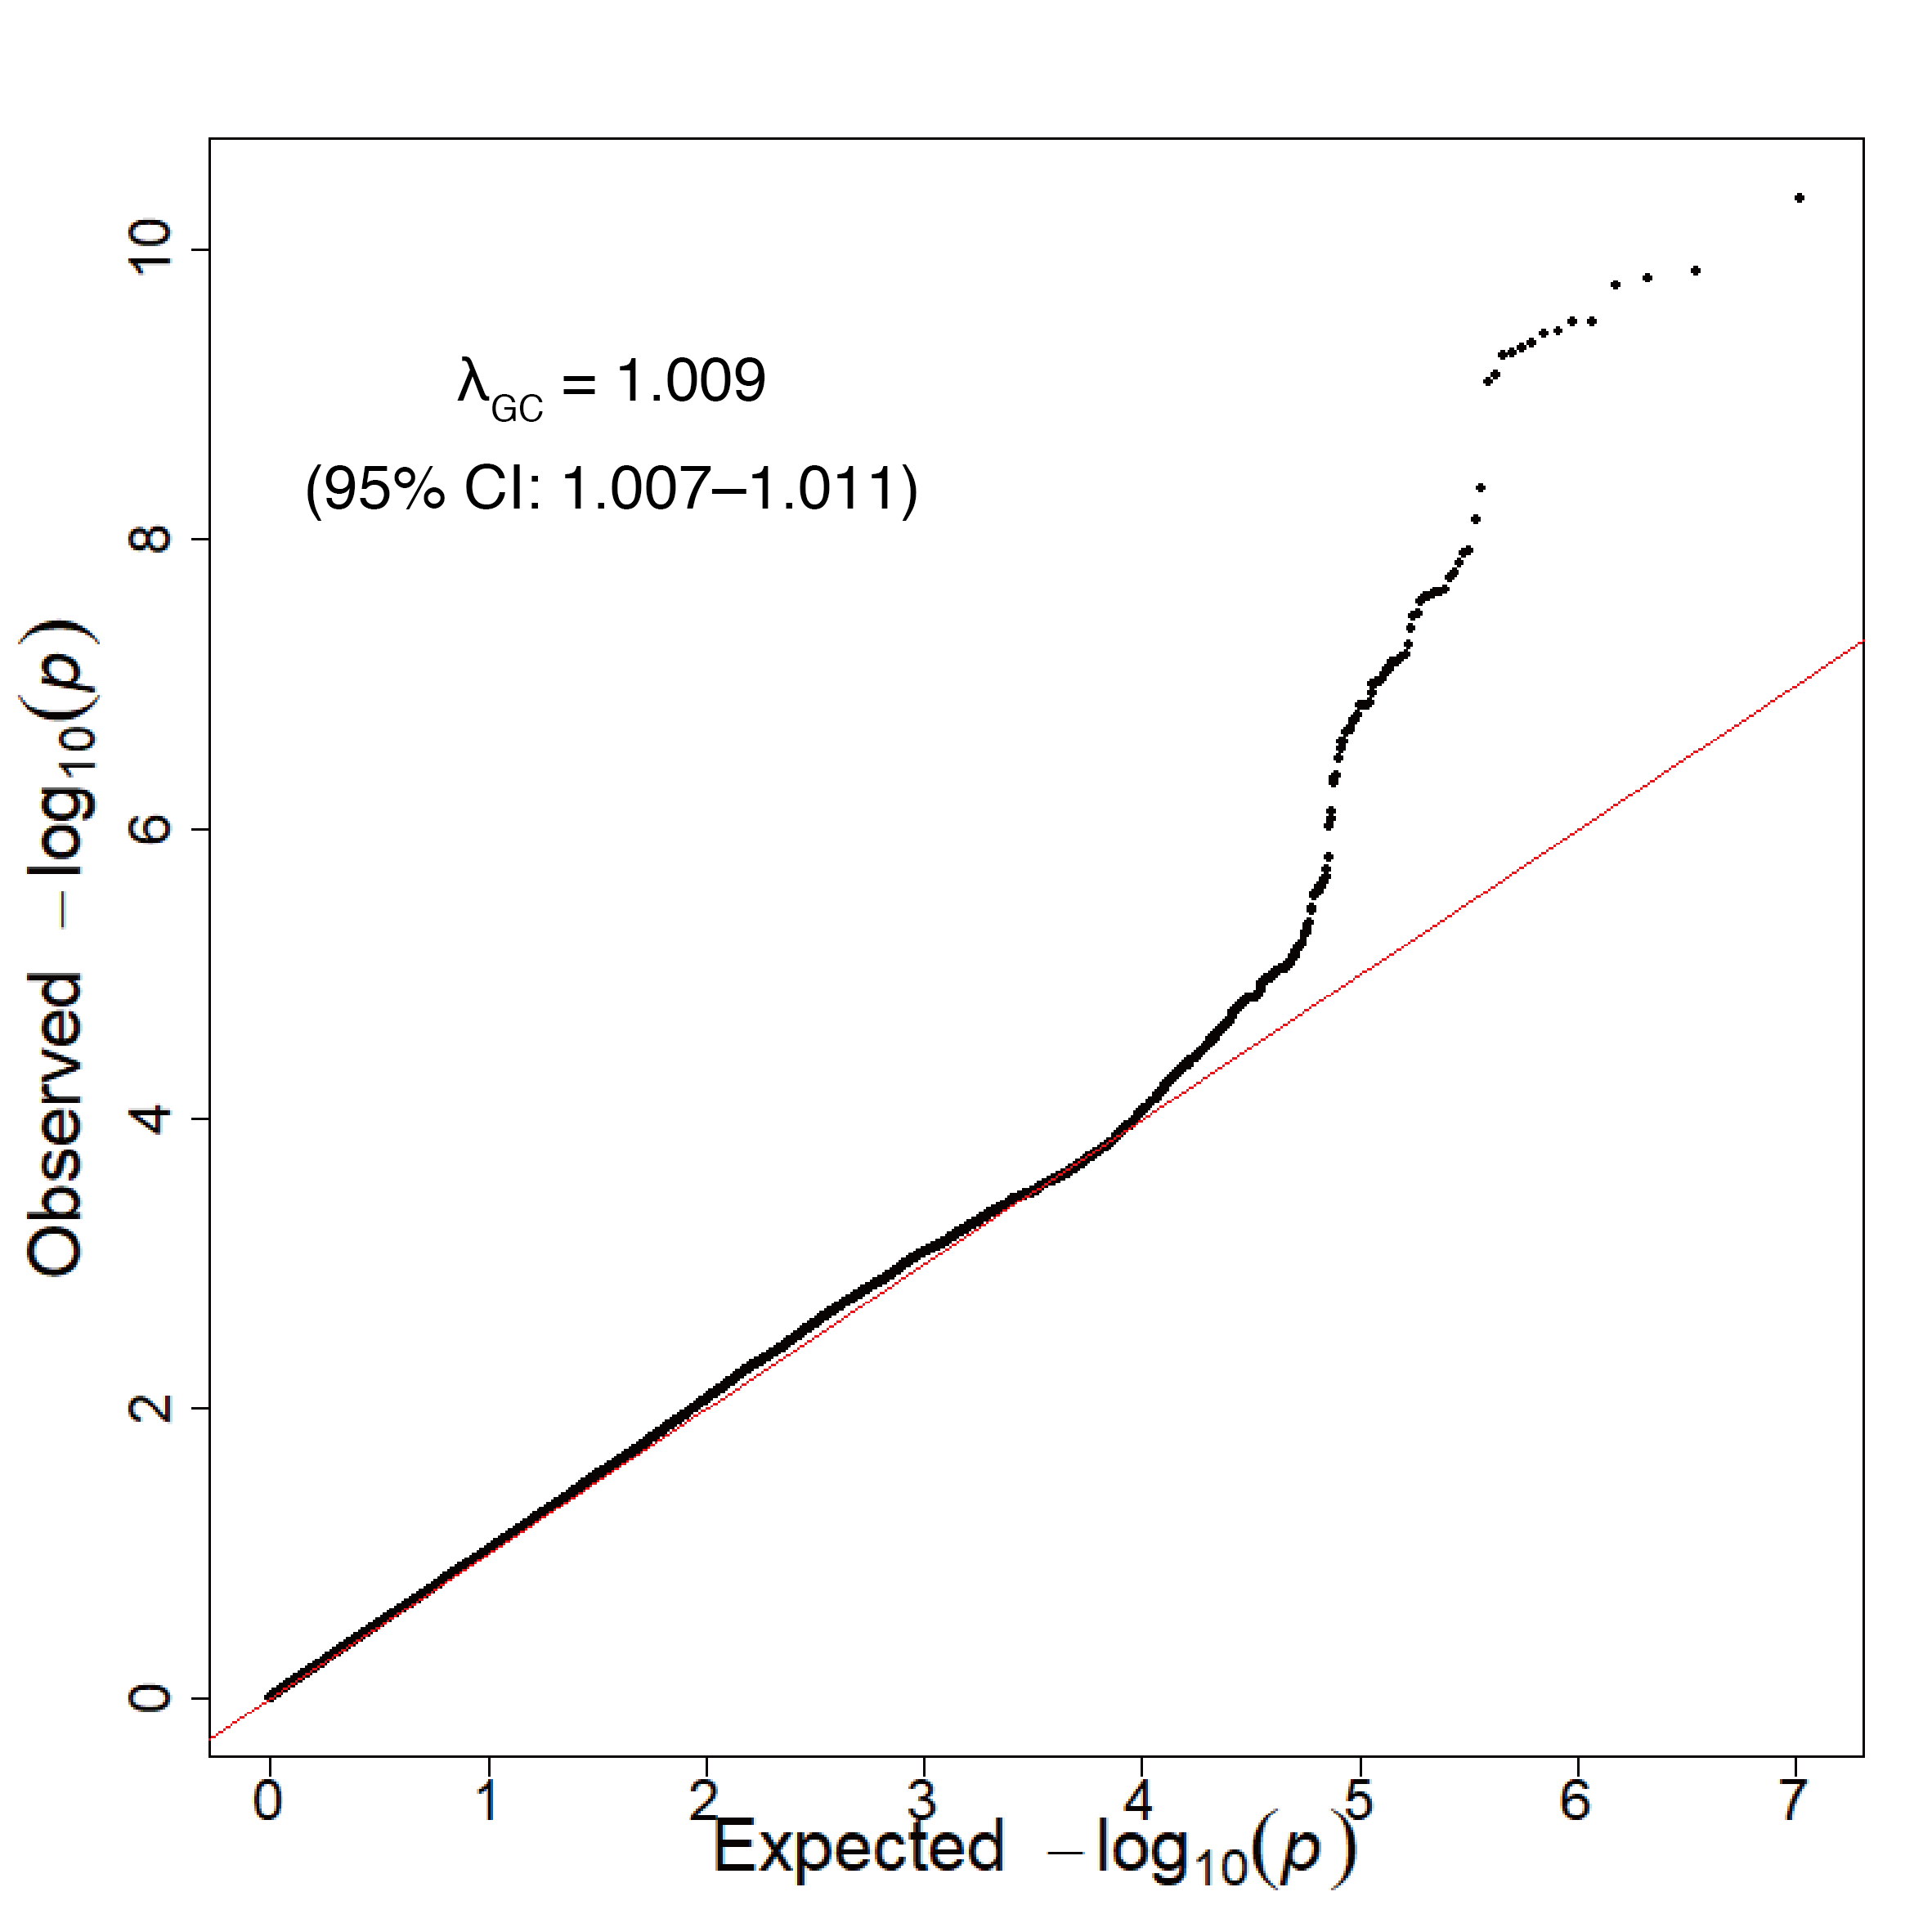
Figure S1. Quantile-quantile plot for the genome-wide analysis of coffee consumption
CI, confidence interval.

Slide 2
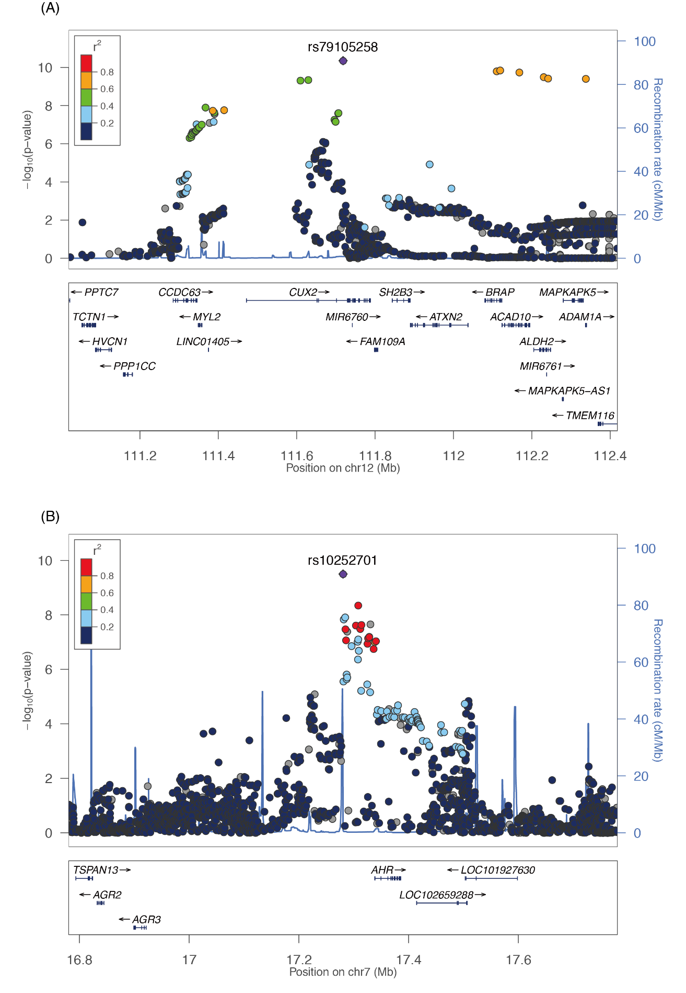
Figure S2. The genomic regional plot from the association analysis of coffee consumption. (a): The region on 12q24 around the most significant SNP, rs79105258. (b): The region on 7p21 around rs10252701. The y-axis represents the negative logarithm of the association P-values, and the x-axis shows the chromosomal position. Each dot represents a variant, and the colors of the dots represent the extent of linkage disequilibrium with the top SNP, which is colored purple. Genes in the region below the x-axis are annotated as the genes near the significant SNPs.

Slide 3
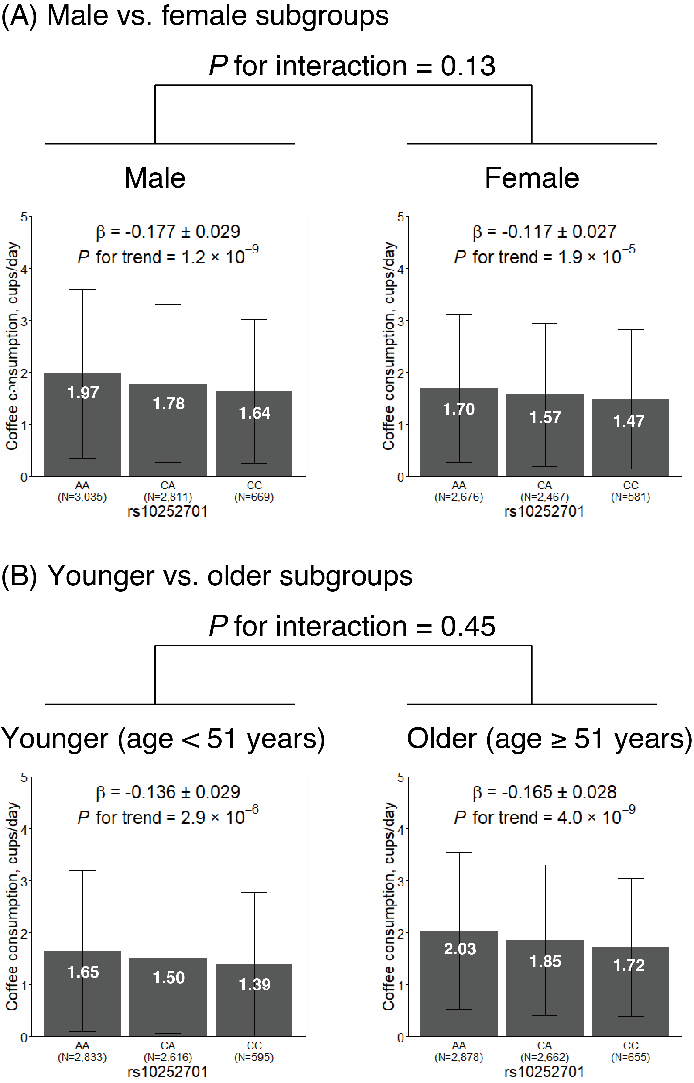
Figure S3 Effects of a 7p21 variant on habitual coffee consumption stratified by sex and age

Slide 4
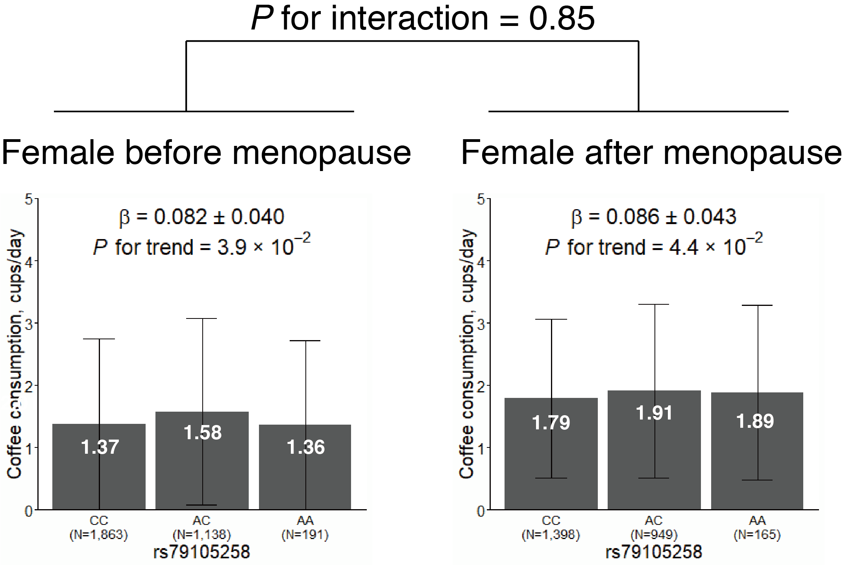
Figure S4. Genetic effect of the 12q24 locus in females before and after menopause

