Slide 1
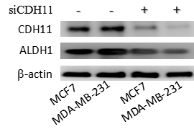
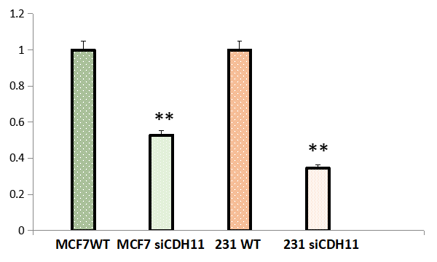
A
B
Relative ALDH1 expression
Suppl. Fig. 1

