Slide 1
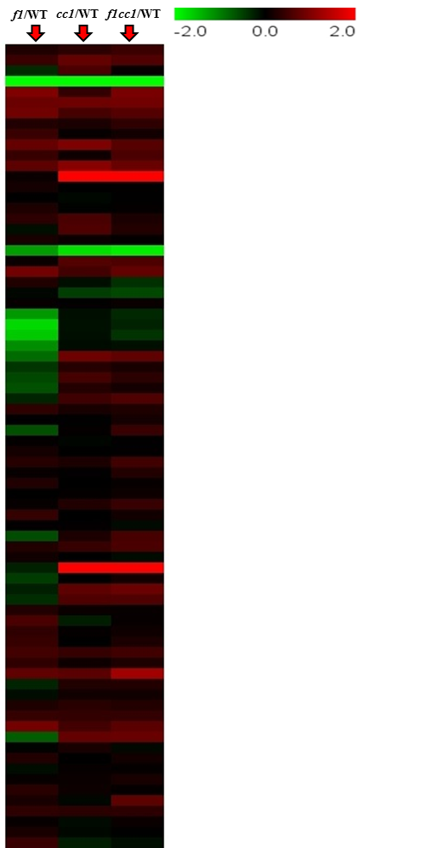
Amino acids
alanine
aspartic acid
glutamic acid
phenylalanine
serine
threonine
valine
2-hydroxy-2-propenoic acid
3-hydroxypropanoic acid
aconitic acid
a-keto-glutaric acid
citric acid
ferulic acid
fumaric acid
glyceric acid
glycolic acid
lactic acid
maleic acid
malic acid
shikimic acid
sinapic acid
sinapoyl-malic acid
succinic acid
threonic acid
threono-1,4-lactone
3,6-anhydro-galactose
fructose
galactose
glucose
raffinose
sucrose
galactinol
galactosylglycerol
myo-inositol
myo-inositol-2-P
ethanolamine
adenosine
palmitic acid
tetracosanoic acid
a-linolenic acid
linoleic acid
1-hexacosanol
2-hydroxy-adipic acid
2-oxo-adipic acid
azelaic acid
stearic acid
22.62 487 kaemferol conj.
kaempferol
15.39 411 glycoside
16.25 398 383 glucoside
2,5-dihydroxybenzoic acid-5-O-glucoside
syringic acid-4-O-glucoside
vanillic acid-4-O-glucoside
B-sitosterol
campesterol
stigmasterol
phytol
1,2,4-benzenetriol
15-nonacosanone
guaiacyl lignan
2,3-diphosphoglycerol
2-hydroxyglutaric acid
4-hydroxybenzoic acid
5-oxo-proline
a-tocopherol
digalactosylglycerol
erythronic acid
ethyl phosphate
gamma-tocopherol
glycerol
glycerol-1/3-P
monopalmitin
monostearin
phosphate
p-toluic acid
stigmastanol
Additional file 5: Fig. S3. The heatmap of log2 ratio of metabolites from 6-week-old stem of fpgs1, ccoaomt1 and fpgs1ccoaomt1 compared with WT. More than 100 peaks were detected in WT, fpgs1, ccoaomt1 and fpgs1ccoaomt1, and 77 were assigned to known chemical structures. The identified compounds were arranged based on their categories, and their relative level changes in fpgs1, ccoaomt1 and fpgs1ccoaomt1 compared to WT were visualized as a heatmap by software MeV. Compound 2-O-feruloyl-malic acid was not detected in WT and fpgs1, so it is not shown on the heatmap. Abbreviations: f1- fpgs1, cc1- ccoaomt1, f1cc1 - fpgs1ccoaomt1. Number positioned in front of tentatively identified metabolites are the retention time (RT; min) and key mass-to-charge (m/z) ratios.
Organic Acids
Sugars
Sugar alcohols
Amine
Nucleotide
Fatty acid
Flavonoid
sterols
Fatty alcohol
Others

