Slide 1
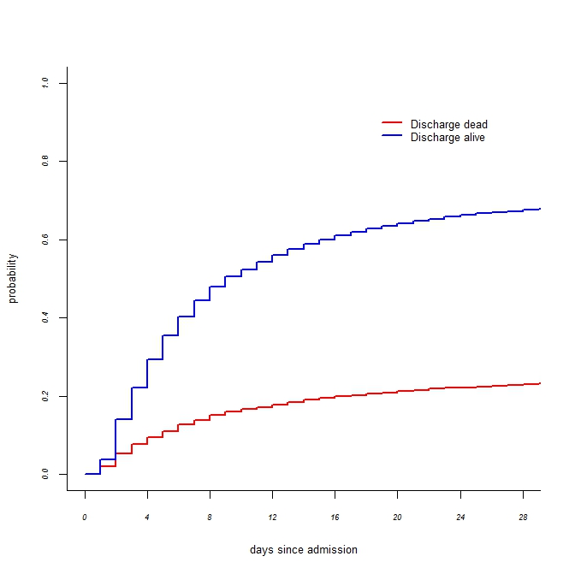
Additional Fig. 2

