Slide 1
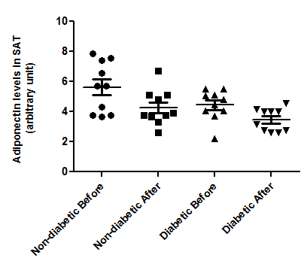
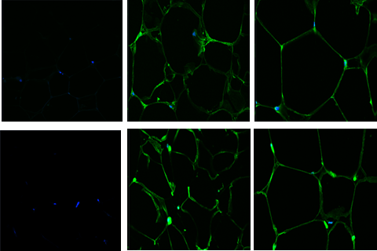
Non-Specific IgG
Adiponectin IgG
Before Exercise
After Exercise
Non- Diabetic
Diabetic
Figure S2

