Slide 1
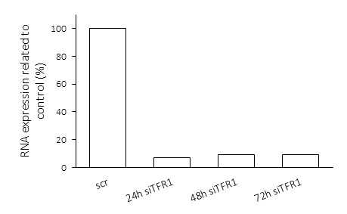
Additional file 2: Figure S2
a)
b)
Count
Count
Log fluorescence intensity
Log fluorescence intensity
Srambled siRNA / Igg-PE
24h siTFR1 / Igg-PE
Scrambled siRNA / antiCD71-PE
48h siTFR1 / Igg-PE
72h siTFR1 / Igg-PE

