Slide 1
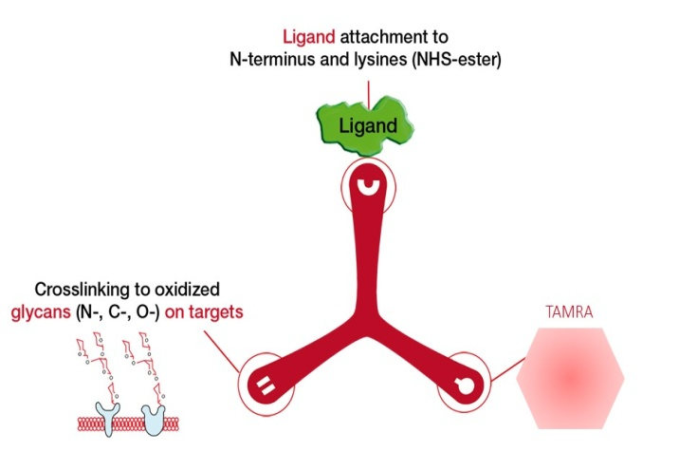
Additional file 1: Figure S1
a)
TriCEPS v.2.0
HATRIC
TriCEPS-TAMRA
b)
Oxidized MDA-MB-231 cells
Non-oxidized MDA-MB-231 cells
Count
Count
Log fluorescence intensity
Log fluorescence intensity
Cells / PE Streptavidin
Gly-TriCEPS-PE
TRFE-TriCEPS-PE
Cells / PE Streptavidin
Gly-TriCEPS-PE
TRFE-TriCEPS-PE

