Slide 1
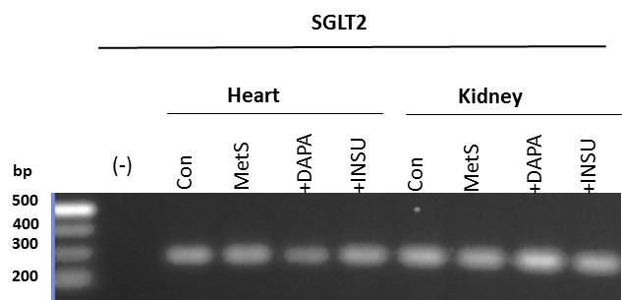
A
B
Additional file 1: Figure S1

