Slide 1
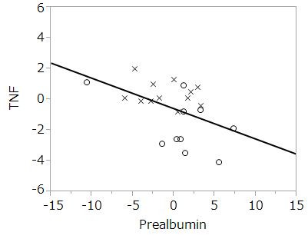
Additional file 3
n=22

