Slide 1
No. of Genes
No. of Genes
A-subgenome (179 genes)
D-subgenome (219 genes)
No. of Genes
Scaffolds (145 genes)
Notes:
Supplemental Figure 1 GhLRR-RLKs Chromosomal distribution
Distribution of G. hirsutum LRR-RLK genes on each chromosomes of the A- and D-subgenome, and on scaffolds.

Slide 2
A
Subclade I
Subclade II
Notes:
Supplemental Figure 2. Exon-intron analysis of G. hirsutum LRR-RLK genes
(A-I) Exon-intron architecture of G. hirsutum LRR-RLK genes. Red arrows represent exons whereas introns are represented with black lines.

Slide 3
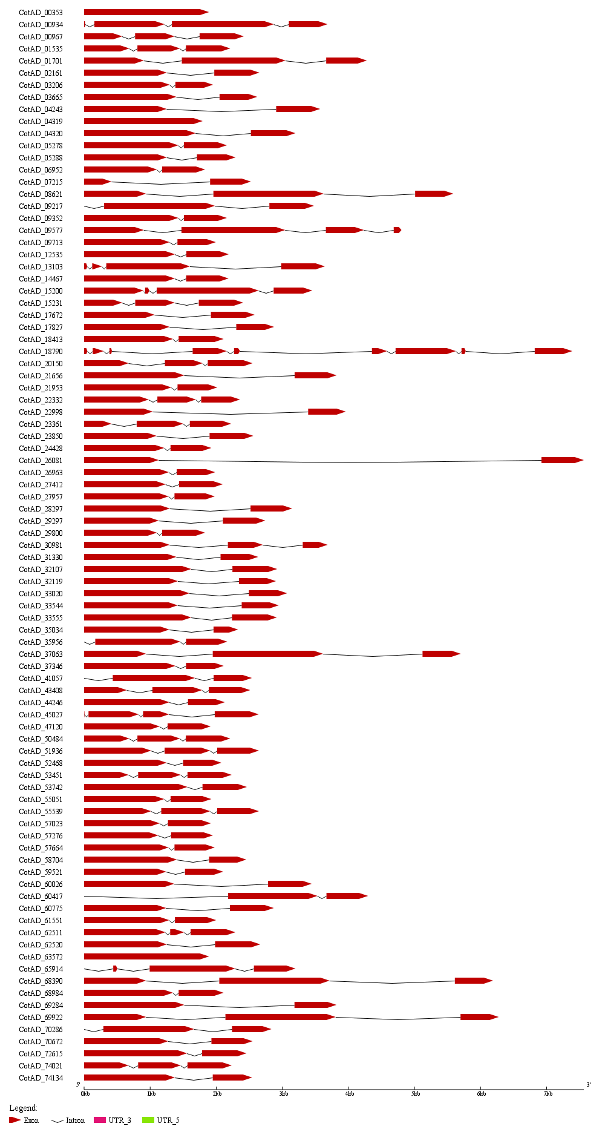
B
Subclade III
Notes:
Supplemental Figure 2(B)

Slide 4
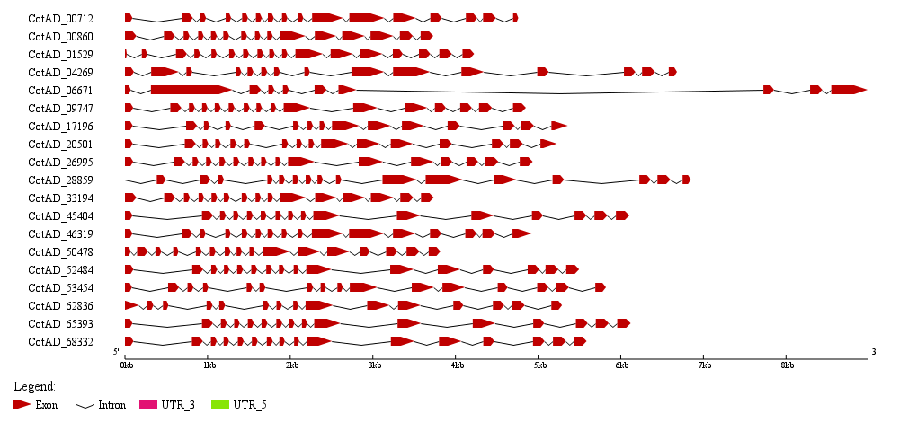
C
Subclade IV-1
Subclade IV-2
Subclade V
Notes:
Supplemental Figure 2(C)

Slide 5
D
Subclade VI-1
Subclade VI-2
Subclade VII
Notes:
Supplemental Figure 2(D)

Slide 6
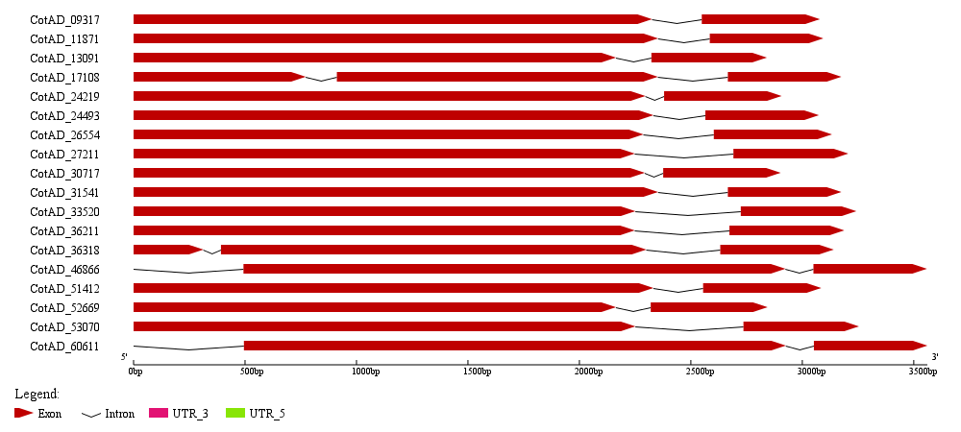
E
Subclade VIII-1
Subclade VIII-2
Subclade IX
Notes:
Supplemental Figure 2(E)

Slide 7
F
Subclade X-1
Subclade X-2
Subclade X-3
Subclade X-4
Notes:
Supplemental Figure 2(F)

Slide 8
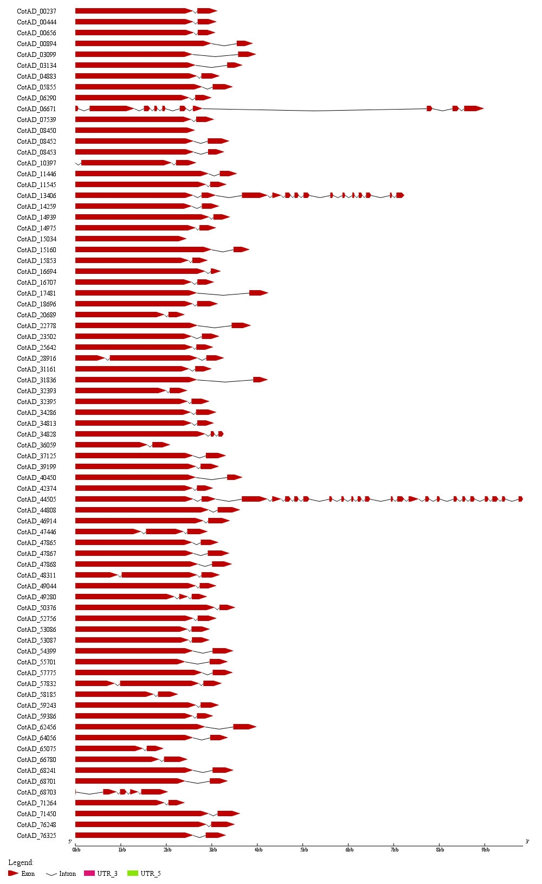
G
Subclade XI-2
Subclade XI-3
Subclade XI-4
Subclade XI-1
Notes:
Supplemental Figure 2(G)

Slide 9
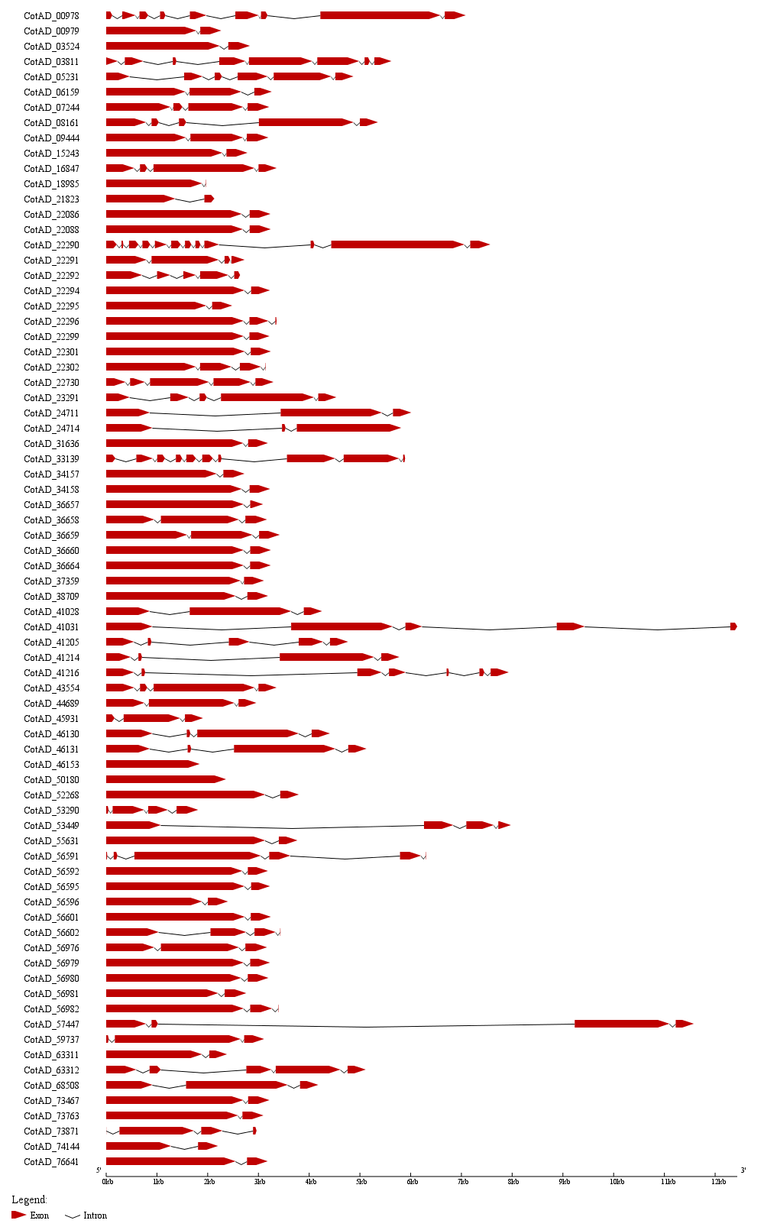
H
Subclade XII-2
Subclade XII-1
Notes:
Supplemental Figure 2(H)

Slide 10
I
Subclade XIII
Outgroup
Notes:
Supplemental Figure 2(I)

Slide 11
Notes:
Supplemental Figure 3 Protein size distribution analysis of GhLRR-RLK

Slide 12
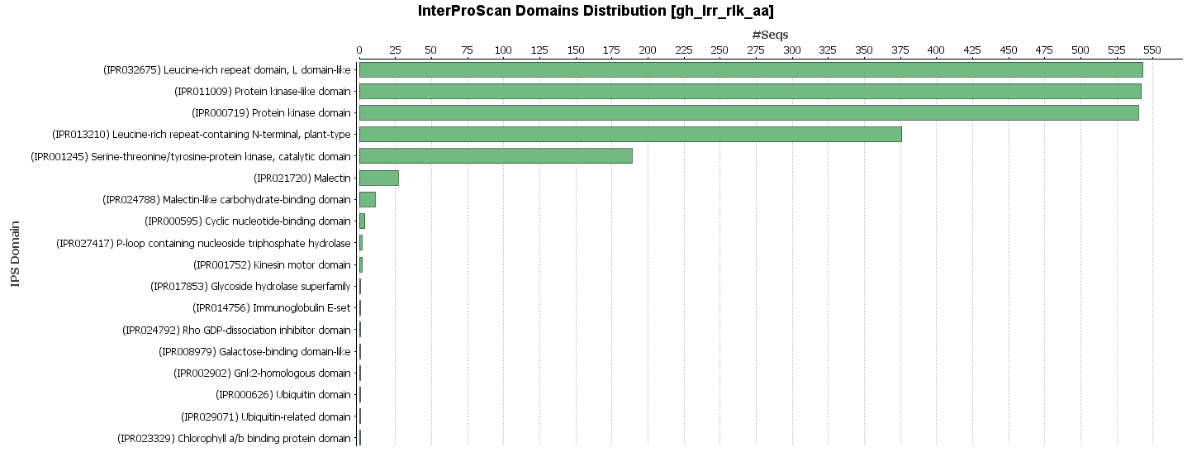
LRR_1
LRRNT_2
LRR_3
LRR_4
LRR_5
LRR_6
LRR_8
LRR_9
Malectin
SIFA
Notes:
Supplemental Figure 4 InterProScan domains distribution of G. hirsutum LRR-RLKs
Analysis were conducted with 543 G. hirsutum LRR-RLK protein sequences. The domain identification were conducted with Blast2GO software.

Slide 13
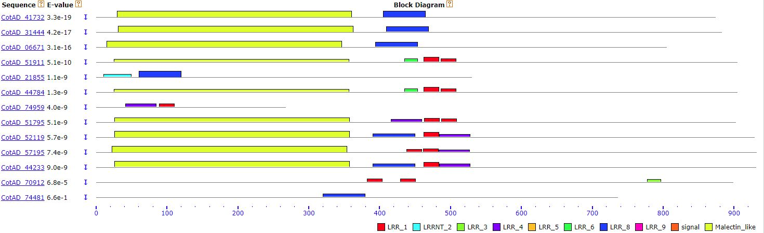
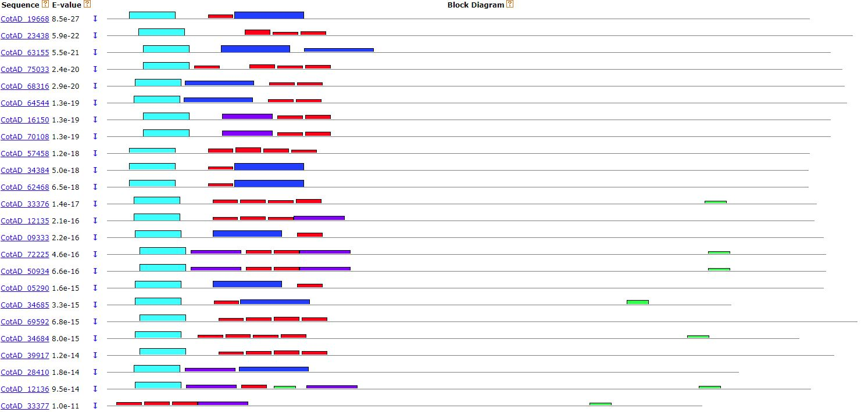
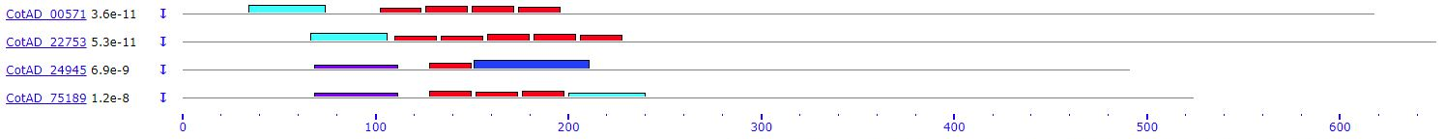
A
Subclade I
Subclade II
LRR_1
LRRNT_2
LRR_3
LRR_4
LRR_5
LRR_6
LRR_8
LRR_9
Malectin
Notes:
Supplemental Figure 5 Protein structure of G. hirsutum LRR-RLKs
Protein structure analysis were conducted on the extracellular part of G. hirsutum LRR-RLK protein sequences with highly conserved LRR clade domains, Malectin domain, and SIFA domain as reference motifs. Boxes with different colors represent different motifs.

Slide 14
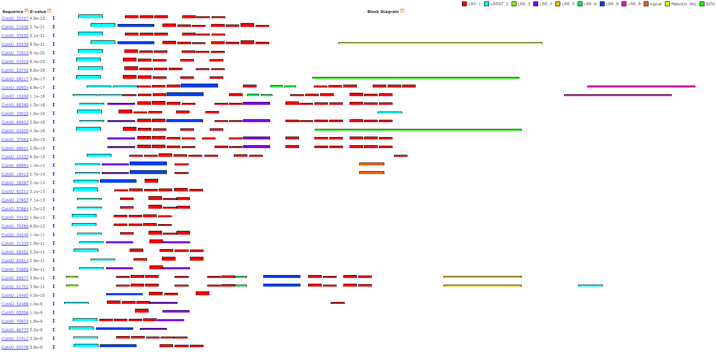
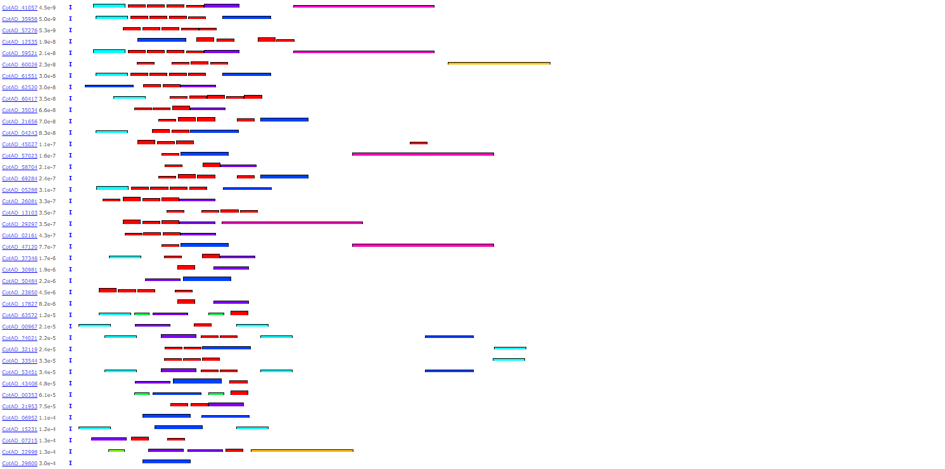
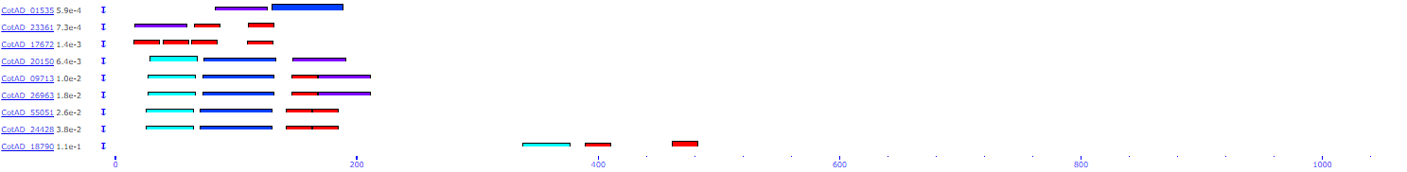
B
Subclade III
LRR_1
LRRNT_2
LRR_3
LRR_4
LRR_5
LRR_6
LRR_8
LRR_9
Malectin
SIFA
Notes:
Supplemental Figure 5(B)

Slide 15
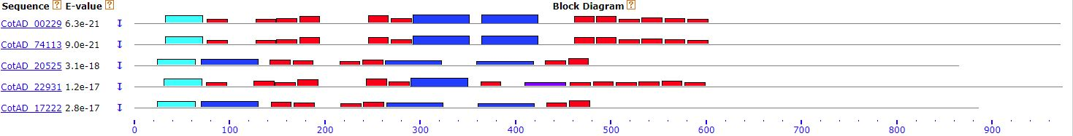
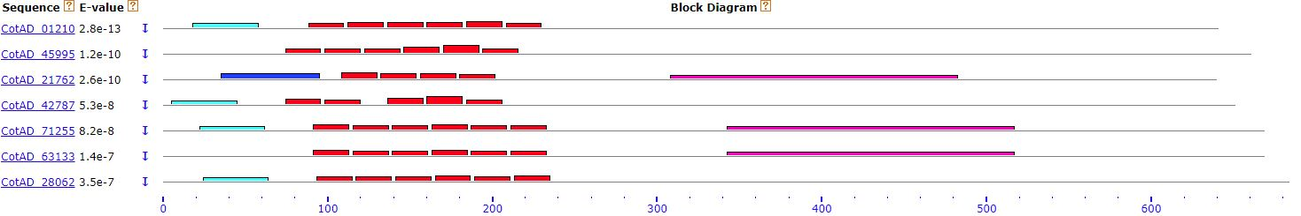
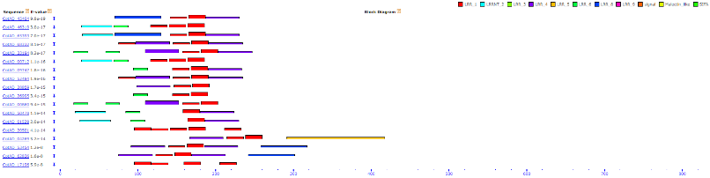
C
Subclade IV-1
Subclade IV-2
Subclade V
LRR_1
LRRNT_2
LRR_3
LRR_4
LRR_5
LRR_6
LRR_8
LRR_9
Malectin
Notes:
Supplemental Figure 5(C)

Slide 16
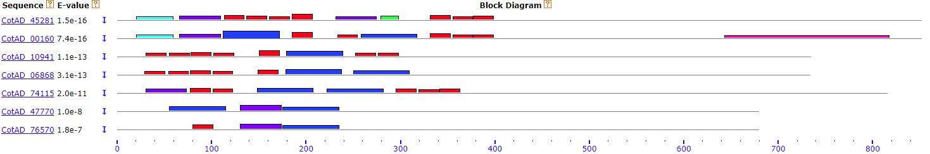
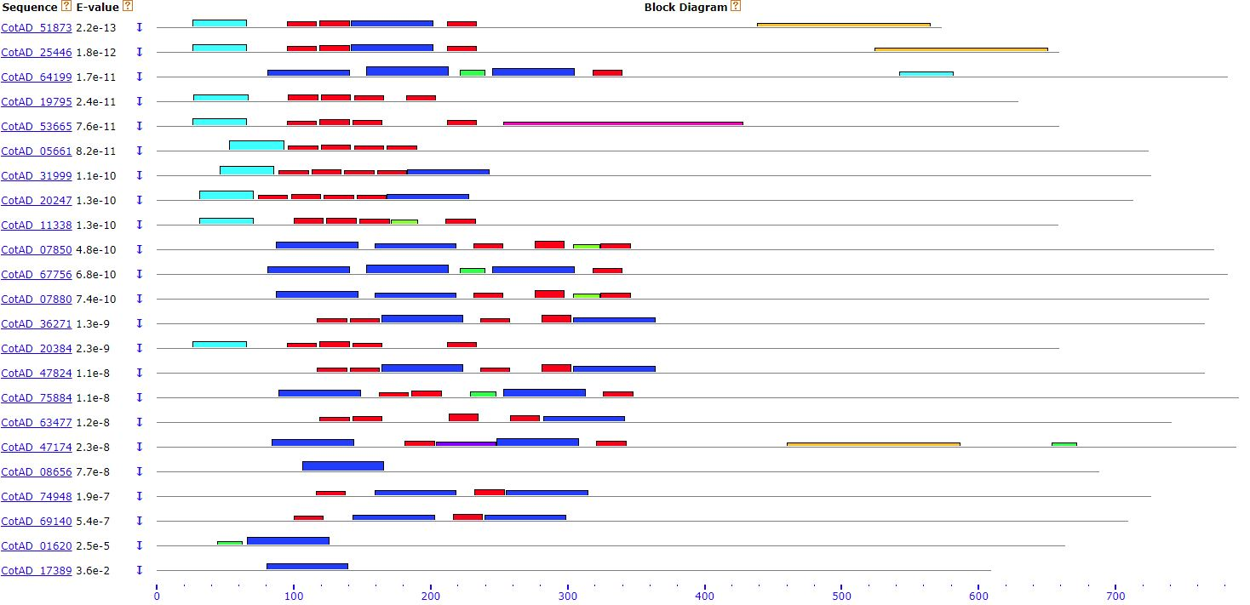
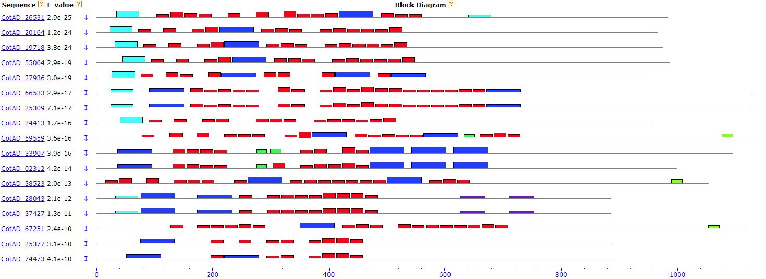
D
Subclade VI-1
Subclade VI-2
Subclade VII
LRR_1
LRRNT_2
LRR_3
LRR_4
LRR_5
LRR_6
LRR_8
LRR_9
Malectin
Notes:
Supplemental Figure 5(D)

Slide 17
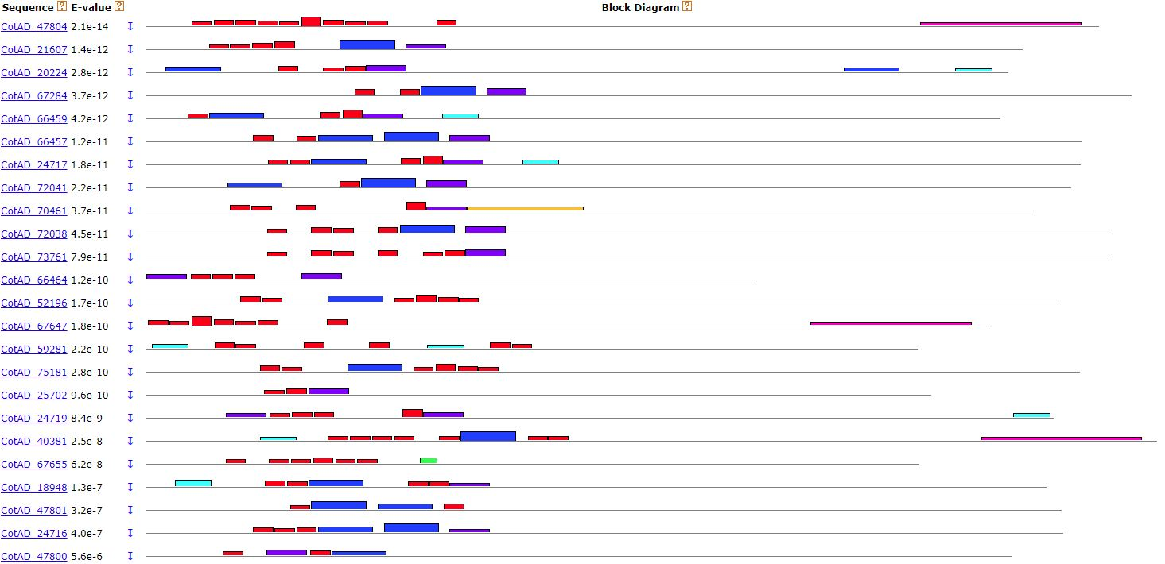
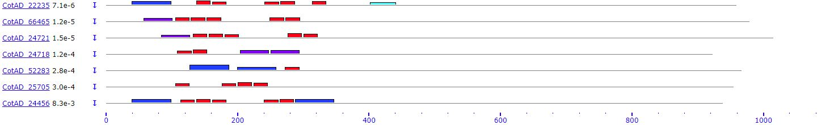
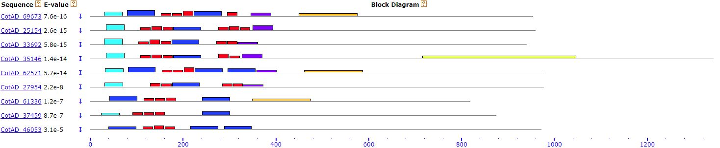
E
Subclade VIII-1
Subclade VIII-2
LRR_1
LRRNT_2
LRR_3
LRR_4
LRR_5
LRR_6
LRR_8
LRR_9
Malectin
Notes:
Supplemental Figure 5(E)

Slide 18
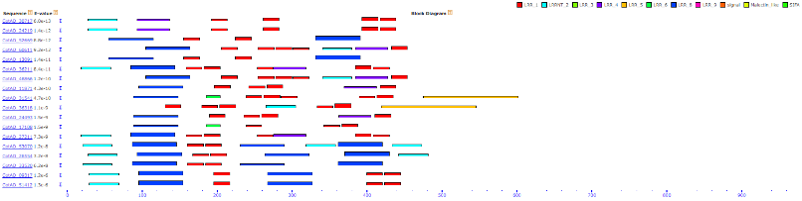
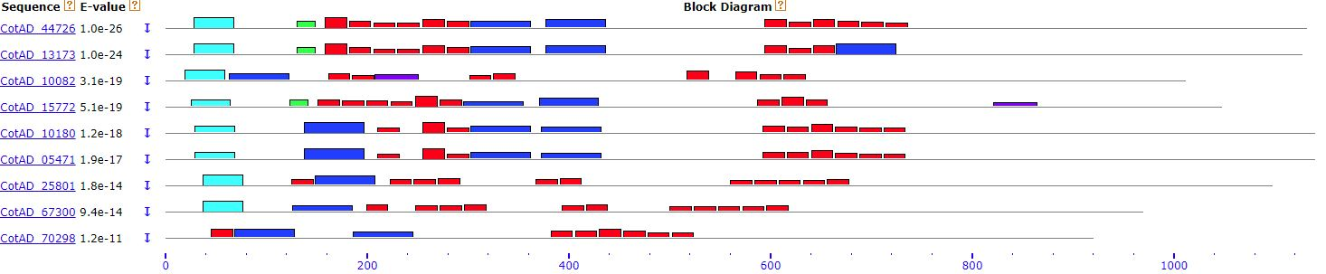
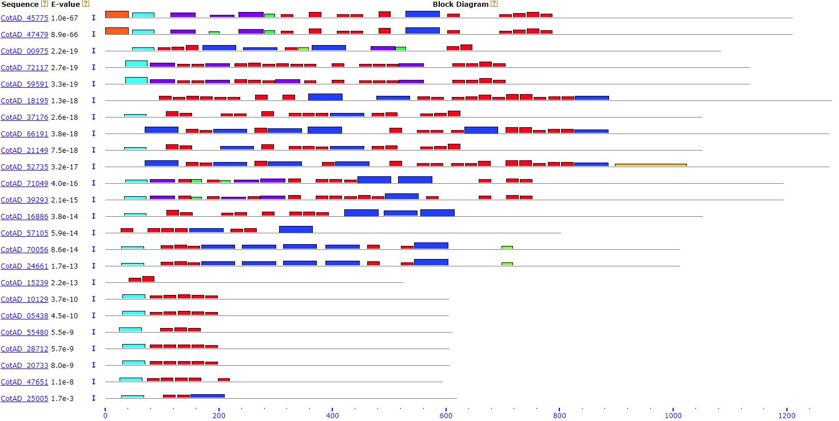
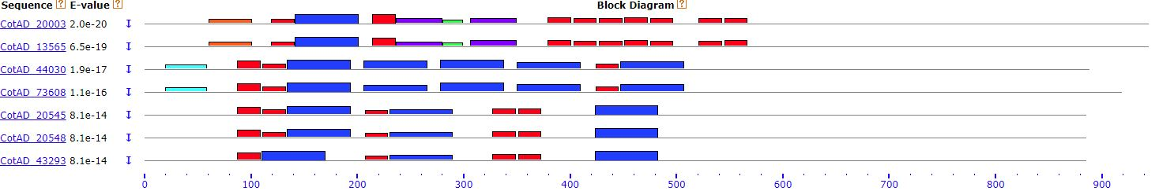
F
Subclade IX
Subclade X-1
Subclade X-2
Subclade X-3
Subclade X-4
LRR_1
LRRNT_2
LRR_3
LRR_4
LRR_5
LRR_6
LRR_8
LRR_9
Malectin
Notes:
Supplemental Figure 5(F)

Slide 19
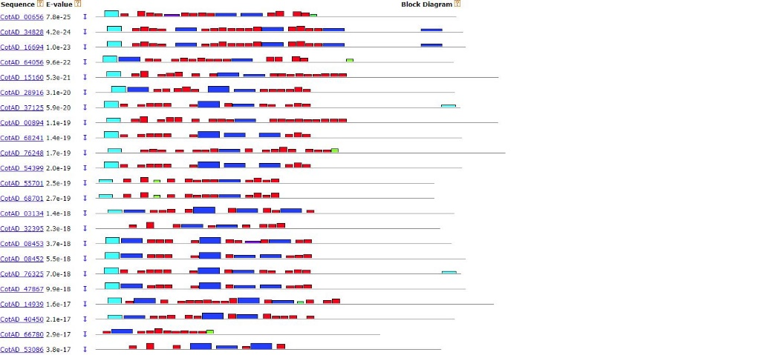
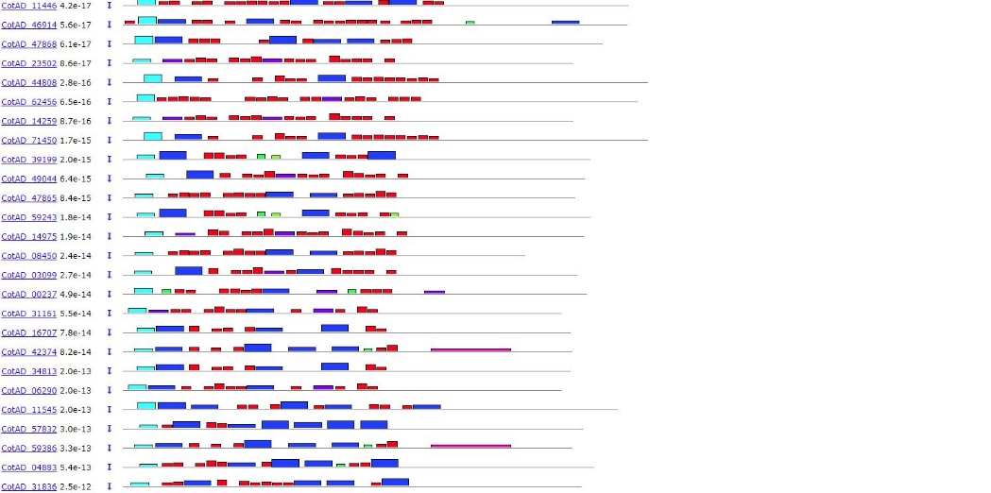
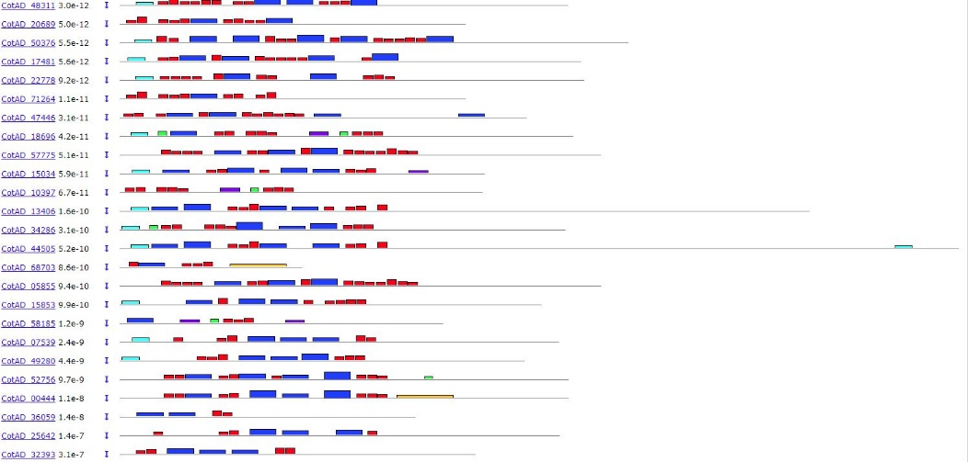
G
Subclade XI-1
LRR_1
LRRNT_2
LRR_3
LRR_4
LRR_5
LRR_6
LRR_8
LRR_9
Malectin
Notes:
Supplemental Figure 5(G)

Slide 20
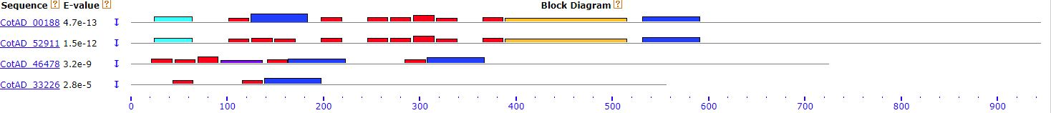
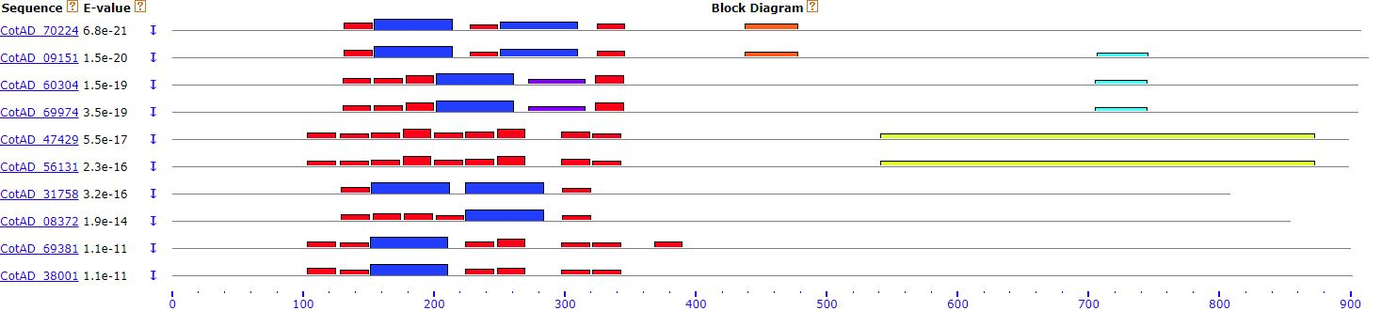
H
Subclade XI-2
Subclade XI-3
Subclade XI-4
LRR_1
LRRNT_2
LRR_3
LRR_4
LRR_5
LRR_6
LRR_8
LRR_9
Malectin
Notes:
Supplemental Figure 5(H)

Slide 21
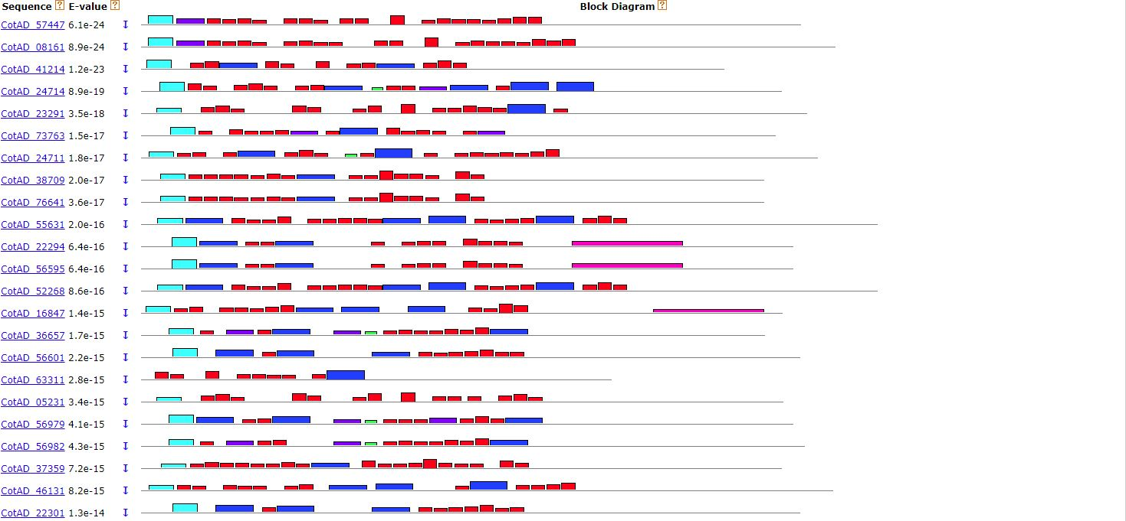
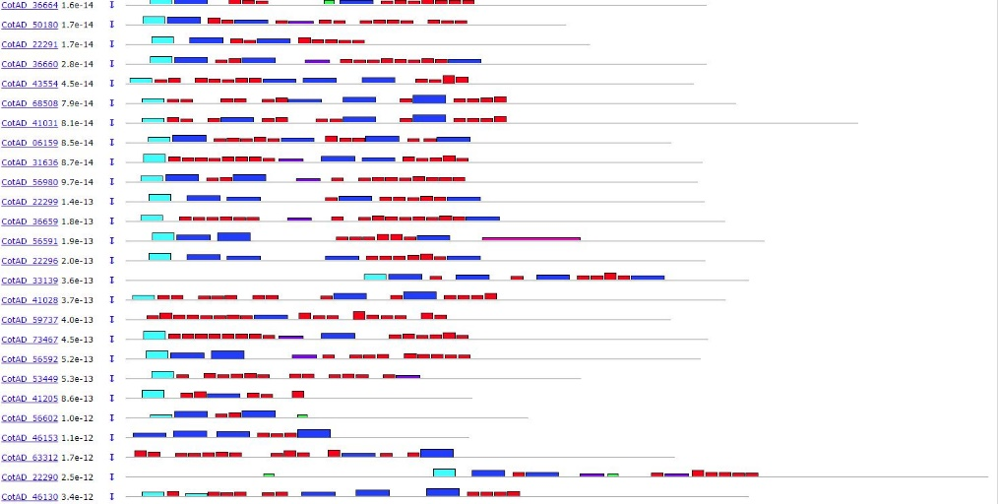
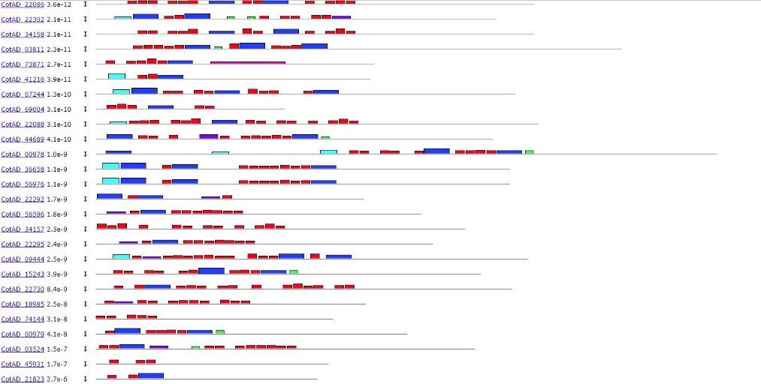
I
Subclade XII-1
LRR_1
LRRNT_2
LRR_3
LRR_4
LRR_5
LRR_6
LRR_8
LRR_9
Malectin
Notes:
Supplemental Figure 5(I)

Slide 22
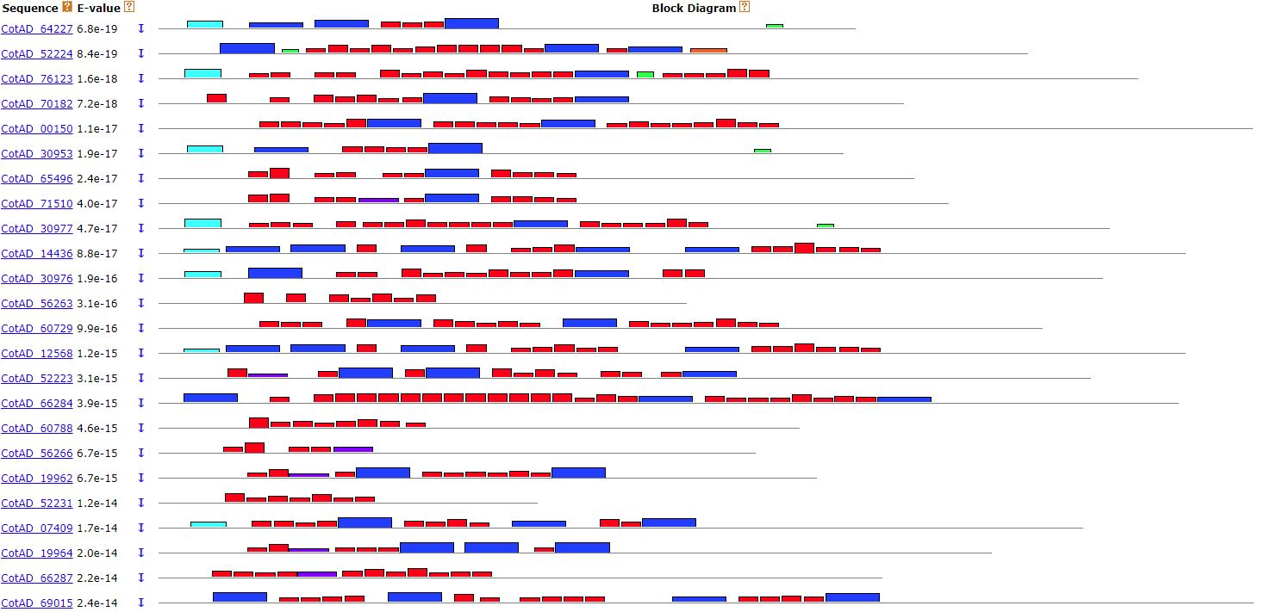
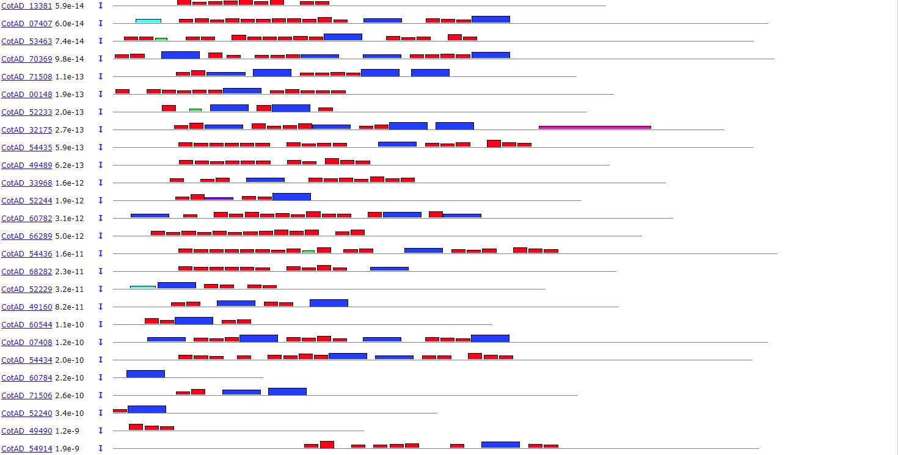
J
Subclade XII-2
LRR_1
LRRNT_2
LRR_3
LRR_4
LRR_5
LRR_6
LRR_8
LRR_9
Malectin
Notes:
Supplemental Figure 5(J)

Slide 23
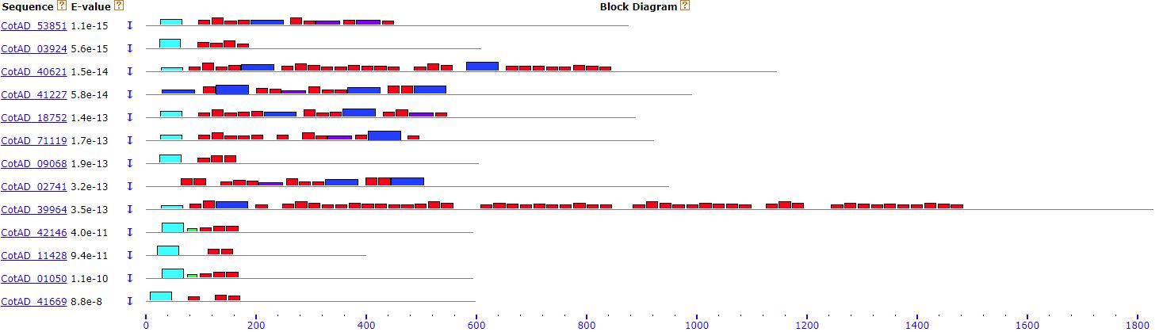
K
Subclade XIII
Outgroup
Notes:
Supplemental Figure 5(K)

Slide 24
Notes:
Supplemental Figure 6 Extracellular motif composition
Domain composition of G. hirsutum LRR-RLK subclades. Columns in the coordinate represent the percent of proteins having the indicated motif in the subclade.

Slide 25
Notes:
Supplemental Figure 6 (continued)

Slide 26
A
B
C
Notes:
Supplemental Figure 7 Blas2GO annotation statistics
GO mapping shows functional categorization of G. hirsutum LRR-RLKs. (A) Biological processes, (B) molecular functions, and (C) cellular components

Slide 27
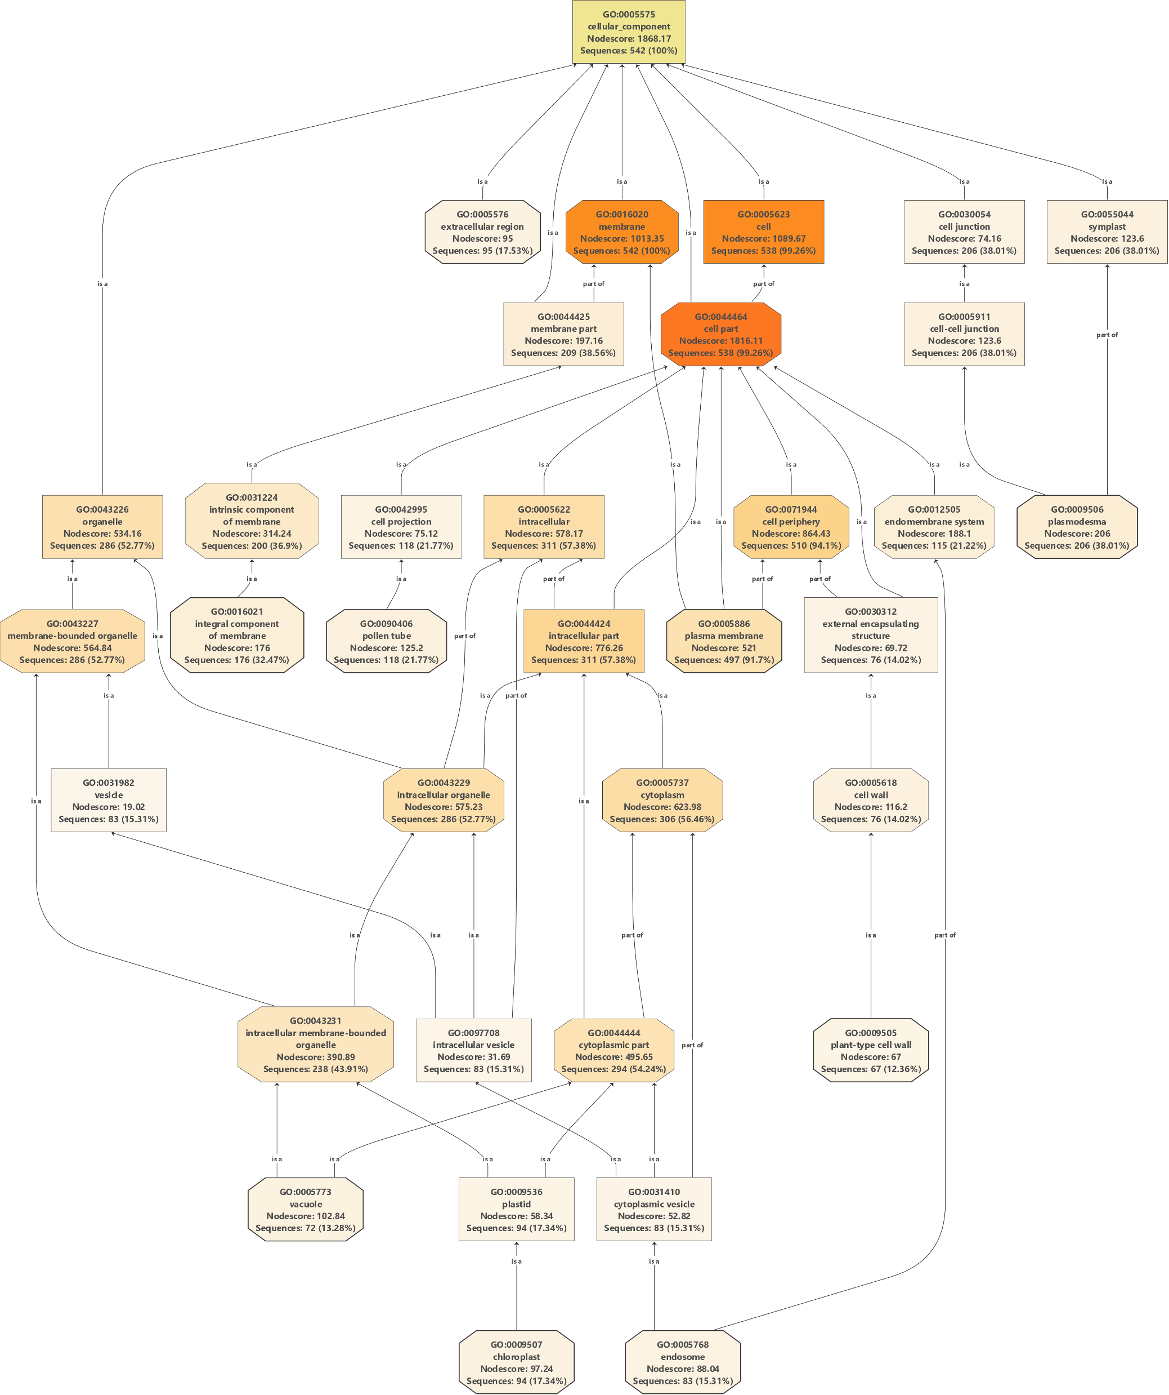
Notes:
Supplemental Figure 8 Blas2GO annotation statistics showing cellular component analysis of GhLRR-RLKs

Slide 28
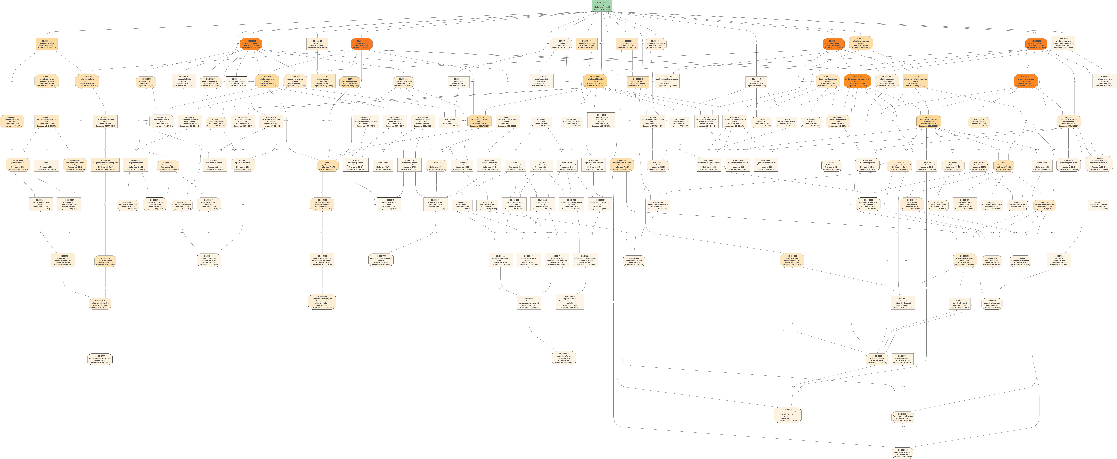
Notes:
Supplemental Figure 9 Blas2GO annotation statistics showing biological processes analysis of GhLRR-RLKs

Slide 29
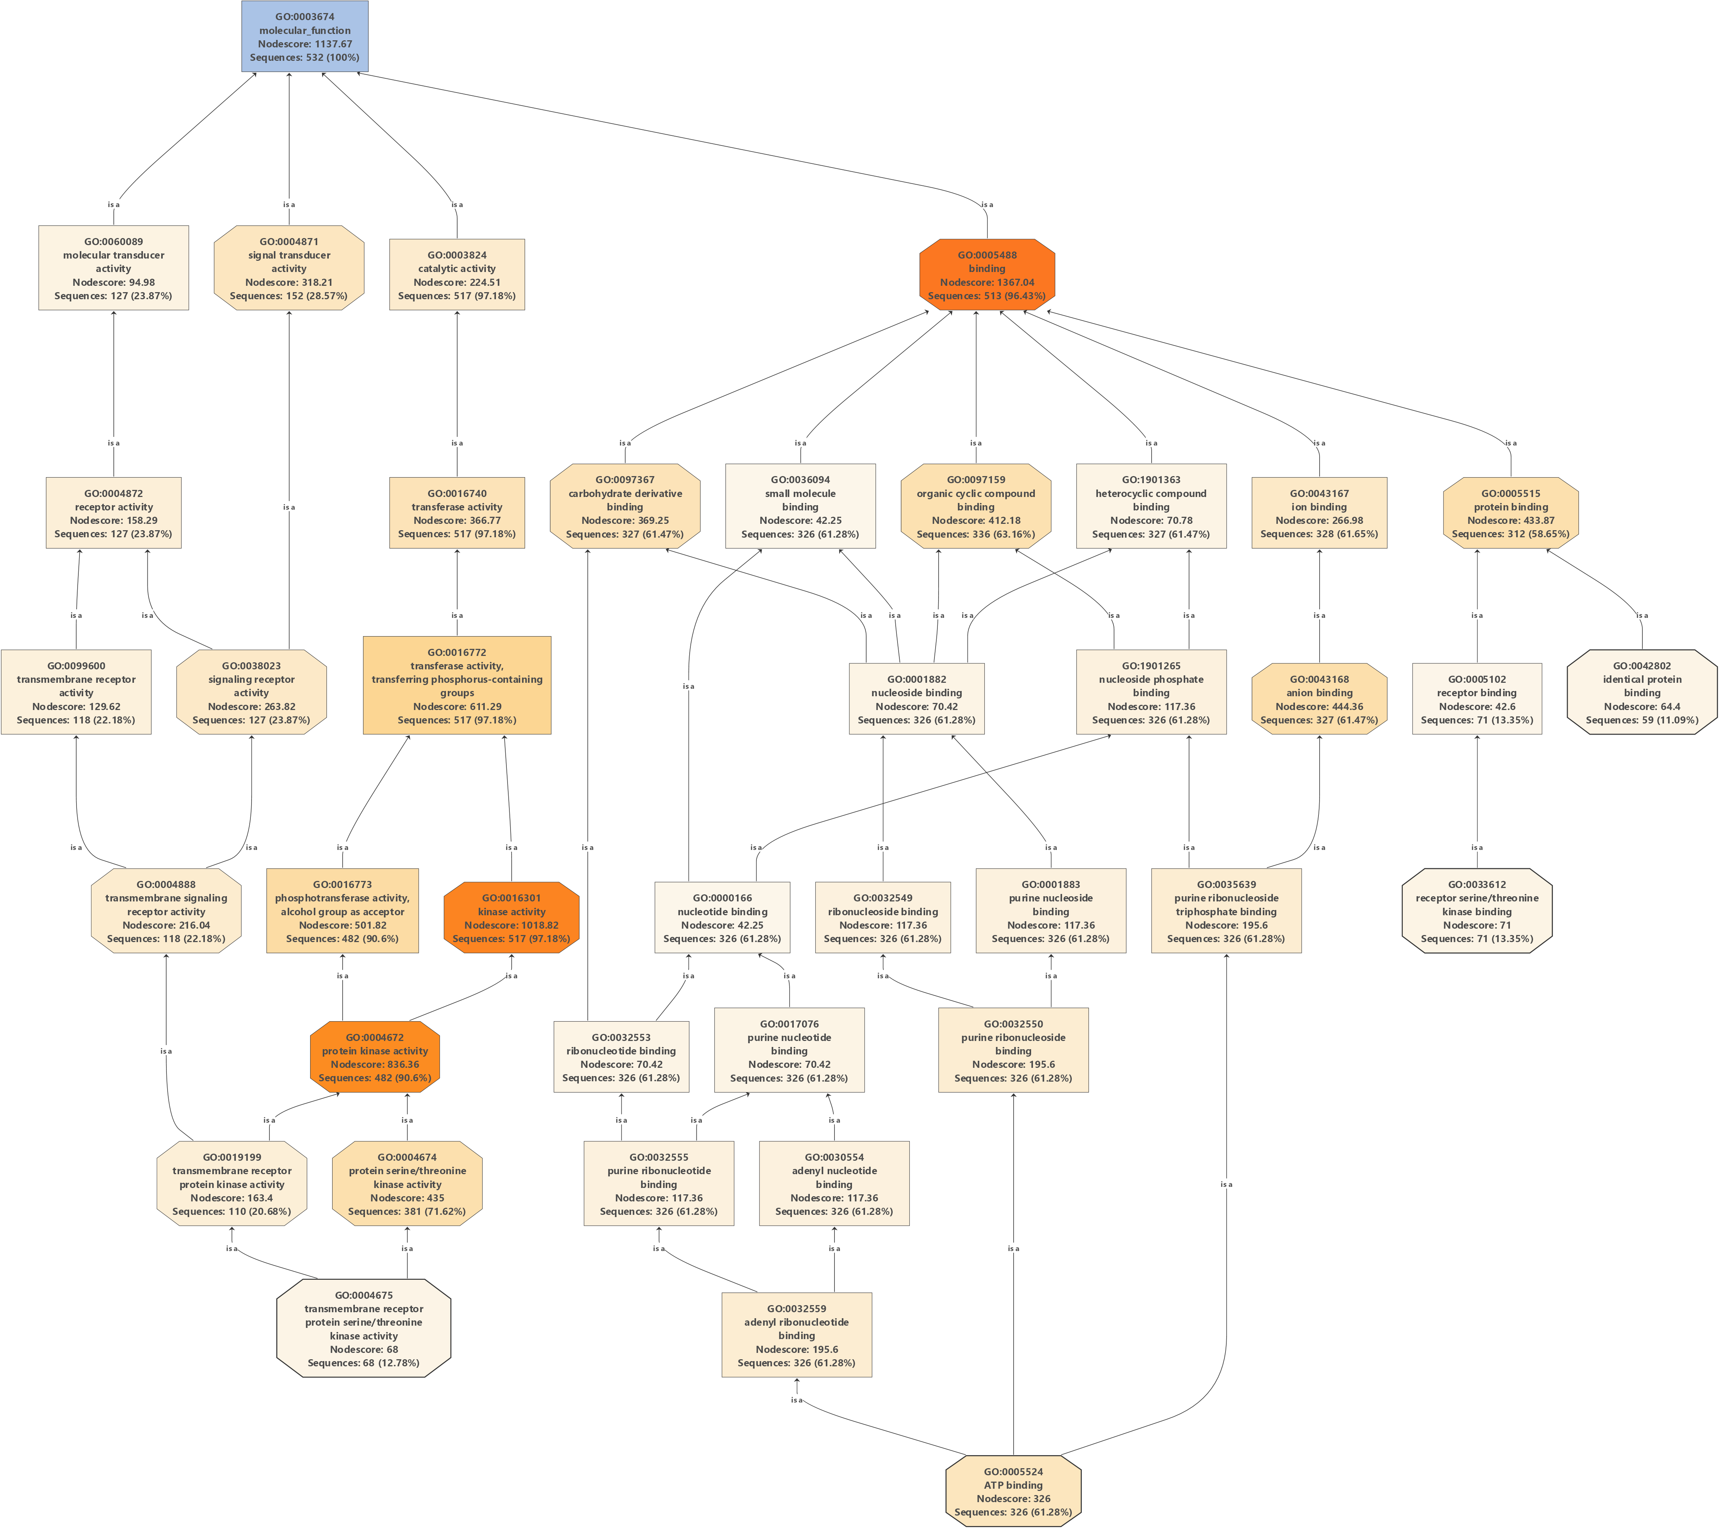
Notes:
Supplemental Figure 10 Blas2GO annotation statistics showing molecular function analysis of GhLRR-RLKs

Slide 30
Notes:
Supplemental Figure S11 Expression analysis of G. hirsutum LRR-RLKs
Hierarchical clustered heatmap for 543 G. hirsutum LRR-RLK genes in -3 dpa ovule, -1 dpa ovule, -0 dpa ovule, 1 dpa ovule, 3 dpa ovule, 5 dpa fiber, 10 dpa fiber, 20 dpa fiber, 25 dpa fiber, and leaves.

