Slide 1
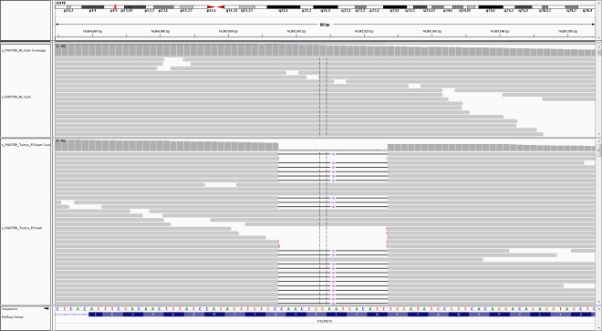
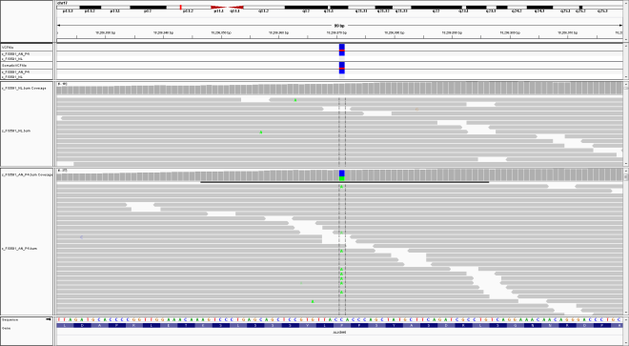
A
TNBC-11
C
2.0N
Normal
4.0N
4
NT/T
Tumor
B
DCLRE1C ^{c.656_671del16}
+
Log₂ratio
0
-
D
TNBC-12
F
2.0N
Normal
4.3N
3
NT
Tumor
E
ALKBH5^{P303Q}
+
Log₂ratio
0
-
Barrett et al., Supplemental Figure 8

