Slide 1
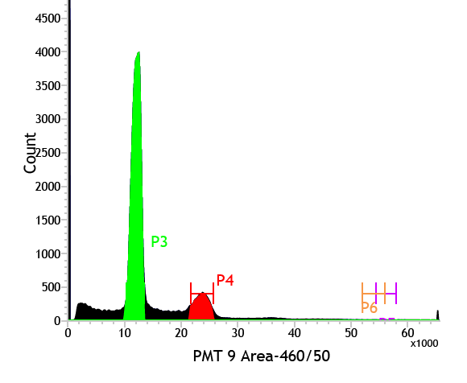
TNBC-29
A
C
2.0N
4.0N
B
Chromosome 9
+
Log₂ratio
0
-
Barrett et al., Supplemental Figure 5

